Slide 1
EUMETSAT capacity building efforts
Ewa Kwiatkowska on behalf of
Vincent Gabaglio
Christine Träger-Chatterjee
Sergio Muacho
Mark Higgins
IOCCG-21 committee meeting, 1 – 3 March, 2016

Slide 2
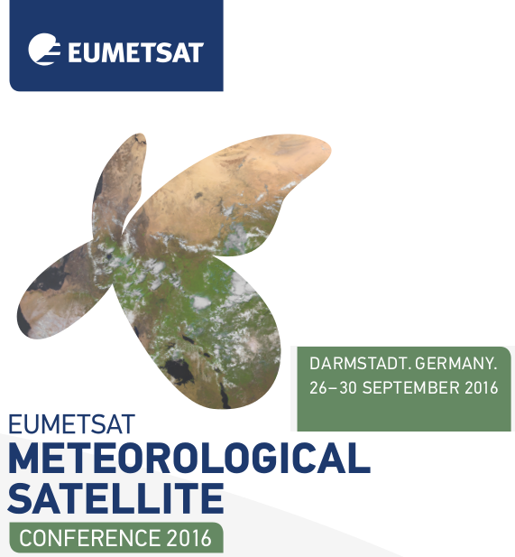
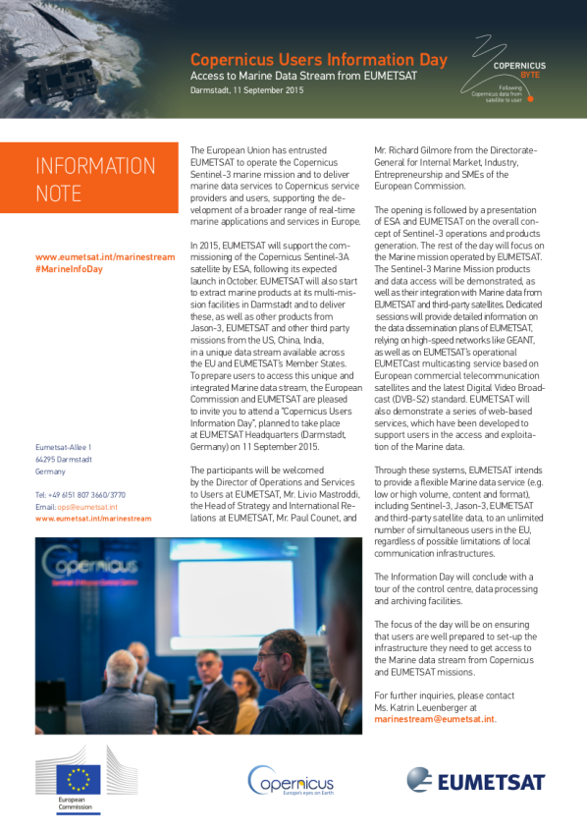

Summary of EUMETSAT capacity building
Operational space agency with a mandate in meteorological, climate and environmental data services
Objective to support user community through user data services, user fora, help desk
Annual EUMETSAT user conferences (every 4 years organized together with AMS conferences)
Training activities
Ocean Colour activities within the Copernicus / EC framework
  Copernicus Users Information Day, access to Marine Data Stream from EUMETSAT, Darmstadt, 11 Sep 2015
  Support to IOCS meetings

Slide 3
EUMETSAT capacity building: two selected topics
Support to Africa
Training activities

Slide 4
EUMETSAT strategic support to Africa
EUMETSAT Strategy in response to the WMO Strategic Plan
Long term commitment to cooperate with Africa
EUMETSAT Activities in Africa
Data Coverage
Free of charge data policy for African users (official and research)
Long term - 2035
Ensure access to the data
Data Dissemination
EUMETCast GEONETCast
Develop capacities to use the data
Training
Ensure link with users
Help Desk
User Forum
Promote further exploitation of the data
Cooperation with EU projects and African partners
PUMA, AMESD, MESA
environment, food security, disaster, climate

Slide 5
EUMETSAT User Forum in Africa
Objective:
Provide information on the latest development at EUMETSAT
Collect feedback from our African Users
Niamey, Niger (1995)
Harare, Zimbabwe (1996)
Rabat, Morocco (1998)
Kampala, Uganda (2000)
Dakar, Senegal (2002)
Brazzaville, Congo (2004)
Maputo, Mozambique (2006)
Accra, Ghana (2008)
Ouagadougou, Burkina Faso (2010)
Addis Ababa, Ethiopia (2012)
South Africa (2014): 8-12 September 2014: see ufa.eumetsat.int

Slide 6
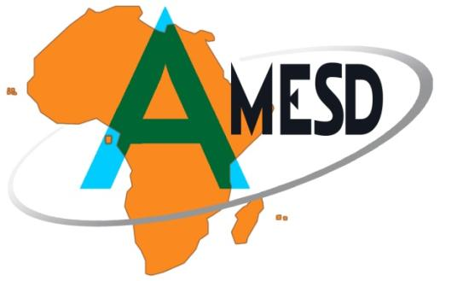

EU-Africa projects
PUMA – 2001-2006, 11M€ (8th EDF), implemented by KMD
    53 PUMA receiving station deployed
    350 African technicians trained
    6 Pilot Projects (Outlook activities) -> AMESD
  AMESD – 2007-2013, 21M€ (9th EDF), implemented by AUC
    All PUMA stations maintained and upgraded
    Training (1000 experts trained)
    Environmental services
MESA – 2013-2017, 37M€ (10th EDF), implemented by AUC
    All PUMA station maintained and upgraded
    Training
    Environmental and Climate services
  EUMETSAT provides in-kind contribution, free of charge, to the projects
EUMETSAT intends to extend the African support with Ocean Colour within the Copernicus / EC framework
Some early achievements are DevCoCast , EAMNet projects
Preparation for the Use of
Meteosat Second Generation in Africa
African Monitoring of the Environment
for Sustainable Development

Slide 7

DevCoCast – FP7 project
GEONETCast applications for and by Developing Countries
Involving Developing Countries in the GEONETCast initiative and sets up a strong user and provider base.
The DevCoCast project will disseminate existing environmental added-value data (both in-situ and satellite) from various sources in Africa, South- and Central America, Asia and also Europe via GEONETCast to a broad range of end-users in Developing Countries.
Duration: 3 years
Started: 1st May 2008
Partners:
5 from Africa
7 from South America
8 from Europe

Slide 8

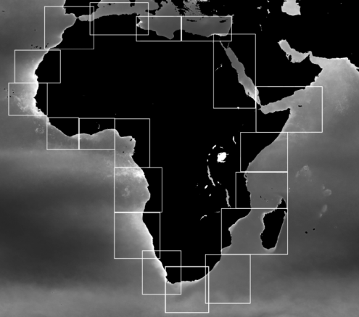
EAMNET
Europe-Africa Marine Network
Objective:
construct a network linking Earth Observation (EO) information providers, user networks and centres of excellence in Europe and Africa in the area of coastal and marine observations towards sustainable development in Africa
Partners:
  4 from Africa
  6 from Europe
Products:
  SST and ocean colour products
Duration:
  3 years, start end of 2009

Slide 9
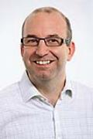
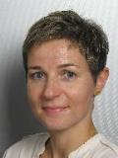
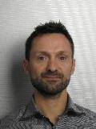
EUMETSAT training activities
Training team in support of Copernicus Marine Data activities
Mark Higgins – manager
Christine Träger-Chatterjee – training officer for marine, oceanographic and climate applications
Sergio Muacho – ocean training and user support expert

Slide 10
EUMETSAT existing training activities
Types of training: classroom, online asynchronous, online synchronous (real-time)
All training in collaboration with partnering organizations and programs
Training information web site http://www.eumetsat.int/website/home/Data/Training/index.html
Training web site http://training.eumetsat.int/
EUMeTrain http://eumetrain.org/ mainly real-time courses

Slide 11
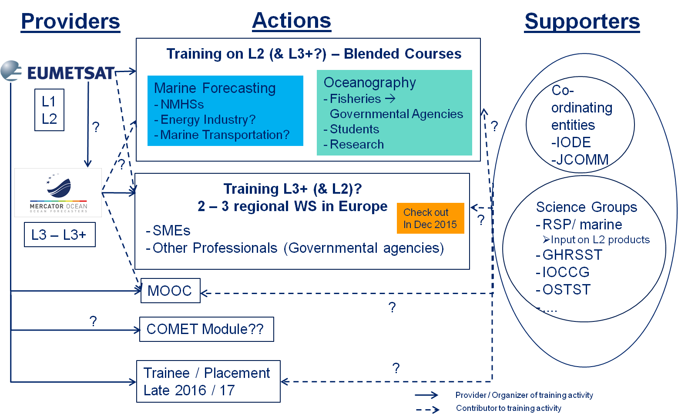
Major training activities – 2016 Copernicus Marine Stream
Development of user training concept for Copernicus Marine Data
Workshop “Expert Exchange on EUMETSAT’s Copernicus Marine Data Stream”
Massive Open Online Course (MOOC) on the Copernicus Marine Stream – 2016 main Copernicus communication/outreach activity
Trainee / Placement (e.g. U. Ghana)
Support to CMEMS training activities

Slide 12

Workshop on Expert Exchange
Workshop Title:
“Expert Exchange on EUMETSAT’s Copernicus Marine Data Stream”
Date:
29 November – 30 December 2016 ??
Venue: International Oceanographic Data and Information Exchange (IODE) Headquarters in Oostende, Belgium
"International Oceanographic Data and Information Exchange" (IODE) is a programme of the Intergovernmental Oceanographic Commission (IOC) of UNESCO

Slide 13
Overview on Workshop Concept - Objectives
  Promote the Copernicus Marine Data Stream (CMDS), focussing on the new services: · Ocean Colour
· SST
  · Altimeter Products
Provide first hand information on the CMDS, chance to talk to product experts
Identify / discuss potential applications
Identify potential users
Identify (different) training needs of the user groups
Identify product requirements for further development
Meet and exchange with other experts in the field, strengthen and widen personal networks

Slide 14
Overview on Workshop Concept - Target Participants
Expert Groups: IOCCG, GHRSST, OSTST
UNESCO’s IODE, especially members of their Ocean Teacher Project
Governmental Agencies in the field of Oceanography
Representatives of Research Institutes
Representatives of Mercator Océan (CMEMS)
SME’s providing services in relevant fields (aquaculture, …)
...

Slide 15
Overview on Workshop Concept - Setup
Online Phase:
  Provide information about the CMDS and its products prior to the workshop:
    The geophysical variables provided including timeliness / temporal resolution and spatial resolution.
    The basic principles of retrieval processes applied.
    The accuracy of the products (Validation results).
    How to access / receive the data.
    Data format.
    Examples of software tools available to handle the data format.
    Examples of applications.
Face-to-face phase will be split into two sub-phases:
  Introductory talks to briefly repeat the online phase.
  Splinter groups on the various CMDS products:
    Explore the CMDS data – hands-on practical exercises
    Q&A session with product experts (technical issues, retrieval, data handling …)
    Moderated group discussions on
      first experiences with / impressions of the data
      potential application areas & potential target audiences w.r.t. training
      training needs of these audiences

Slide 16
MOOC: Objectives
MOOC: Massive Open Online Course
Increase awareness of applications and importance of the impacts of Copernicus marine data
  Tell the taxpayer why Copernicus marine data and services are useful
  Joint Outreach / Communication and Training activity
  CMEMS involvement

Slide 17
MOOC Parameters
Online course
  Free and open
  Material can be reused
Online: October 2016 (once L2 Sentinel-3 data are available)
Full ITT issued – open until 4 March
Content to be developed by service provider
  Input from remote sensing experts and ocean scientists (incl. CMEMS) will be needed

