Slide 1
IOCCG Summer lecture series 2016
SLS 2016
18-31 July 2016
Villefranche sur mer, France
Update on preparation,
as of 1st of March, 2016

Slide 2
Villefranche Oceanography
Laboratory (LOV)

Slide 3
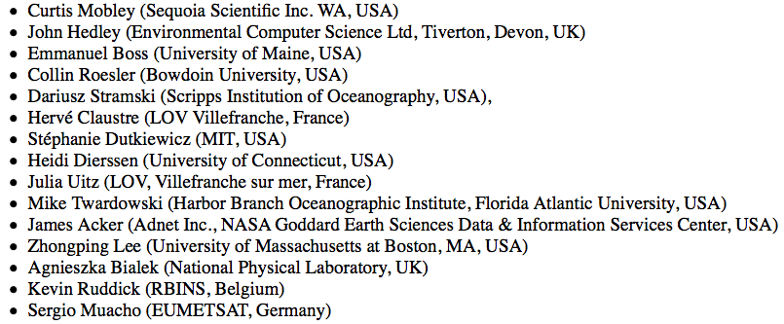
Lecturers
About 50 applications so far
(open until 30th March)

Slide 4
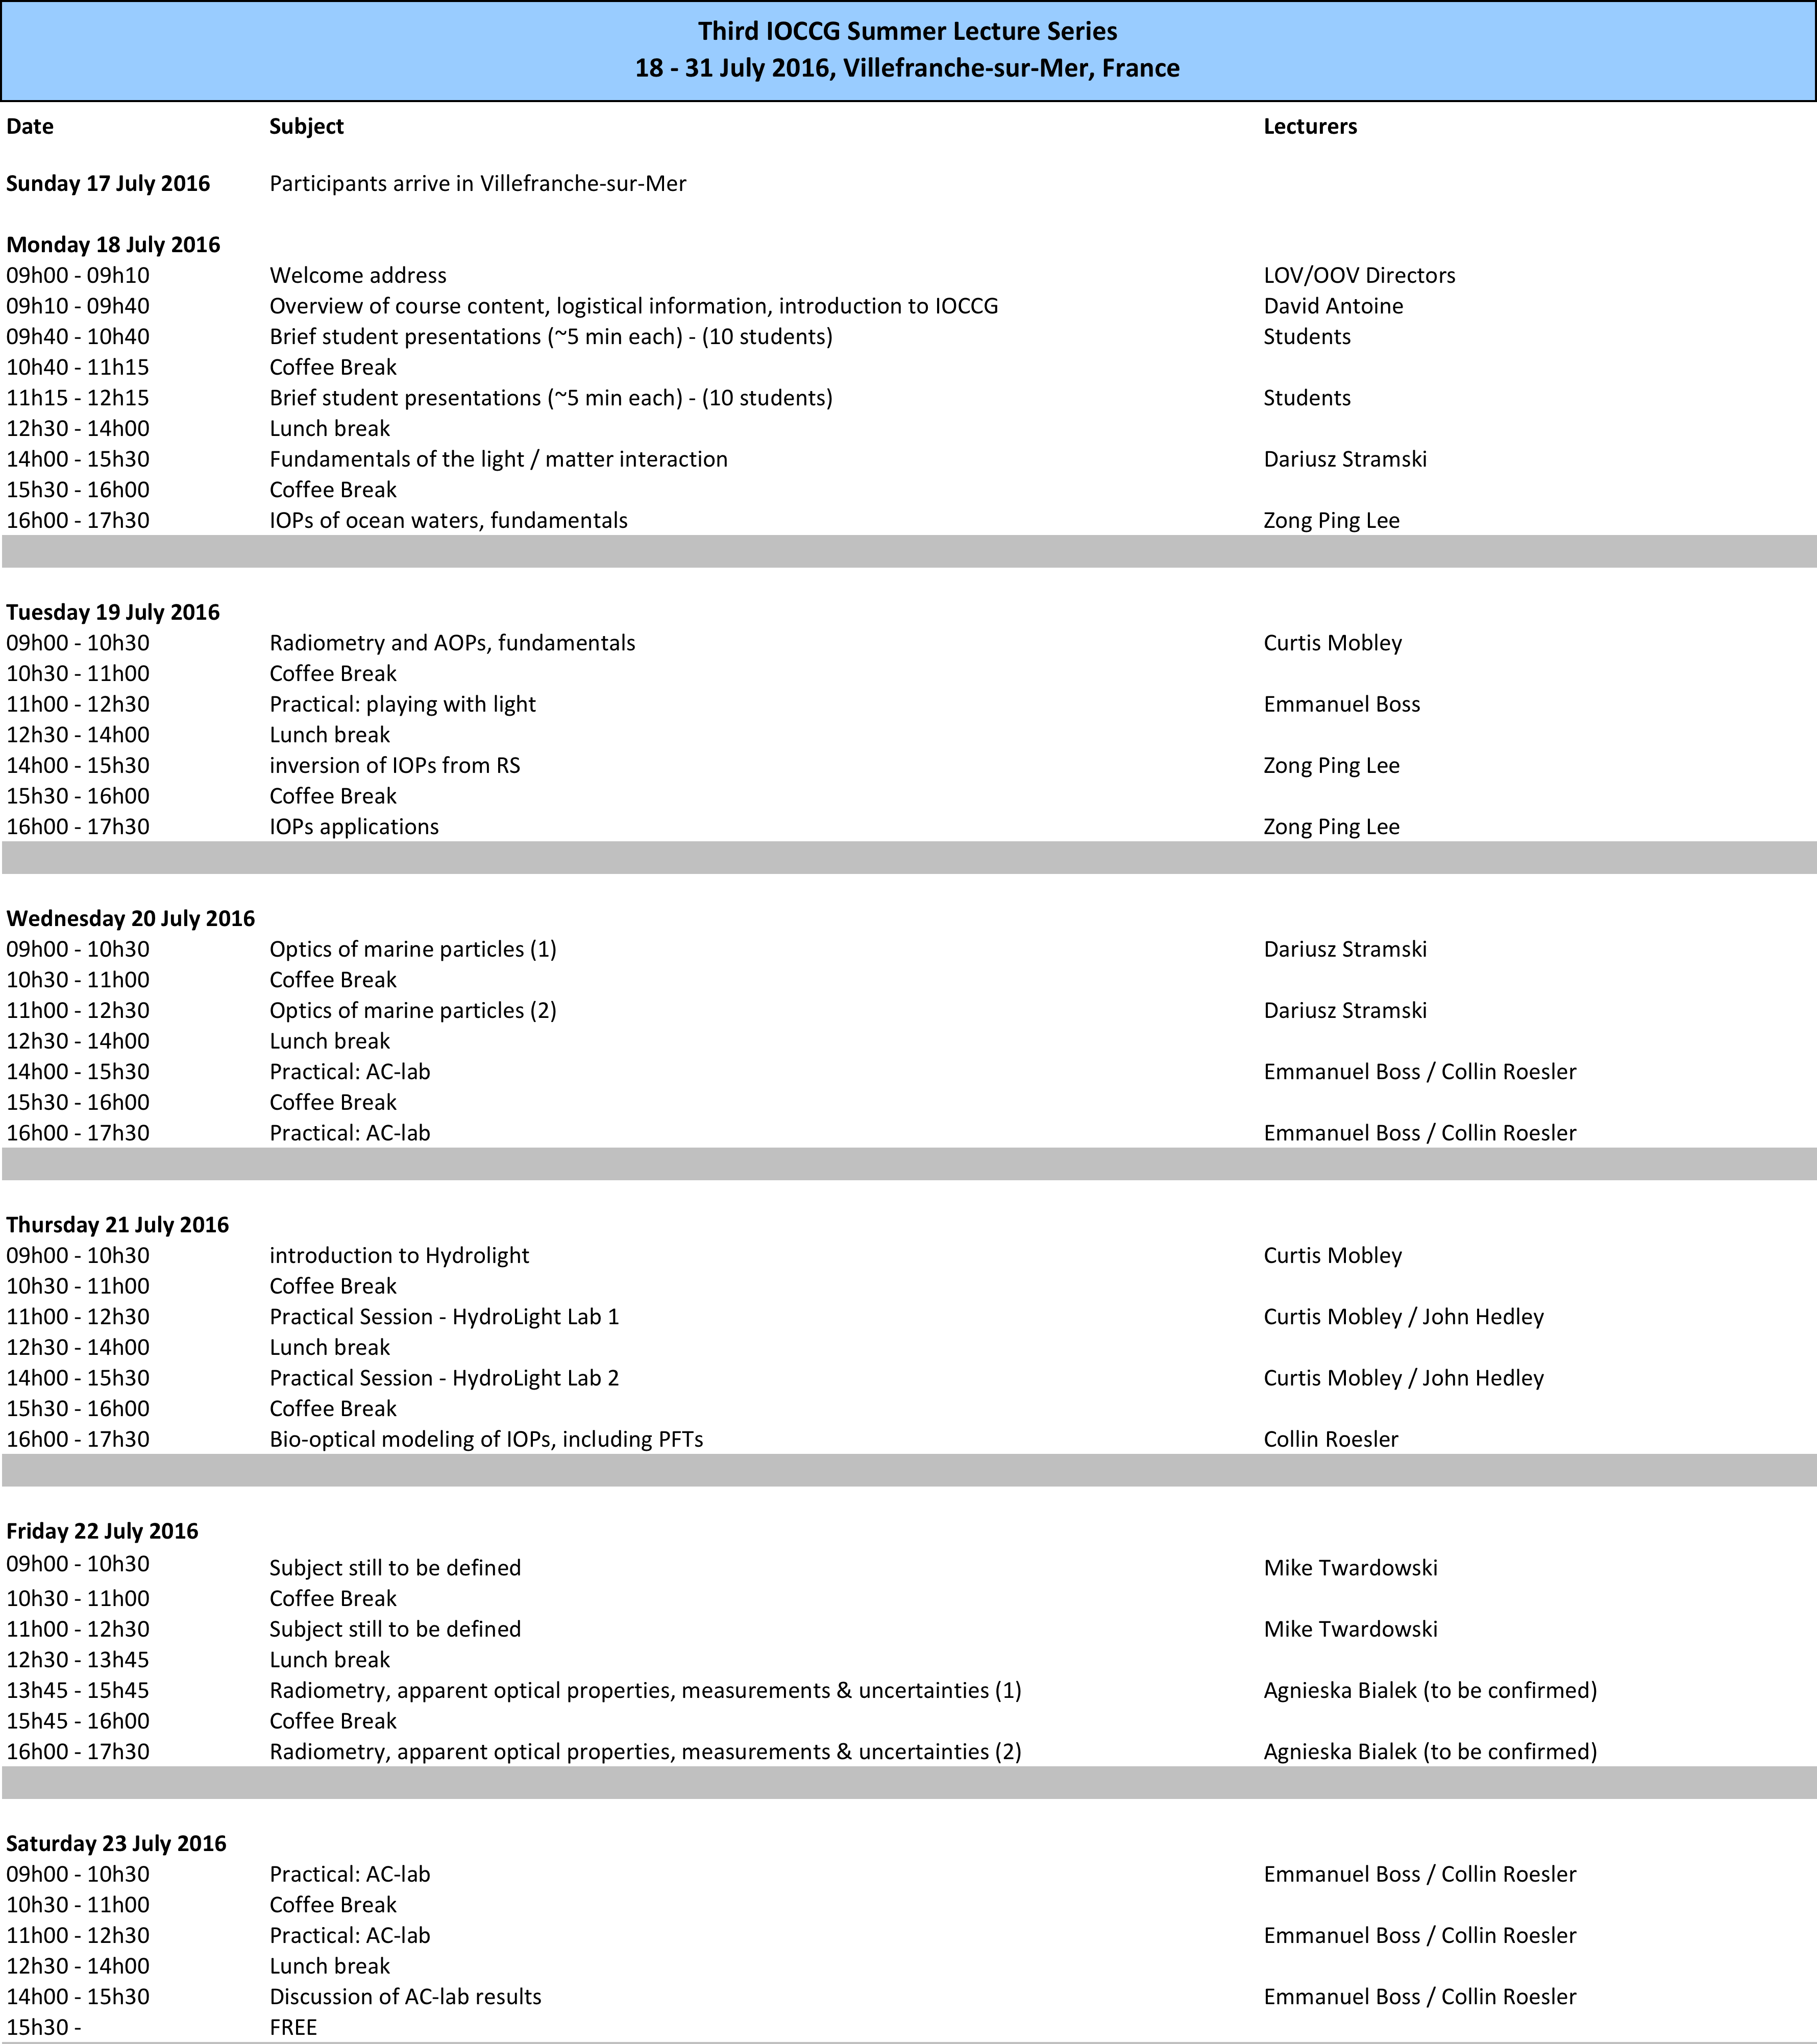

Slide 5
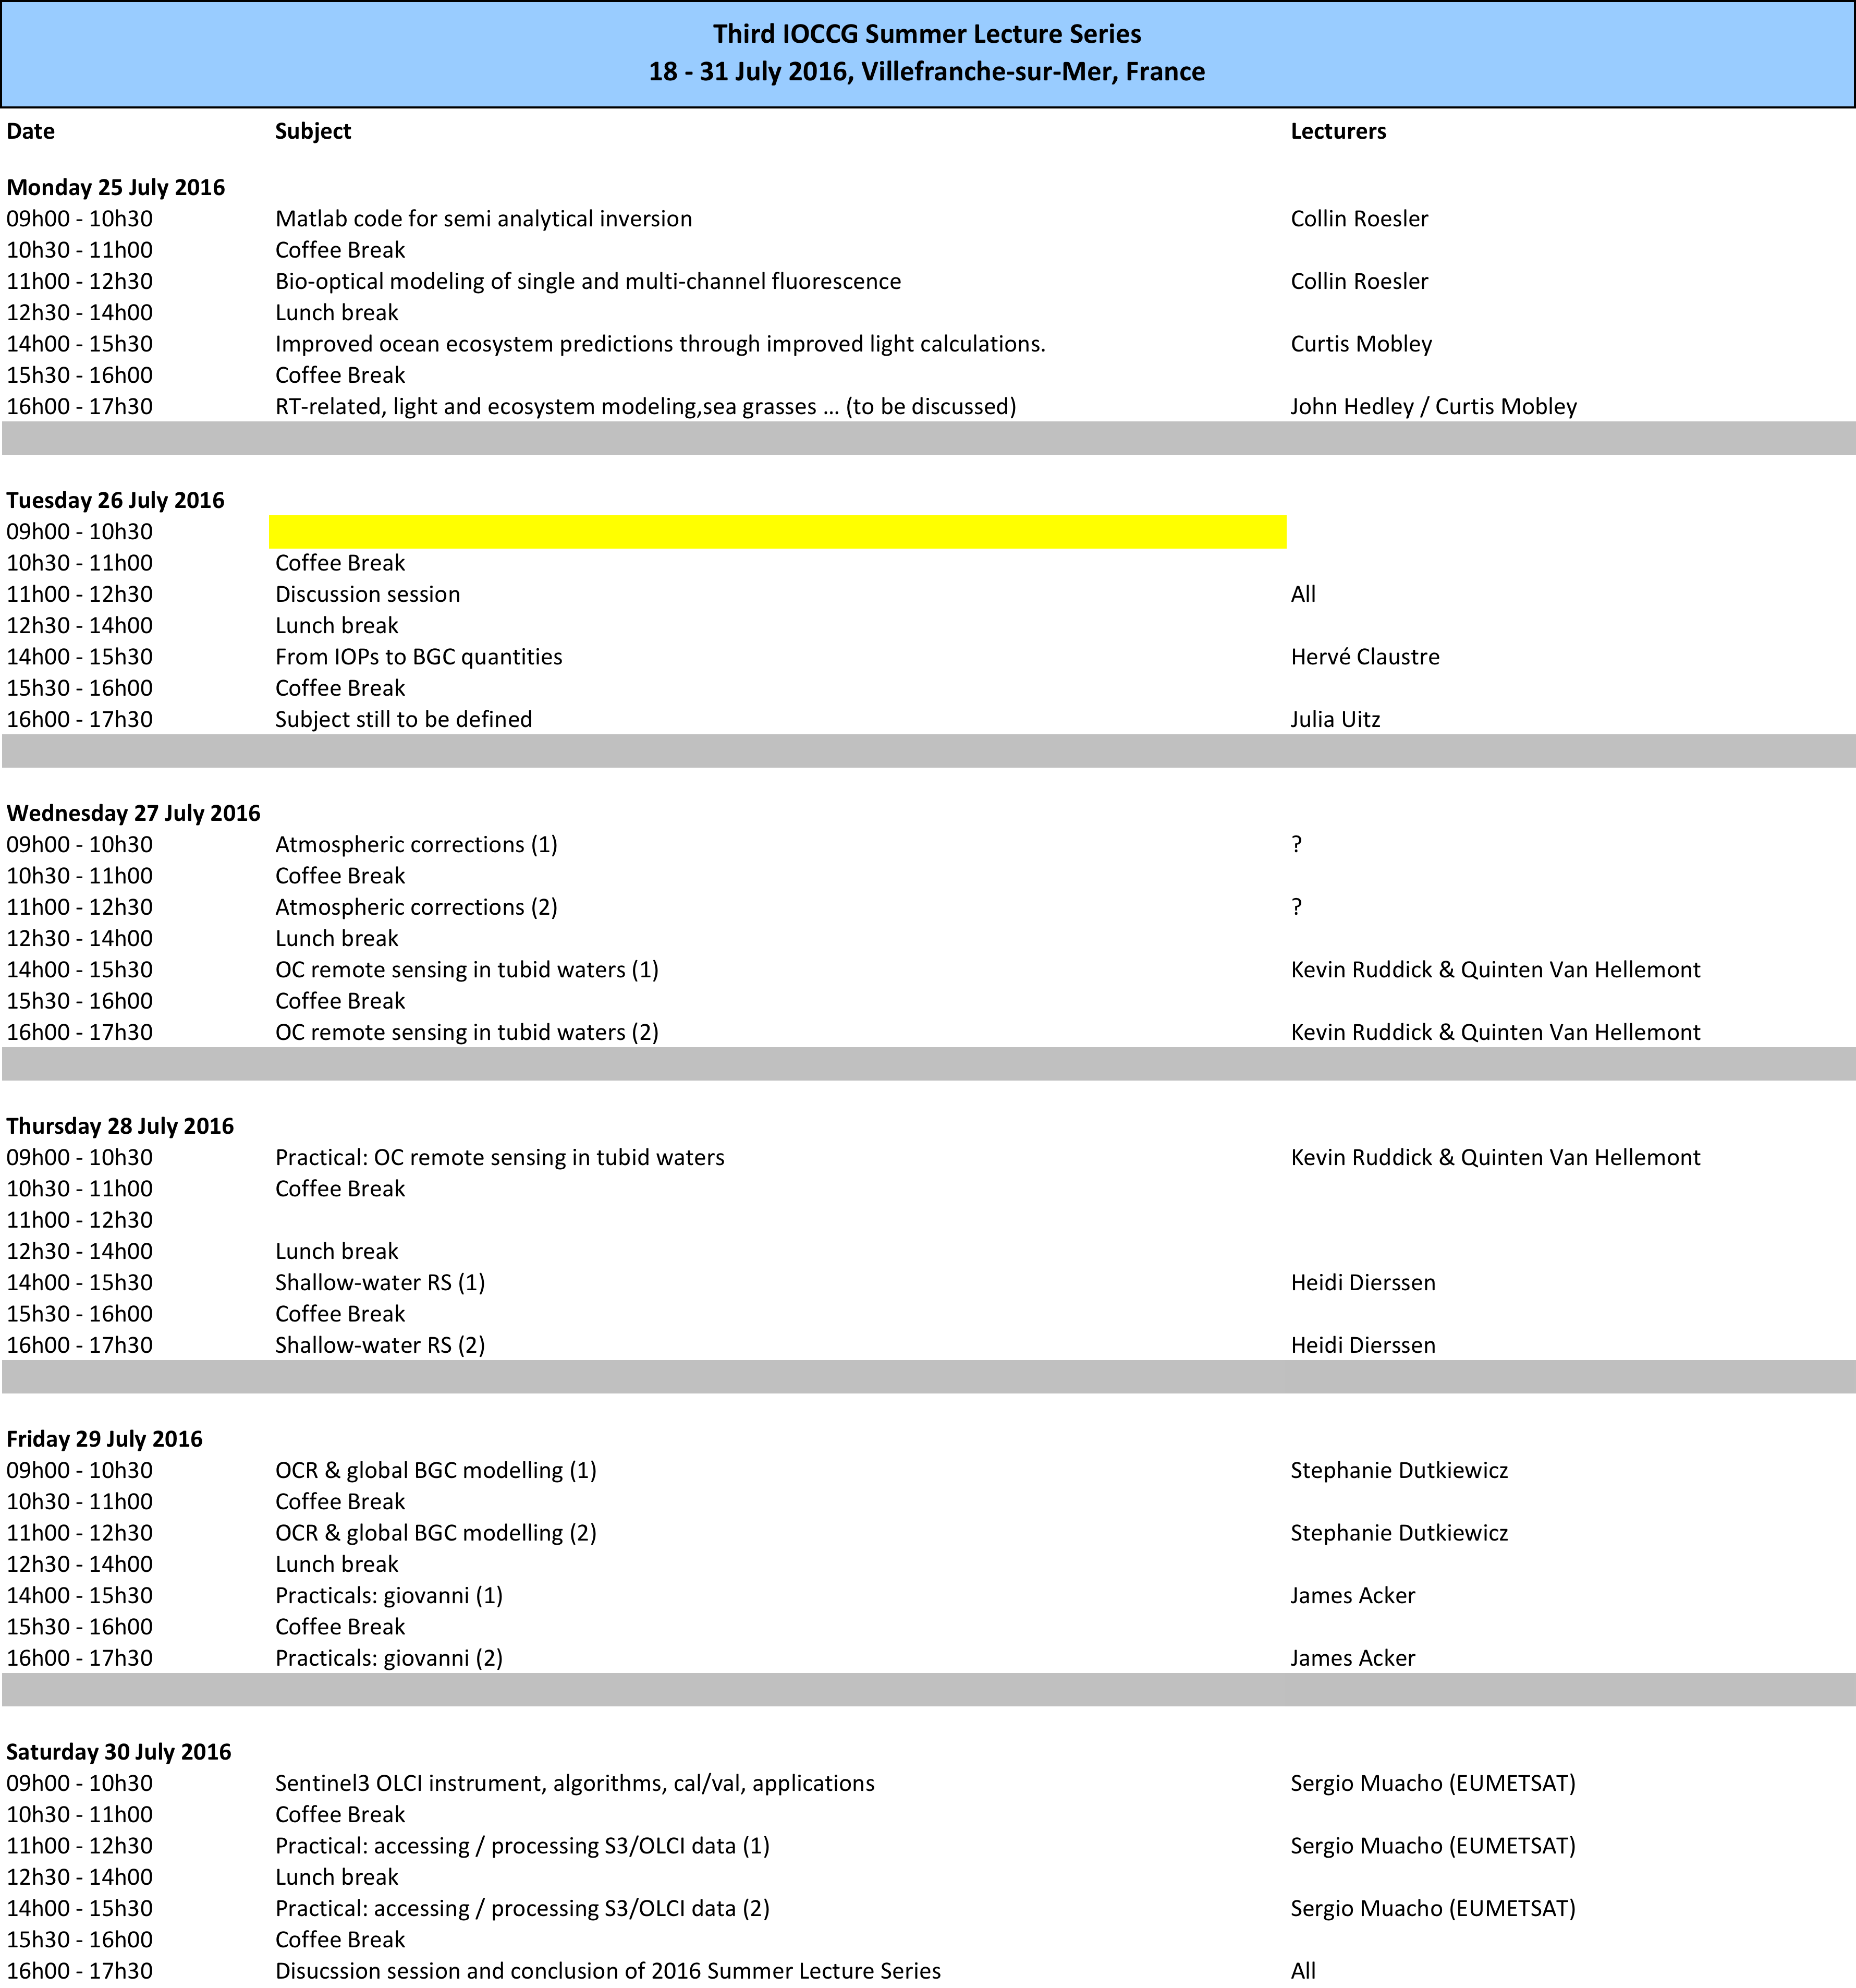

Slide 6
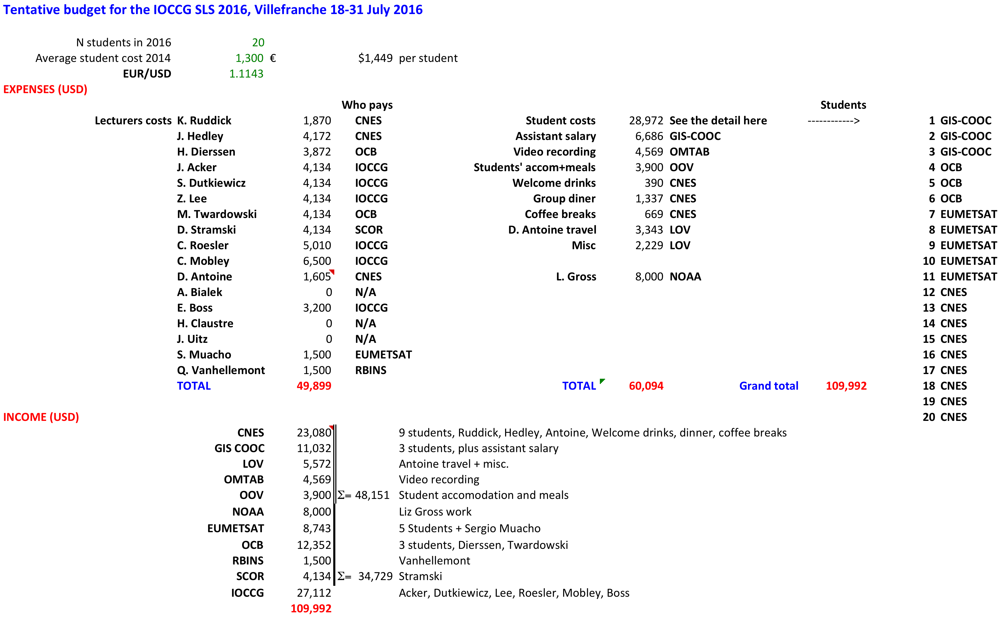
Budget

