Slide 1
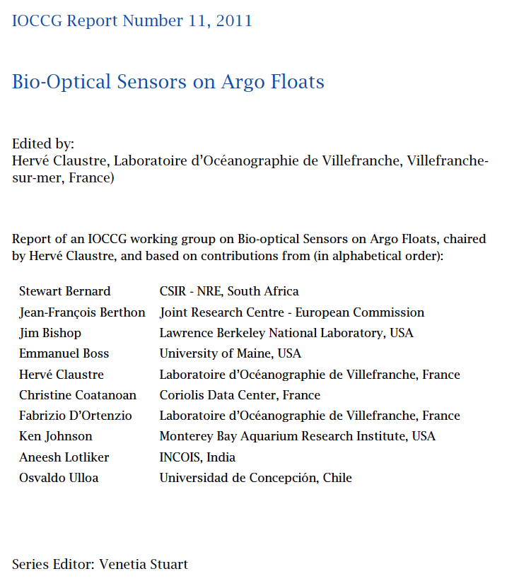

Slide 2
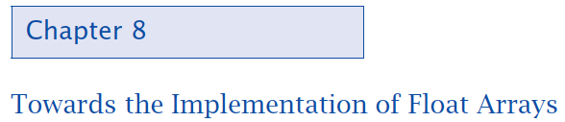



Slide 3
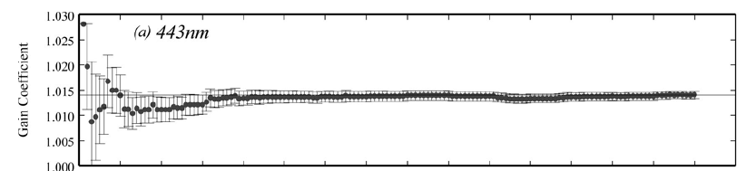
Using float-based sensors to calibrate remote sensors.
Examples: NOPP and ProVal efforts
We cannot calibrate a radiometer going to space sufficiently well on the Earth.
In order to obtain sufficiently accurate radiance measurements in space we need to calibrate the sensor system once in space with Earth-based measurements.
Currently done with MOBY and BOUSSOLE. It takes time to build a sufficiently long cross-calibration history for gains to settle down.
Franz et al., 2007
It takes O(40) high quality matchups to calibrate a sensor (0.1%).
For SeaWIFS – 2-3yrs.

Slide 4
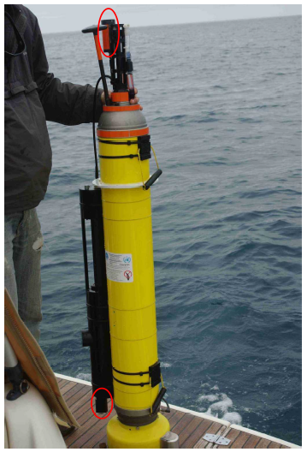
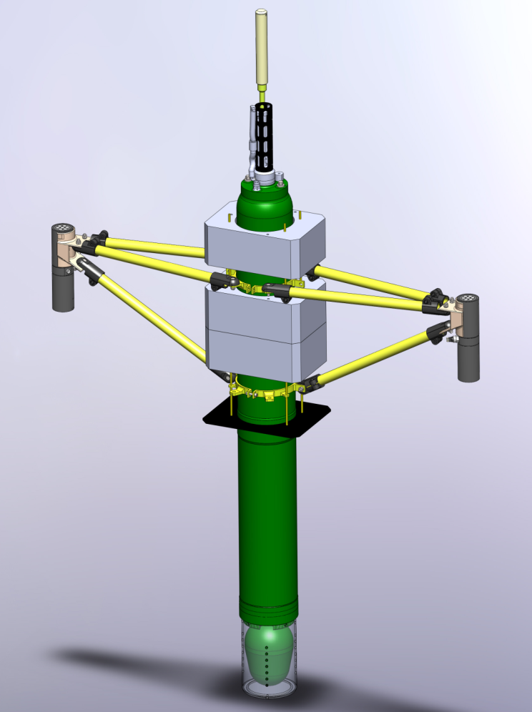
Using float-based sensors to calibrate remote sensors.
Examples: NOPP and ProVal efforts

Slide 5
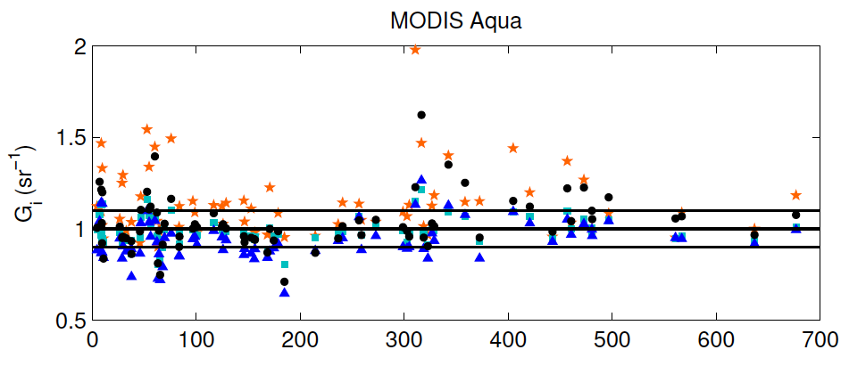
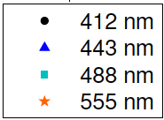
Using float-based sensors to calibrate remote sensors.
Examples: NOPP and PACE efforts
Floats provide the possibility to shorten this time if uncertainties of float based measurements are small enough and of known uncertainties.
Days since deployment
No drift observed in relation
Gerbi et al., in prep.

Slide 6
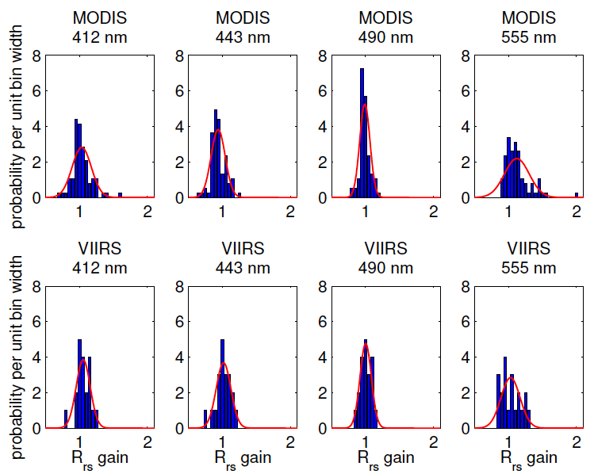
Using float-based sensors to calibrate remote sensors.
Examples: NOPP and PACE efforts
Floats provide the possibility to shorten this time if uncertainties of float based measurements are small enough and of known uncertainties.
Gerbi et al., in prep.

Slide 7
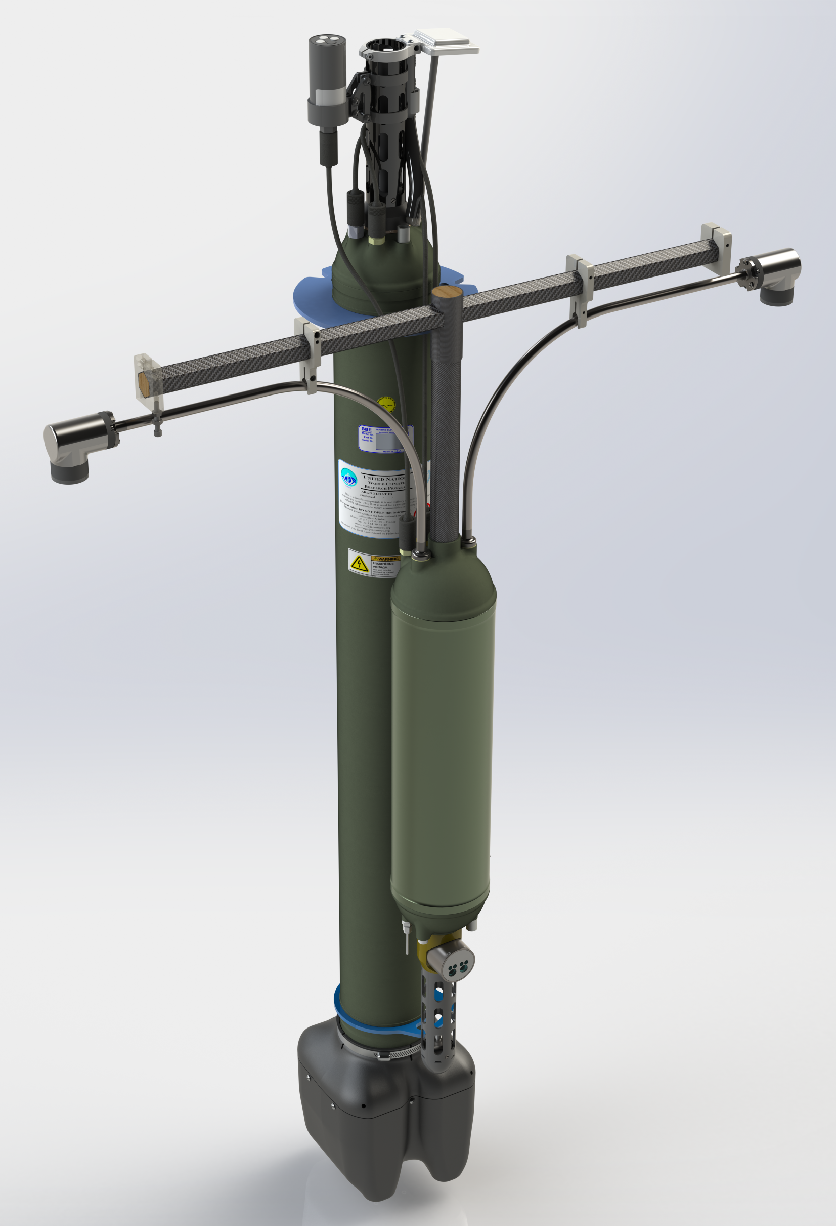
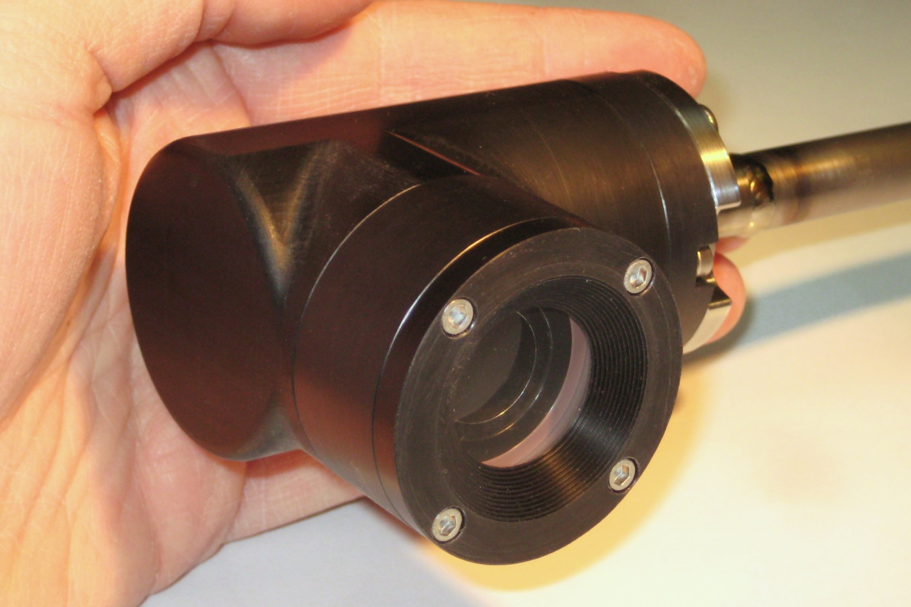
Latest and greatest
Antenna
Ed (OCI-504)
Temperature and salinity
Lu, tilt
Lu, tilt
Radiometer
electronics, tilt/compass
Navis
Pressure
MCOMS

Slide 8



The prospects and rationale for a global biogeochemical Argo system (BGC Argo)
Kenneth S. Johnson, Monterey Bay Aquarium Research Institute, johnson@mbari.org
Jorge L. Sarmiento, Princeton University
Hervé Claustre, Laboratoire d‘Océanographie de Villefranche

Slide 9
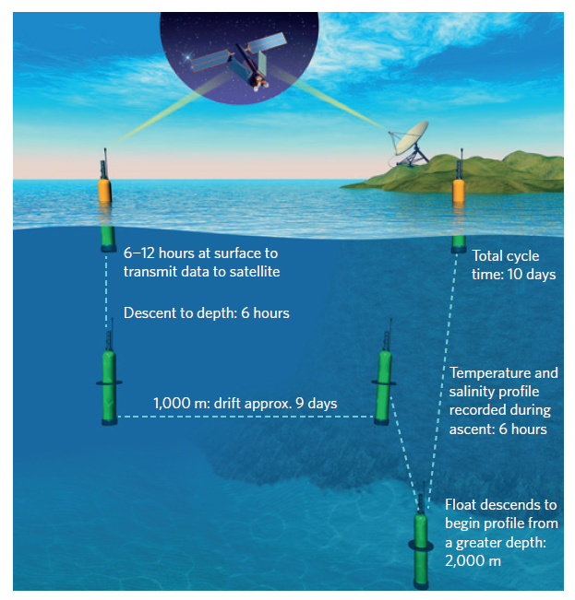

Slide 10
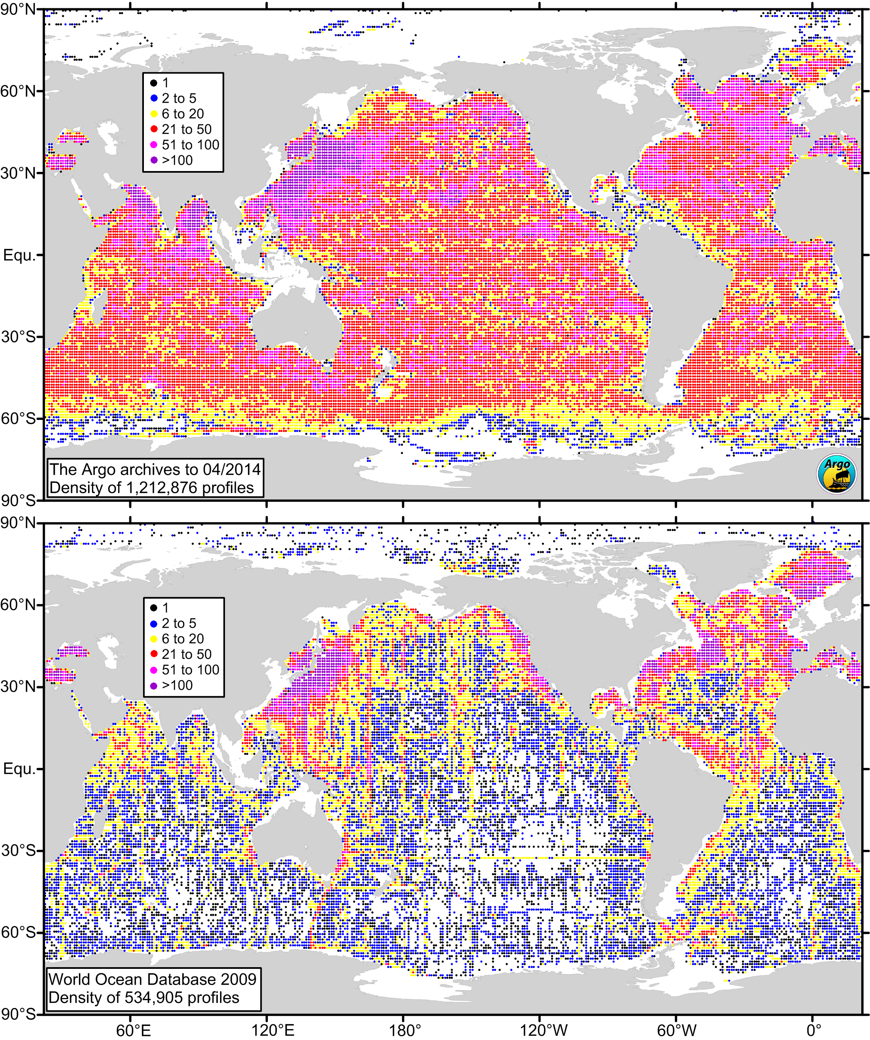
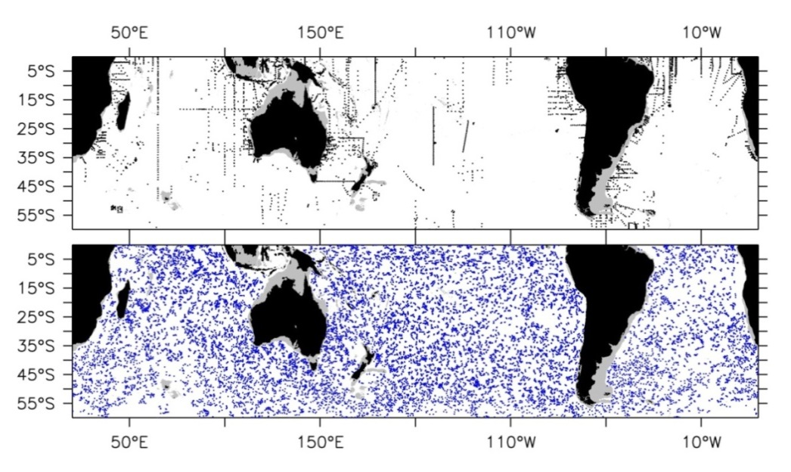
Argo transformed global-scale oceanography into global oceanography.
Argo: 1,000,000 T/S profiles milestone achieved in 2012.
Argo Floats Do Not Mind Bad Weather
All August T/S profiles (> 1000 m, 1951 - 2000).
Argo
5 years of August Argo T/S profiles (2008-2012).
The World Ocean Circulation Experiment was a global survey of 8,000 T/S profiles in 7 years (1991-1997).
Argo is a global survey of 12,000 T/S profiles every month.
20th Century: 500,000 T/S profiles > 1000 m
Courtesy S. Piotrowicz

Slide 11
We can now do the same for biogeochemistry/ocean carbon cycling!
Why observe carbon/oxygen/nitrate/biooptics?
Current status of system/sensors.
Basin-scale experiments and results.
  SOCCOM – Southern Ocean Carbon and Climate Observations and Modeling
Linkage to satellite observations.
The path forward BGC Argo, a global biogeochemical Argo system.

Slide 12
A paradigm shift in ocean observing:
Autonomous biogeochemical sensors on profiling floats enable a widely distributed observing system.
Field developing rapidly:
  Körtzinger, et al. (2005) – O₂
  Tengberg et al. (2006) – O₂
  Bittig et al. (2015) – O₂
  Johnson et al. (2015) – O₂
  Johnson et al. (2010) – Optical nitrate
  Johnson et al. (2013) – Optical nitrate
  Martz et al. (2010) – DuraFET pH
  Johnson et al. (2016) – Deep-Sea DuraFET pH
  E. Boss et al. (2008 ) – Biooptics (chlorophyll & particles)
  Whitmire et al. (2009 ) – Biooptics
  Boss and Behrenfeld (2010) – Biooptics
Notes:
Tengberg, A., J. Hovdenes, H.J. Andersson, O. Brocandel, R. Diaz, D. Hebert, T. Arnerich, C. Huber, A. Körtzinger, A. Khripounoff, and others. 2006. Evaluation of a lifetime-based optode to measure oxygen in aquatic systems. Limnology and Oceanography: Methods 4:7–17
Körtzinger, A., J. Schimanski, and U. Send. 2005. High quality oxygen measurements from profiling floats: A promising new technique. Journal of Atmospheric and Oceanic Technology 22:302–30
Riser, S.C., and K.S. Johnson. 2008. Net production of oxygen in the subtropical ocean. Nature 451:323–326
Johnson K.S., Riser, S. C., Karl, D. M. 2010 Nitrate supply from deep to near-surface waters of the North Pacific subtropical gyre, Nature, doi:10.1038/nature/09170
Johnson, K.S., and L.J. Coletti. 2002. In situ ultraviolet spectrophotometry for high resolution and long term monitoring of nitrate, bromide and bisulfide in the ocean. Deep-Sea Research Part I 49:1,291–1,305
Boss, E., D. Swift, L. Taylor, P. Brickley, R. Zaneveld, S. Riser, M.J. Perry, and P.G. Strutton. 2008. Observations of pigment and particle distributions in the western North Atlantic from an autonomous float and ocean color satellite. Limnology and Oceanography 53:2,112–2,122
L. Whitmire, Letelier R. M., Villagrán, and Ulloa, O., 2009. Autonomous observations of in vivo fluorescence and particle backscattering in an oceanic oxygen minimum zone. Optics Express
E. Boss, and M. Behrenfeld. 2010. In situ evaluation of the initiation of the North Atlantic phytoplankton bloom. Gephysical Research Letters, v. 37, DOI 10.1029/2010GL044174
T. R. Martz, Connery, J.G., Johnson, K. S. 2010. Testing the Honeywell Durafet for seawater pH applications. Limnology and Oceanography: Methods. DOI 10.4319/lom.2010.8.172

Slide 13
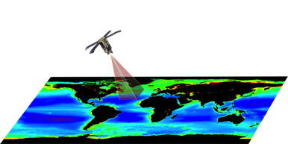
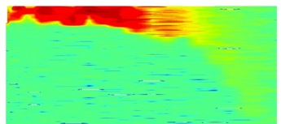
Synergetic Ocean Color remote sensing-profiling float approach
Floats and ocean color share key biogeochemical variables (matchups & validation):
  Chla
  b_{bp} (POC)
  Kd
  CDOM
Satellite: Global scale
(y)
(x)
Benefits of a coupled approach:
  OC satellites “see” only the 1/5 of the euphotic layer => Profiling floats bring vertical dimension
  Profiling floats bring observations under cloud cover or no light conditions
  Remote sensing provides extrapolation to the global ocean
(z)
Bio-Argo profiling float: Vertical dimension
→ 3D/4D OCEAN BIOGEOCHEMISTRY

Slide 14
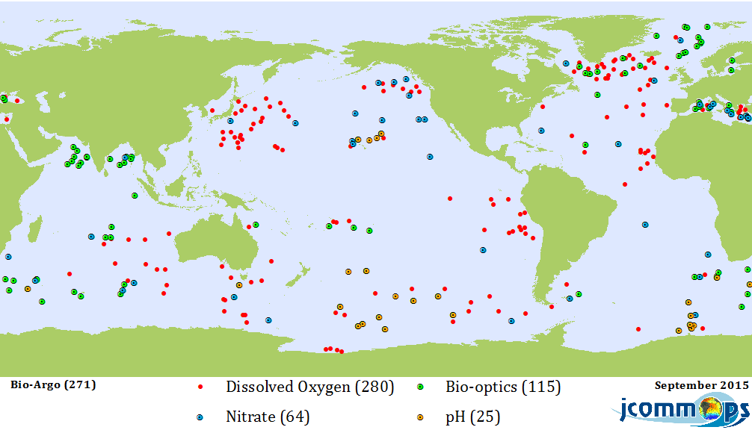
Biogeochemical (BGC) Argo has grown to a global reach, but so far has no formal structure.

Slide 15
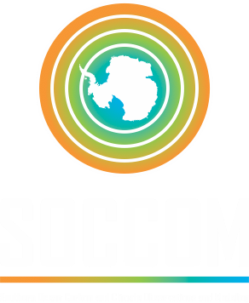

Notes:
Decline of STC in July 2013 due to Sequestration

Slide 16
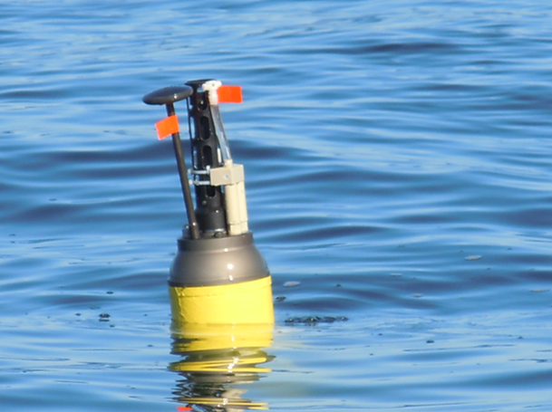
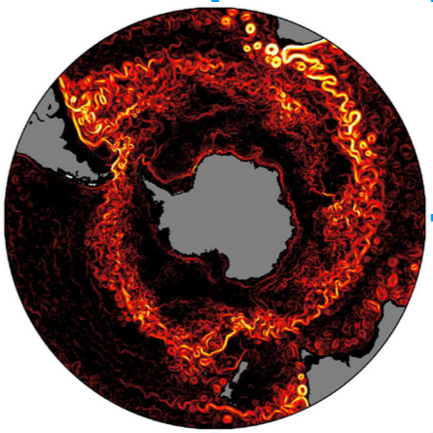

200 profiling floats over 6 years with pH, NO₃⁻, O₂, biooptics with calibration tied to GO-SHIP observations
Southern Ocean State Estimate model to get 4D fluxes
Improved coupled climate model (GFDL) predictions of Southern Ocean role in carbon and climate

Slide 17
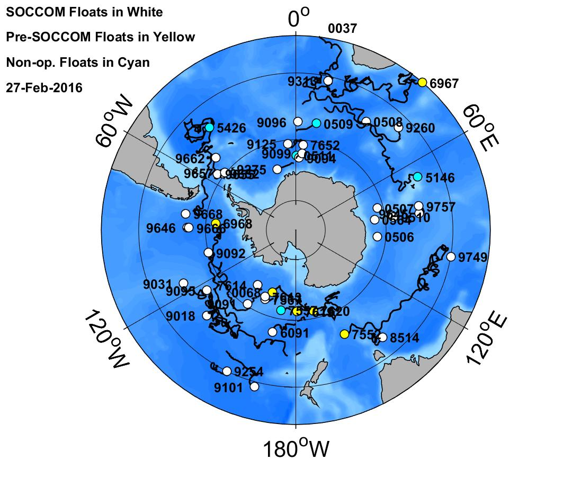
37 BGC floats deployed from March 2014 to date
16 more deployments in 2016 (I8S, P15S)
~37 in construction for 2016/17 season
Funded for ~100 more 2017/2020.
All data public in real time at soccom.princeton.edu

Slide 18
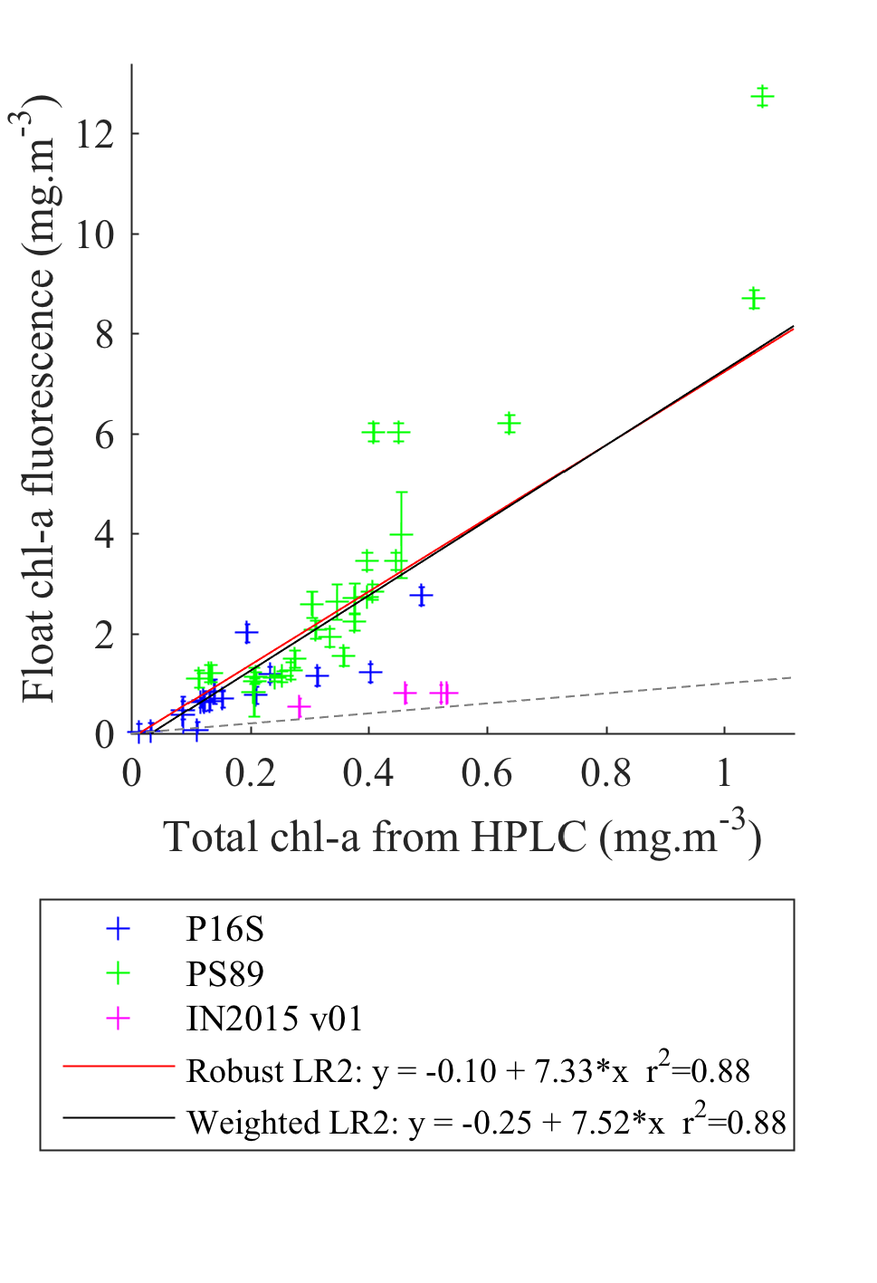
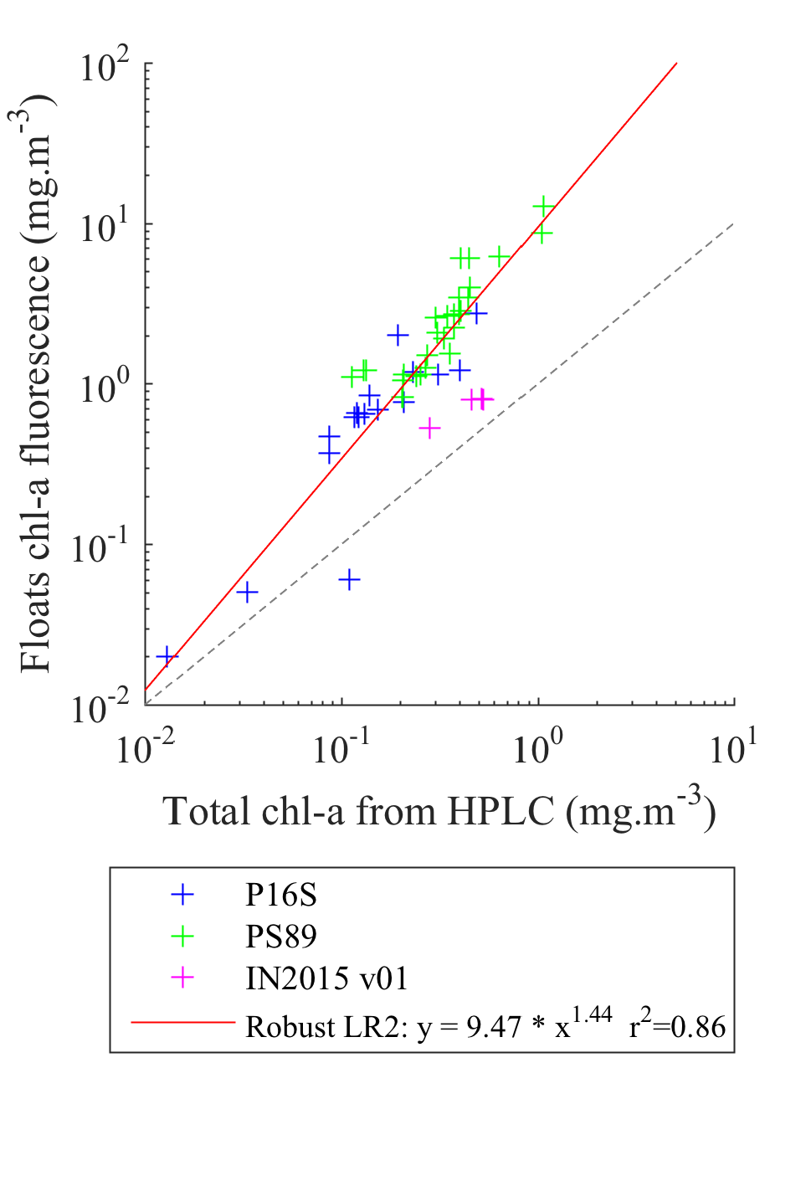
Comparison of F_chl and HPLC

Slide 19
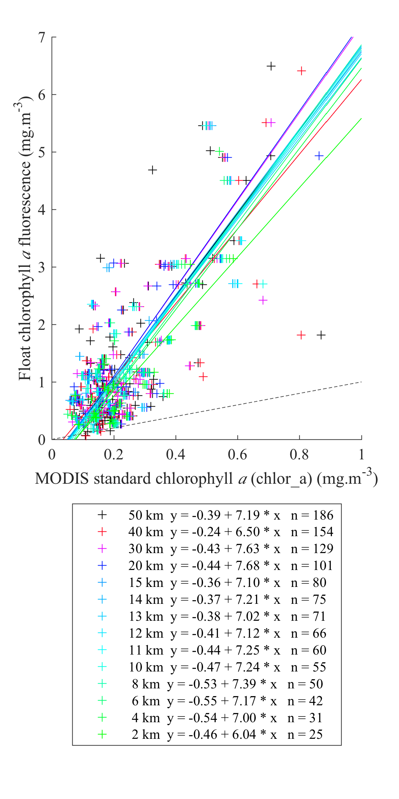
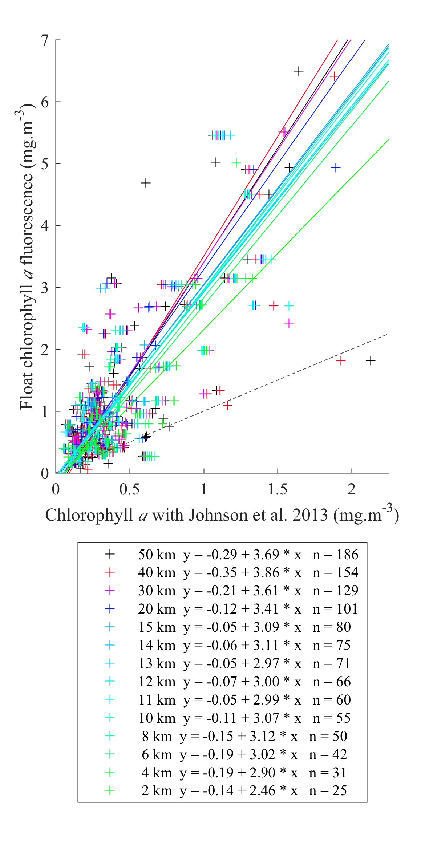
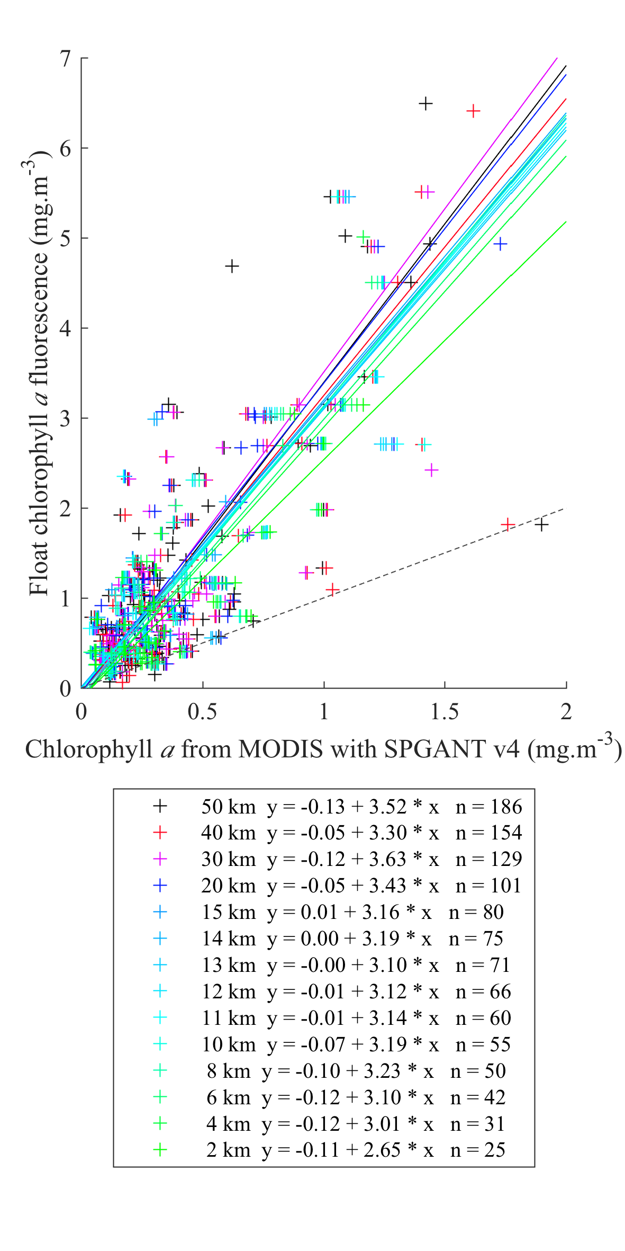
SOCCOM satellite matchups
Standard NASA
Johnson et al., 2013
Kahru and Mitchell
Use ‘robust’ type-II regression, inversly weighted by F_chl variability

Slide 20
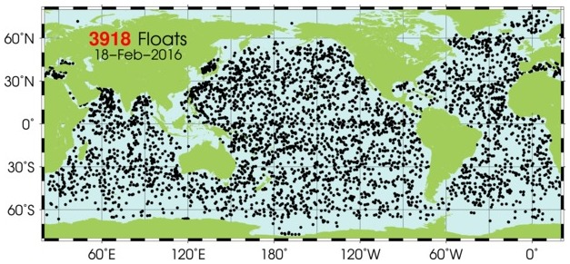
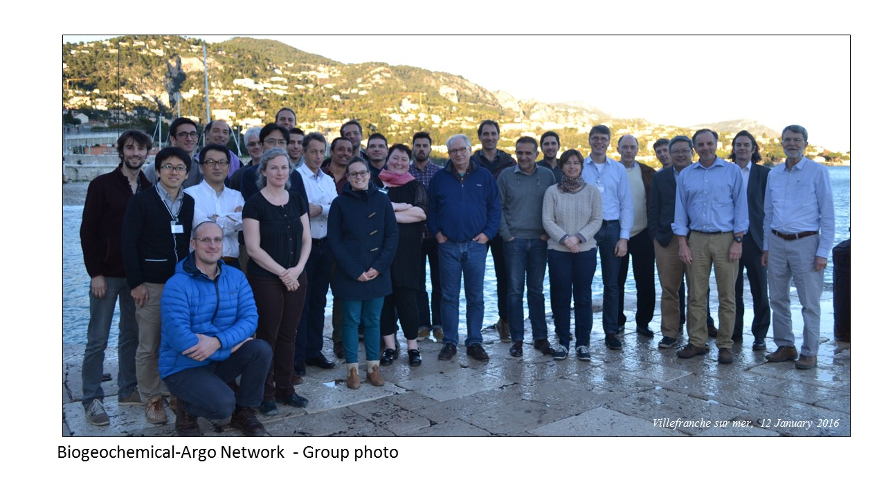
Planning for a global network has begun. First meeting in Villefranche-sur-Mer, 11-13 January.
Draft implementation plan being written.

Slide 21
BGC Argo is an extension of Argo. It follows main Argo philosophy.
A BGC Argo float carries O₂/pH/NO₃⁻ chemical sensors, chlorophyll fluorescence, optical backscatter, & downwelling radiance sensors.
It profiles to near 2000 m depth.
Target array size is ~1000 BGC floats.
All data are public in real time.
With a 4 year lifetime, 250 floats/yr will be required
$25,000,000/year at $100,000/float lifetime cost!!!!!
BGC Argo should be a sub-committee that reports to the Argo Steering Team.

