Slide 1
European proposal for the organization of the IOCS-2017 meeting

Slide 2
European Team
Proposal jointly submitted by EUMETSAT and ESA, with the support of the European Commission (Copernicus)
2017 marks the beginning of operational, sustained ocean colour data stream from the EC’s Copernicus programme, from both Sentinel-3 and Sentinel-2 missions
Proposal to celebrate this occasion by jointly supporting the organization the third IOCS meeting in 2017
Unique contribution that Copernicus observations will provide to science and operational ocean colour user communities

Slide 3
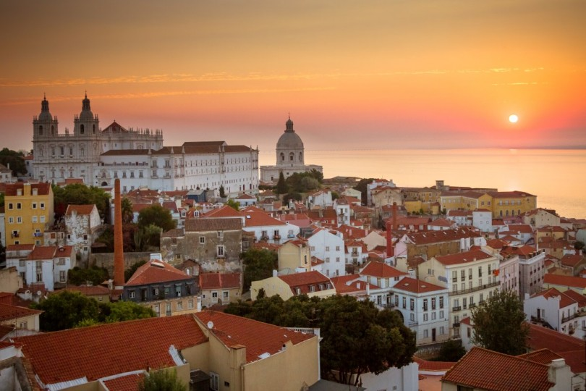
Location

Slide 4
Location and dates
Lisbon, Portugal, a city open to the ocean
15-19 May 2017
Local support from Instituto Português do Mar e da Atmosfera (IPMA)
High priority and visibility of Copernicus marine services and ocean colour observations in Portugal
IOCS 2017 can gain high visibility from local and national authorities
Lisbon is an attractive destination, suitably located on the coast of the Atlantic Ocean
Lisbon airport is 6 miles / 9km from the city centre

Slide 5
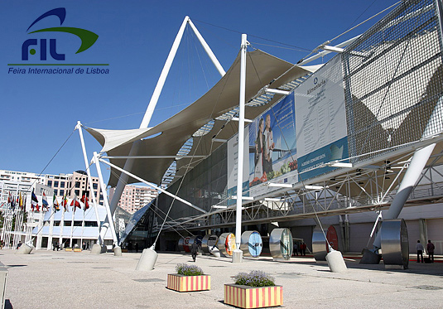
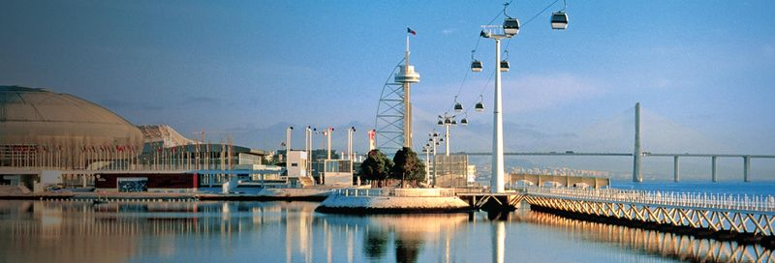
Lisbon venue
Lisbon Exhibition and Congress Centre http://www.fil.pt
Venue located on the river with the view on the Vasco da Gama bridge
Plenty of restaurants nearby, some hotels
Exclusive use of the entire building

Slide 6
Format of the meeting and European contribution
Proposal to extend the meeting to 4 days
minimize the number of parallel sessions
accommodate extra programme
Usual IOCS format plus additional emphasis on Copernicus, with a half-a-day devoted to Copernicus
European contribution to the agenda:
opening Key Note speech from a prominent European scientist
1/2 day Copernicus plenary session
4 breakout sessions
1 day training session on the day after the meeting

Slide 7
IOCS committees
Usual committees (to be established soon)
Scientific / Programme Committee to include European Commission (1), ESA (2) and EUMETSAT (2) members
Organising Committee to include EUMETSAT with the support of IOCCG, IPMA and ESA
For the Organising Committee EUMETSAT will provide a support team experienced with organizing the first IOCS 2013 in Darmstadt (Rowanna and Sylwia)

Slide 8
Registration fee and budget
Registration fee
300 participants expected
No decision whether to charge the fee or not
for charging the fee: to boost meeting finances and to force commitment to attending the meeting when people register
against charging the fee: to assure IOCS is perceived as a working meeting, community building activity, IOCCG service to the community, and not a conference
Coffee breaks, icebreaker and a gala dinner will be offered for free
Lunches will not be provided
Costs shared between
the European Commission
EUMETSAT
ESA
other sponsors / agencies highly encouraged

