Slide 1
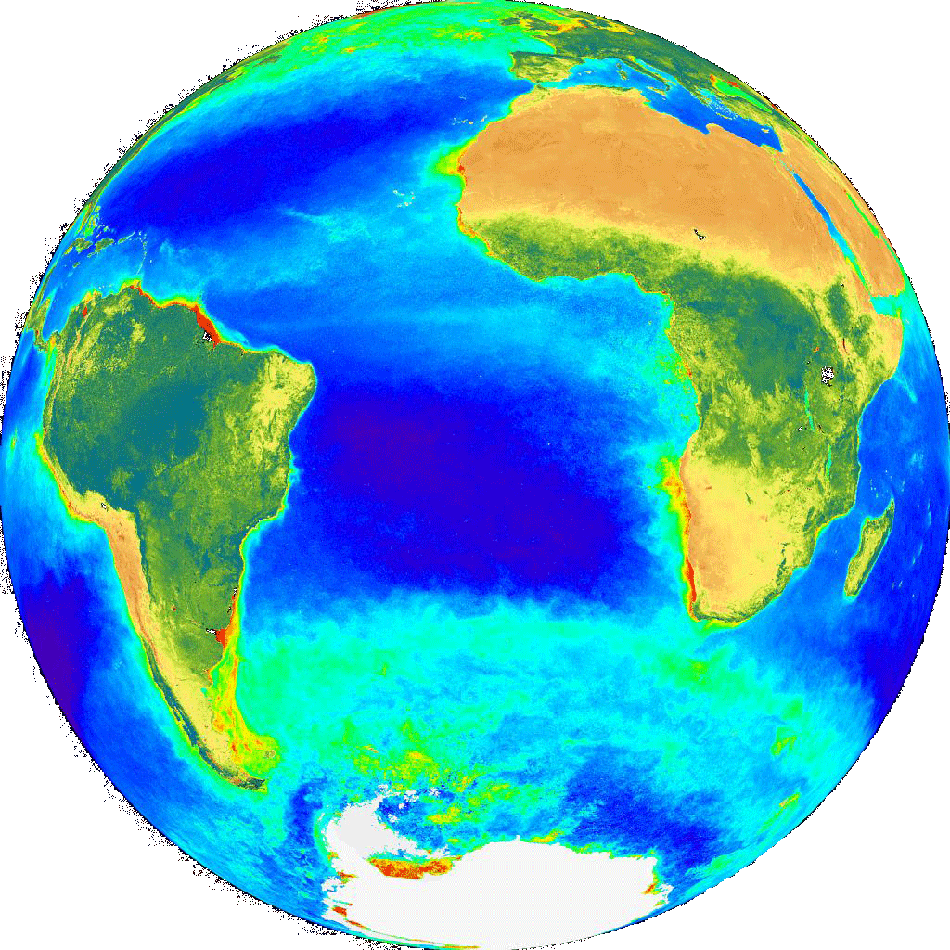
The International Ocean Colour Coordinating Group
International Network for Sensor Inter-comparison and Uncertainty assessment for Ocean Color Radiometry (INSITU-OCR) & CEOS Gap Analysis
IOCCG-21, March 2016

Slide 2
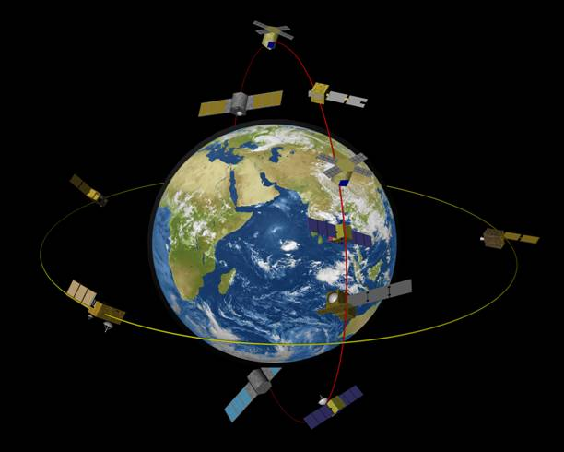
Ocean Colour Radiometry – Virtual Constellation (OCR-VC)
Established by IOCCG through CEOS to provide a long time series of calibrated ocean colour radiances from measurements obtained from multiple satellites.
Goals of the OCR-VC
To ensure the continuity of the ocean colour time series – Climate Data Record
To provide high quality data sets through a concerted inter‐agency effort on activities relating to sensor inter‐comparison (INSITU-OCR)
Data harmonization, support implementation of ECVs (IOCCG Task Force on ECV Assessment)
Facilitate timely and easy access to data (user interface)
Capacity building and outreach
All space agencies on the IOCCG Committee contribute
to the OCR-VC
Committee on Earth Observation Satellites

Slide 3
Within the OCR-VC Framework
International Network for Sensor Inter-comparison and Uncertainty Assessment for
Ocean Colour Radiometry. SIMBIOS follow-on: plan to establish an Inter-Agency
Project Office. Produced a White Paper with recommendations on:
space sensor radiometric calibration, characterization and temporal stability;
development and assessment of satellite products;
in situ data generation and handling;
information management and support.
INSITU-OCR
Provides guidance on the generation of better, long-term
OCR climate data records.
Task Force on ECV Assessment
Task Force on Satellite Sensor Calibration
Proposed Inter-Agency task force to facilitate
collaboration to maximize the accuracy and
stability of ocean-colour radiometry records
from individual missions.
Coordination of In Situ Measurement Protocols
Proposed group to coordinate and
revise in situ measurement
protocols.

Slide 4
INSITU-OCR activities
…the INSITU-OCR initiative aims at integrating and rationalizing inter-agency efforts on satellite sensor inter-comparisons and uncertainty assessment for remote sensing products with particular emphasis on requirements addressing the generation of Ocean Color Essential Climate Variables (ECV)…
Space sensor radiometric calibration, characterization and temporal stability;
2. Development and assessment of satellite products;
3. In situ data generation and handling;
4. information management and support.

Slide 5
Extracts from last input to CEOS-SIT, December 2015 (Paula)
For VC-07 – Suggested input:
In 2014, IOCCG undertook a relevant "agency mapping" exercise that included consideration of available, and planned, international agency assets and resources for OCR cal/val. As a first step towards implementation of the International Network for Sensor Inter-comparison and Uncertainty assessment for Ocean Colour Radiometry (INSITU-OCR) by IOCCG member agencies, the IOCCG asked that each agency indicate on the spreadsheet their potential area of contribution to INSITU-OCR implementation. At the 3-5 March 2015 IOCCG meeting, IOCCG asked the member agencies to provide an agency-based list of infrastructure and assets. IOCCG has collated this information. Once formatted IOCCG will submit to CEOS.
For VC-09 – Suggested input:
IOCCG requested that agencies identify resources to support the INSITU-OCR; IOCCG is using this information to identify gaps in infrastructure that agencies could collectively address. As of June 2015, agencies were requested to submit to the IOCCG Chair a short list of actual gaps in support of existing/upcoming missions, a list of priorities from their perspective, as well as areas where they need help, e.g., a need for more validation sites. Once the OCR-VC has this updated information compiled, it will be conveyed to CEOS-SIT via the OCR-VC Chairs. Additionally, there have been recent discussions about the format for submissions of in situ data to the agencies. (Note: it would be beneficial to have an interagency standard template.) Next SIT meeting will be the deadline for the OCR-VC gap analysis along with mapping exercise output from VC-07.
Short, useful gap analysis needed – one that we are able to address…..

Slide 6
Some suggestions for gaps in infrastructure that agencies could collectively address….
Space sensor radiometric calibration, characterization and temporal stability
suggest we leave this, already have good WGCV progress , permanent WG etc
2. Development and assessment of satellite products;
Multi-water type processing?
New generation of PFT products?
3. In situ data generation and handling;
Protocols (NASA group efforts & potential protocol publications), also new needs for optically complex waters & PFTs
4. information management and support.
Large volume data distribution & curation/re-processing

