Slide 1
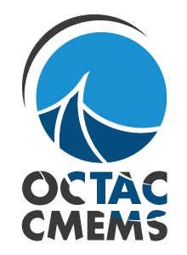
The Copernicus Marine Moniroting Environment Service: Ocean colour
Rosalia Santoleri – CNR

Slide 2
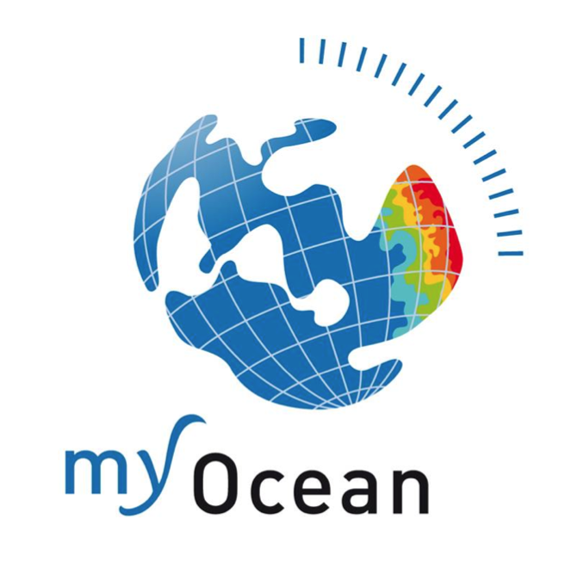
Copernicus Marine Moniroting Environment Service
« The Marine Environment Monitoring Service provides regular and systematic reference information on the physical state and dynamics of the ocean and marine ecosystems for the global ocean and the European regional seas. This capacity encompasses the description of the current situation (analysis), the prediction of the situation a few days ahead (forecast), and the provision of consistent retrospective data records for recent years (re-analysis). »
(2015-2021)

Slide 3
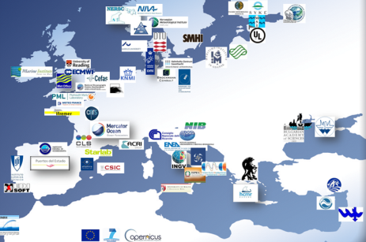
The Copernicus Marine Monitoring Environment Service
An EU Marine Service with a clear ambition
Operational AND scientifically assessed
Observations AND models
Worldwide AND European-wide coverage
Designed for long-term sustainability
Generic but used by thousands of users

Slide 4
Copernicus Marine Service An integrated information
OPERATIONAL OCEANOGRAPHY BUILT UPON MULTIPLE SOURCES OF INFORMATION
OBSERVATIONS
AND MODELS
PHYSICS AND BIOGEOCHEMISTRY
REAL-TIME AND REANALYSES

Slide 5
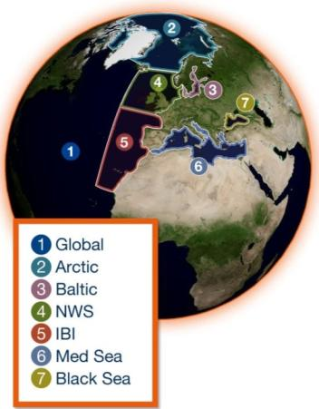
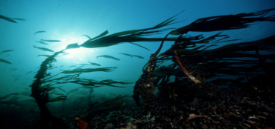
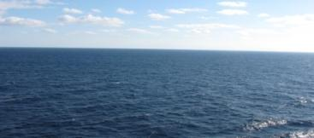
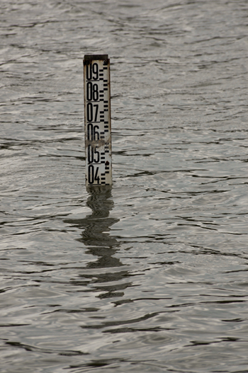
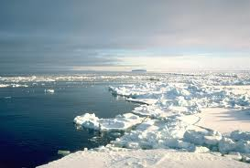
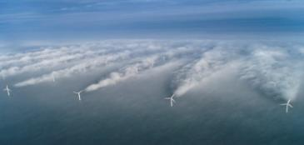
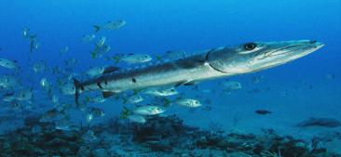
REANALYSES
10 to 45 years
REAL-TIME
Daily, hourly
FORECAST
2 to 10 days
ESSENTIAL OCEAN VARIABLES
TEMPERATURE
SALINITY
CURRENTS
SEA ICE
SEA LEVEL
WAVES
DISCOVER
VIEW
DOWNLOAD
BIOGEO
CHEMISTRY
SEA WIND
Open & Free

Slide 6
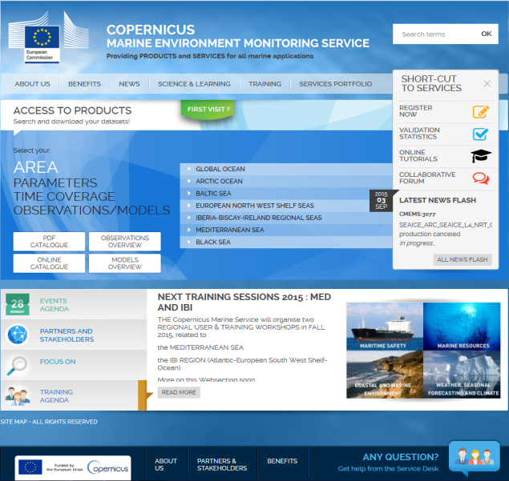
Copernicus Marine Service a unique service
marine.copernicus.eu
EASY ACCESS TO OPERATIONAL OCEANOGRAPHY PRODUCTS FOR ANYONE
ONE-STOP-SHOP-WINDOW
WORLD OCEAN / EUROPEAN SEAS
MARINE ESSENTIAL VARIABLES

Slide 7
Copernicus Marine Service a unique service
marine.copernicus.eu
EASY ACCESS TO OPERATIONAL OCEANOGRAPHY PRODUCTS FOR ANYONE
ONE-STOP-SHOP-WINDOW
WORLD OCEAN / EUROPEAN SEAS
MARINE ESSENTIAL VARIABLES
> 6000 registered users

Slide 8
Ocean Colour

Slide 9
OC TAC Mission & Purpose:
The OC TAC operates the European Ocean Colour component within the CMEMS, bridging the gap between space agencies, providing ocean colour data, and all users that need the added-value information not available from space agencies.
The OC TAC provides an Ocean Colour expert centre service with respect to ocean colour missions and products within the CMEMS organization.
The OC TAC generates and deliver L3 & L4 NRT, DT, REP products and INDICES covering the CMEMS regions:
Global, Arctic, Baltic, North Atlantic, Mediterranean and Black Sea
+ an European Sea (EUR) product combining the individual regional products.
+ Specific products developed and produced for the CMEMS MFC
The OC TAC contributes to the CMEMS cross-cutting activities by:
developing and implementing product quality metrics, in line with user needs.
contributing to the CMEMS training, communication and outreach activities
contributing to CMEMS reprocessing/reanalysis activities and to the preparation of the annual Ocean State Report.

Slide 10
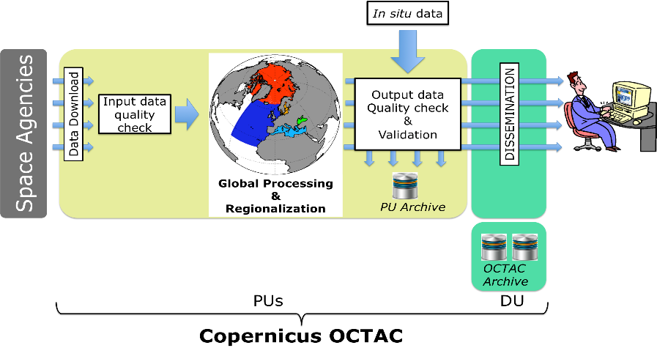
CMEMS OC TAC: Architecture
CNR leads the OCTAC. OTAC is composed by 3 distributed Production Units (ACRI, CNR, PML) and one Dissemination Unit (CNR). OC DU @CNR provides access to OC products via CMEMS portal.

Slide 11
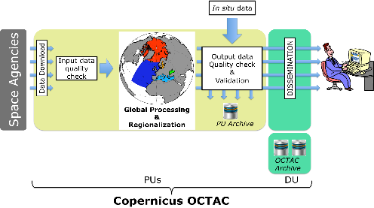
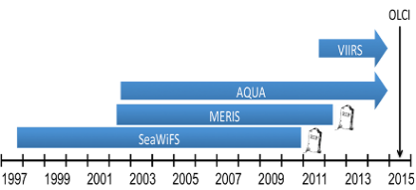
OCTAC Architecture: interfaces
In situ Upstreams:
CMEMS IN SITU (e.g.bioArgo)
Public data: NOMAD, SeaBass, MERMAID, AERONET-OC
Partners data (eg. Cruise data, CNR buoy data)
Downstreams:
CMEMS CIS
CMEMS Web Portal
CMEMS users
CMEMS MFCs
CMEMS cross-cutting elements
modelling communities
national and international projects
Space Upstreams:
NASA: SeaWiFS, MODIS and VIIRS
NOAA: VIIRS data
ESA: MERIS data & OC-CCI data
EUMETSAT: VIIRS and OLCI data
EumetCast interface in addition to ftp to acquire space data

Slide 12
OCTAC products (V1: today )
Code | Ocean Region | coverage | NRT L3 | NRT L4 | REP L3 | REP L4
GLO | Global Ocean | 90.0°S - 90.0°N 180.0°W - 180.0°E | Multi (MODIS+VIIRS) | Multi (MODIS+VIIRS) | multi (SeaWIFS+MODIS+MERIS)
ARC | Arctic Ocean | 67.0°N - 90.0°N 180.0°W - 80.0°E | single M0DIS & VIIRS |  | Multi (SeaWIFS+MODIS+MERIS)
BAL | Baltic Sea | 53.0°N - 66.85°N 9.25°W - 30.25°E | single MODIS |  | Multi (SeaWIFS+MODIS+MERIS)
ATL | Atlantic Ocean | 20.0°N - 66.0°N 46.0°W - 13.0°E | single M0DIS & VIIRS | Multi (MODIS+VIIRS) | Multi (SeaWIFS+MODIS+MERIS)
MED | Mediterranean Sea | 30.0°N - 46.0°N 6.0°W - 36.5°E | single M0DIS & VIIRS | single M0DIS & VIIRS | Multi (SeaWIFS+MODIS+MERIS) | Multi Based on L3
BS | Black Sea | 40.0°N - 48.0°N 26.5°W - 42.0°E | single M0DIS & VIIRS | single M0DIS & VIIRS | Multi (SeaWIFS+MODIS+MERIS) | Multi Based on L3
EUR | European Sea | 20N - 65.85 N 30 W - 42 E | Single (MODIS)
Ocean Colour Products Types:
CHL: L3 (daily composite products) and L4 analysis (no data gaps)
OPTICS: IOPs , Kd490, Secchi depth, Rrs, PAR, CDOM, SPM.
30 OC Products (184 datasets) covering the global ocean and the European Regional Seas.
Regional products produced using regional algorithms to improve the quality
NRT: products within few hours, NRT replaced by consolidated product within few days
REP: consistent re-processed time series from 1997 to the 2012 based on OC-CCI
Product quality information available for all products based on CMEMS metrics

Slide 13
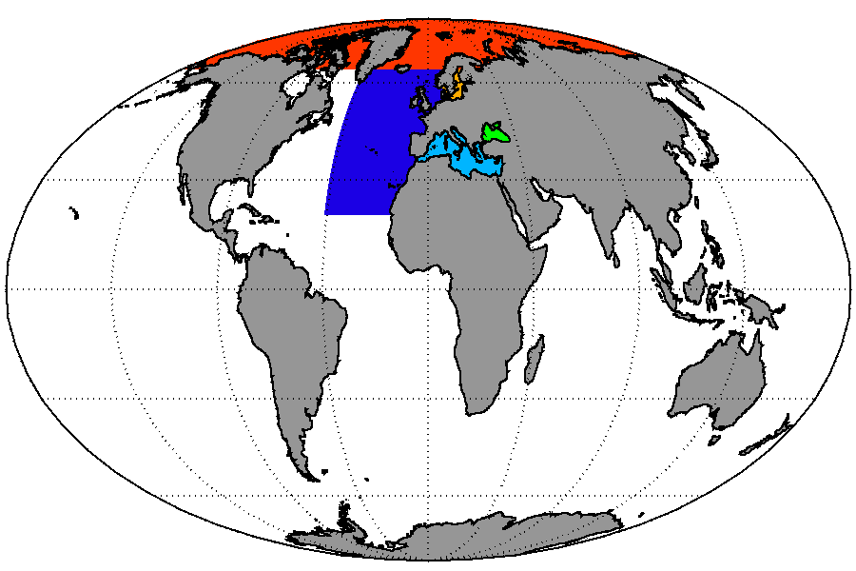
V1 OC NRT products
Harmonized state-of-the-art NRT products based on
VIIRS & MODIS
ARC:
OC488 (Taberner et al, 2014)
BAL
Based on HZG regional processor
ATL:
OC488 (Taberner et al, 2014)
L4 : OI scheme
BSAlg (Kopelevich et al., 2013)
L4 : DINEOF scheme
GLOBAL:
GSM Maritorena, et al. 2010
L4: OI scheme
MedOC4 (Volpe et al., 2007)
L4: DINEOF scheme

Slide 14
V1 OC REP products
Homogeneous and state-of-the-art multi-sensor merged reprocessed datasets
ESA-CCI input data (1997-2012)+ Chl Regional Algorithms
BalAlg (D’Alimonte et al.,2012)
OC488 (Taberner et al, 2014)
BSAlg (Kopelevich et al., 2013)
GLOBAL: ESA-CCI
MedOC4 (Volpe et al., 2007)
L4: DINEOF scheme

Slide 15
OCTAC products (V2 & V3)
Code | Ocean Region | coverage | NRT L3 | NRT L4 | REP L3 | REP L4
GLO | Global Ocean | 90.0°S - 90.0°N 180.0°W - 180.0°E | Multi (MODIS+VIIRS + OLCI) Single OLCI | Multi | multi (SeaWIFS+MODIS+MERIS+VIIRS) From CCI + OSS2015 | Multi Based on L3
ARC | Arctic Ocean | 67.0°N - 90.0°N 180.0°W - 180.0°E | single & Multi M0DIS & VIIRS& OLCI | Multi | Multi (SeaWIFS+MODIS+MERIS) | Multi Based on L3
BAL | Baltic Sea | 53.0°N - 66.85°N 9.25°W - 30.25°E | single MODIS & OLCI | Multi | Multi (SeaWIFS+MODIS+MERIS) | Multi Based on L3
ATL | Atlantic Ocean | 20.0°N - 66.0°N 46.0°W - 13.0°E | single & Multi M0DIS & VIIRS & OLCI | Multi | Multi (SeaWIFS+MODIS+MERIS) | Multi Based on L3
MED | Mediterranean Sea | 30.0°N - 46.0°N 6.0°W - 36.5°E | single & Multi M0DIS & VIIRS & OLCI | Multi | Multi (SeaWIFS+MODIS+MERIS) | Multi Based on L3
BS | Black Sea | 40.0°N - 48.0°N 26.5°W - 42.0°E | single & Multi M0DIS & VIIRS & OLCI | Multi | Multi (SeaWIFS+MODIS+MERIS) | Multi Based on L3
EUR | European Sea |  | Multi | Multi
Simplification of the product catalogue: redundant product removed -> V2 (April 2016)
Improve the regional algorithm (coastal & open water) and the analysis schemes -> V2 (April 2016)
Only one Chl product for each area/sensor: chl12 products -> V2 (April 2016)
Extending the NRT merged multi-sensor data production to ATL, ARC, MED, BS and BAL -> V3 (April 2017)
Updated REP based on new version of CCI: Regional REP produced ingesting CCI Rrs at 1 Km resolution, redistribution of GLO OC-CCI v2 version -> V2
OLCI Products -> V2.1 (ASAP …..)

Slide 16
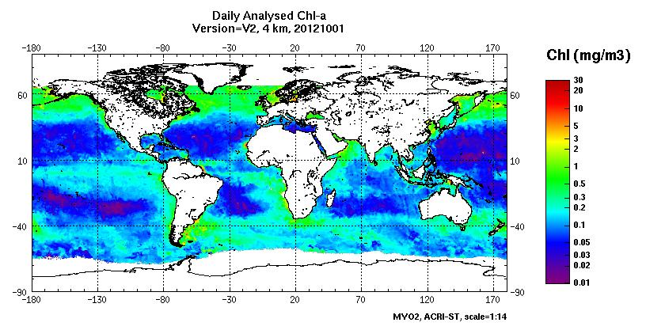
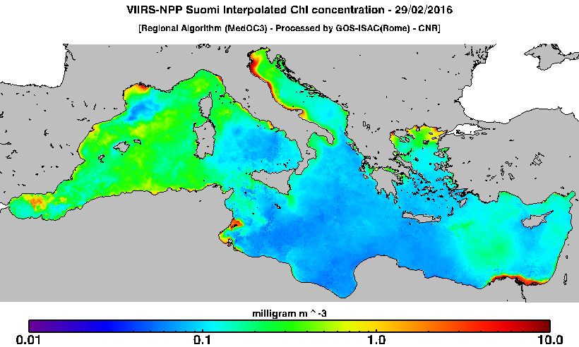
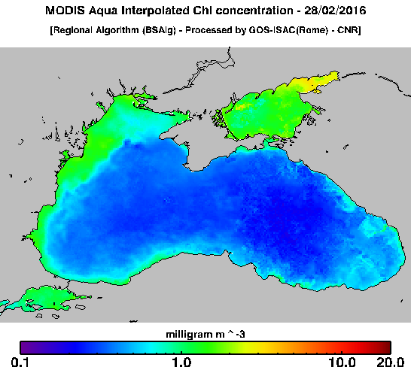
L4 daily Field

Slide 17
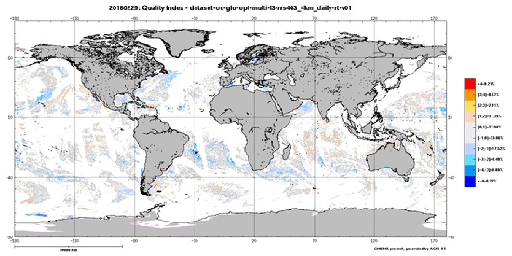
OCTAC CAL/VAL STATISTICS
Unification of the operational Cal/Val activity at TAC level.
Common metrics have been adopted by the PUs of the OC TAC.
Evaluation of the products against in situ data before to enter in operational production and dissemination based on classical matchup analysis
QG in NRT of the NRTproducts
Due to the non-availability of NRT in situ data, the product quality control is determined in terms of the satellite observations’ temporal consistency through the use of climatological satellite data.
Data quality information provide to users by the:
Quality Information Document : QUID
On line http://marine.copernicus.eu/web/103-validation-statistics.php
Difference between daily observations and climatology. The difference is then divided by the standard deviation of the climatology. The result is an indicator usually bounding in the range [-4, +4]. This indicator is computed at pixel level on the daily NRT product.
MyOcean2 Close Out Meeting – 25-26 September 2014

Slide 18
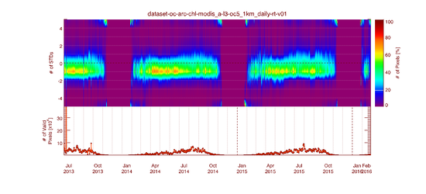
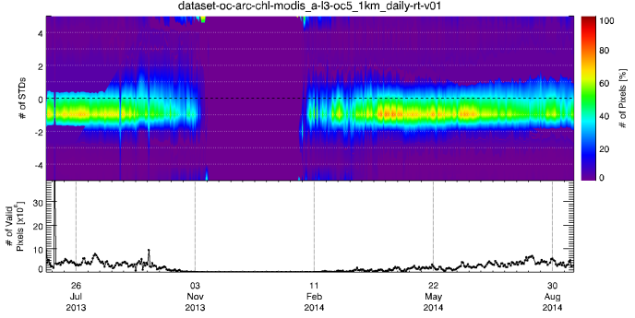
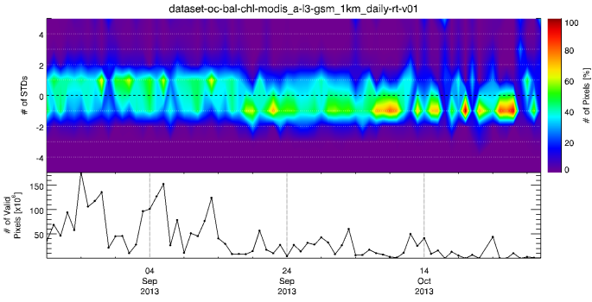
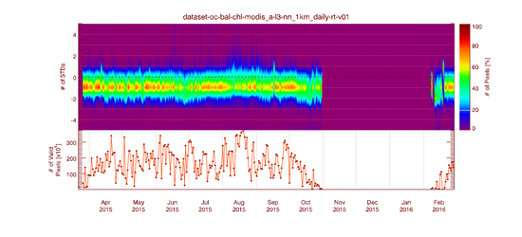
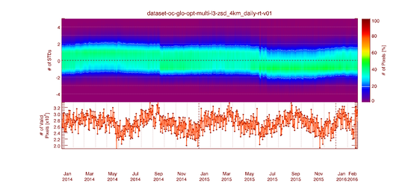
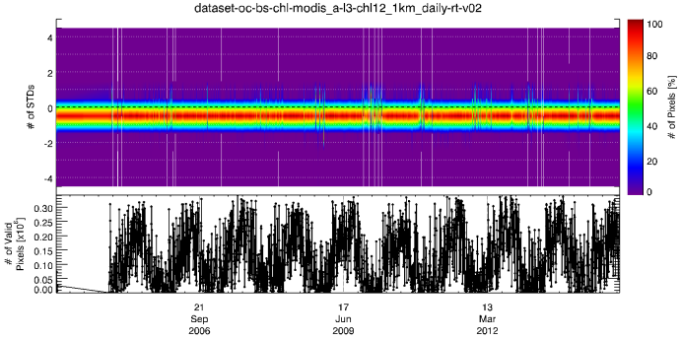
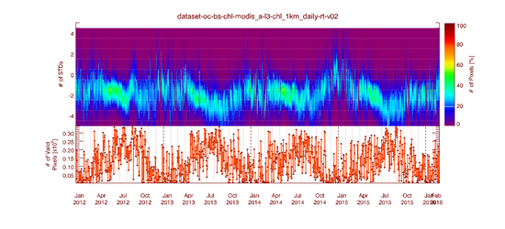
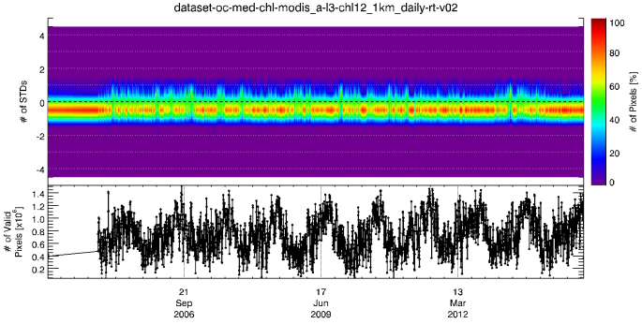
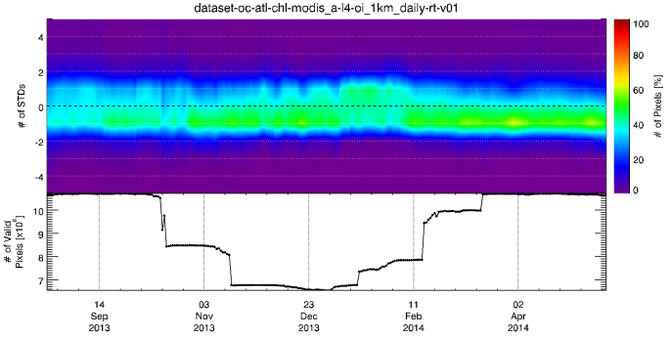
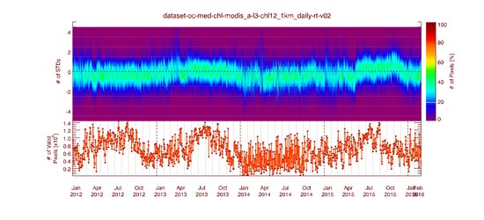
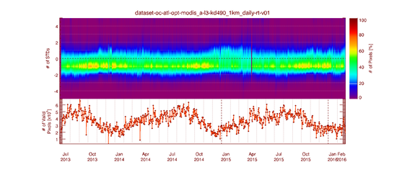
OCTAC NRT VALIDATION
GLO
MyOcean2 Close Out Meeting – 25-26 September 2014

Slide 19
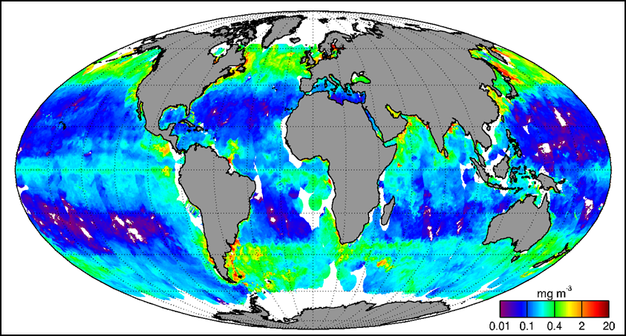
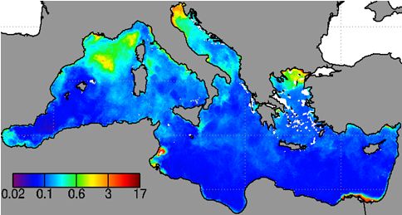
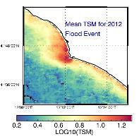
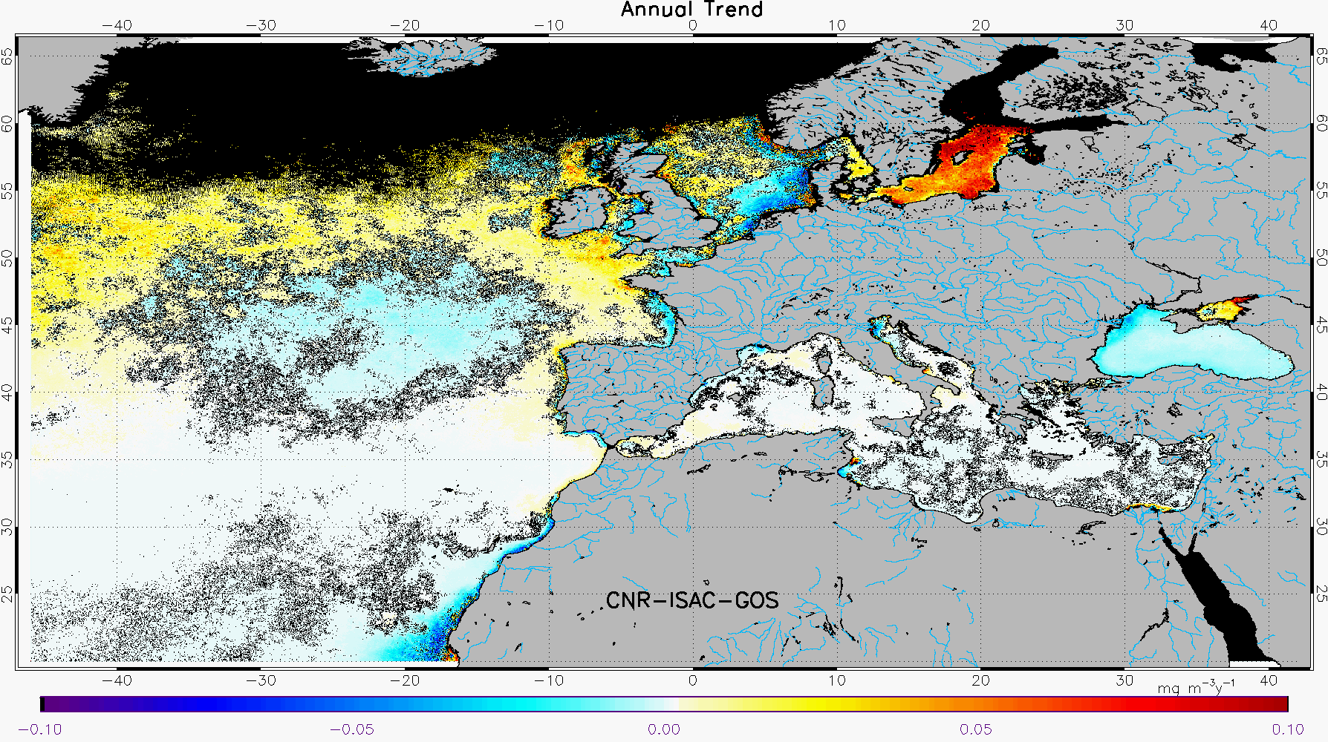
Sentinel-3 OLCI integration in CMEMS
OLCI data will be ingested in NRT by the CMEMS OCTAC to:
Produce Global Daily L3 & L4 multi sensors OC fields
To Produce daily L3 global OC OLCI fields
Daily NRT L3 &L4 regional products for the European Seas
to provide data for assimilation in bio-geochemical models
To produce new version of global and regional OC REP products
Produce indicators for monitor the marine environment for the marine policies (eg. MSFD)
To provide indicator for the management of marine resources

Slide 20
Thanks
for your attention

