Slide 1

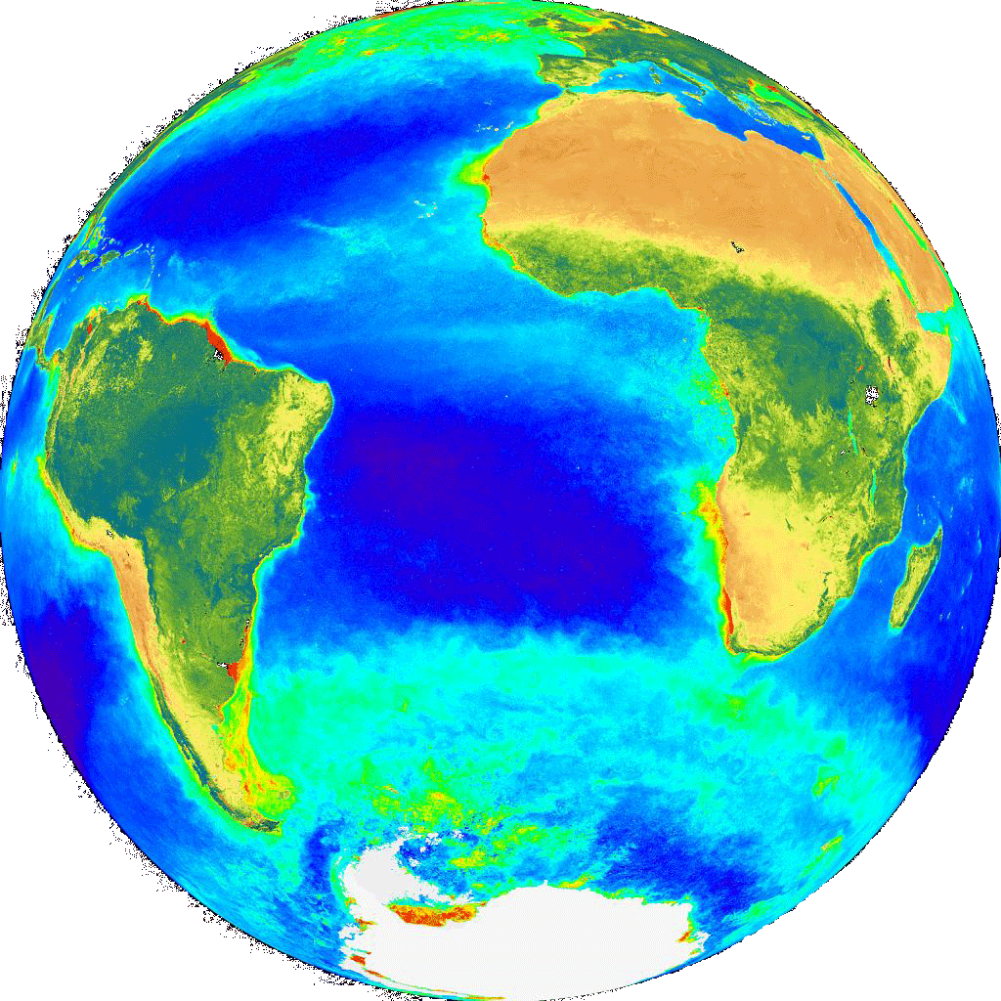
The International Ocean Colour Coordinating Group
INSITU-OCR
Potential Provisions for In Situ Data Processing
Sentinel 3 Validation Team
Second Joint ESA-EUMETSAT Meeting
December 2014

Slide 2
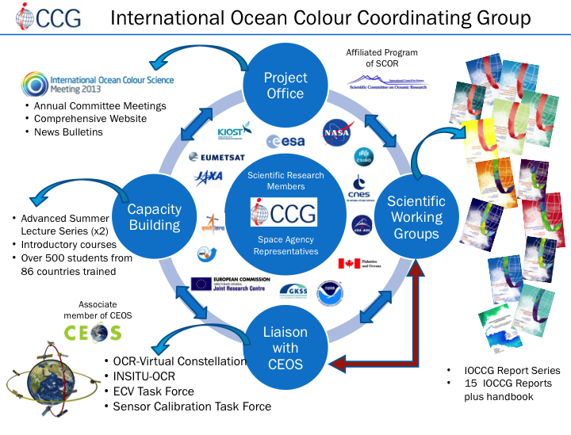
































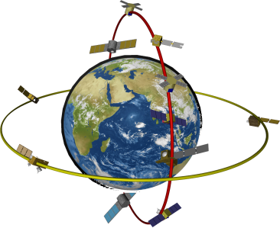
International Ocean Colour Coordinating Group
Project Office
Scientific Working Groups
Liaison with CEOS
Capacity Building
Affiliated Program of SCOR
Annual Committee Meetings
Comprehensive Website
News Bulletins
Scientific Research
Members
IOCCG
Space Agency
Representatives
Advanced Summer Lecture Series (x2)
Introductory courses
Over 500 students from 86 countries trained
Associate member of CEOS
OCR-Virtual Constellation
INSITU-OCR
ECV Task Force
Sensor Calibration Task Force
IOCCG Report Series
15 IOCCG Reports plus handbook

Slide 3
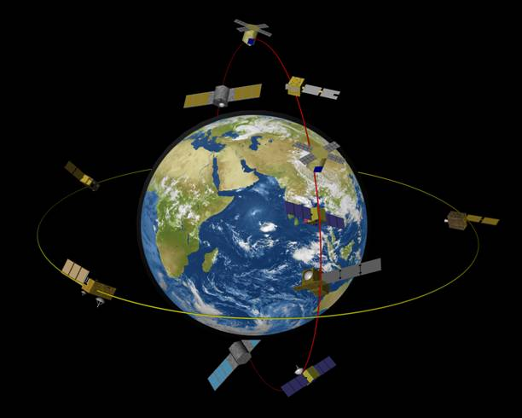

Ocean Colour Radiometry – Virtual Constellation (OCR-VC)
Established by IOCCG through CEOS to provide a long time series of calibrated ocean colour radiances from measurements obtained from multiple satellites.
Goals of the OCR-VC
To ensure the continuity of the ocean colour time series – Climate Data Record
To provide high quality data sets through a concerted inter‐agency effort on activities relating to sensor inter‐comparison (INSITU-OCR)
Data harmonization, support implementation of ECVs (IOCCG Task Force on ECV Assessment)
Facilitate timely and easy access to data (user interface)
Capacity building and outreach
All space agencies on the IOCCG Committee contribute
to the OCR-VC
Committee on Earth Observation Satellites

Slide 4
Within the OCR-VC Framework
International Network for Sensor Inter-comparison and Uncertainty Assessment for
Ocean Colour Radiometry. SIMBIOS follow-on: plan to establish an Inter-Agency
Project Office. Produced a White Paper with recommendations on:
space sensor radiometric calibration, characterization and temporal stability;
development and assessment of satellite products;
in situ data generation and handling;
information management and support.
INSITU-OCR
Provides guidance on the generation of better, long-term
OCR climate data records.
Task Force on ECV Assessment
Task Force on Satellite Sensor Calibration
Proposed Inter-Agency task force to facilitate
collaboration to maximize the accuracy and
stability of ocean-colour radiometry records
from individual missions.
Coordination of In Situ Measurement Protocols
Proposed group to coordinate and
revise in situ measurement
protocols.

Slide 6
Extracts from last input to CEOS-SIT, December 2015 (Paula)
For VC-07 – Suggested input:
In 2014, IOCCG undertook a relevant "agency mapping" exercise that included consideration of available, and planned, international agency assets and resources for OCR cal/val. As a first step towards implementation of the International Network for Sensor Inter-comparison and Uncertainty assessment for Ocean Colour Radiometry (INSITU-OCR) by IOCCG member agencies, the IOCCG asked that each agency indicate on the spreadsheet their potential area of contribution to INSITU-OCR implementation. At the 3-5 March 2015 IOCCG meeting, IOCCG asked the member agencies to provide an agency-based list of infrastructure and assets. IOCCG has collated this information. Once formatted IOCCG will submit to CEOS.
For VC-09 – Suggested input:
IOCCG requested that agencies identify resources to support the INSITU-OCR; IOCCG is using this information to identify gaps in infrastructure that agencies could collectively address. As of June 2015, agencies were requested to submit to the IOCCG Chair a short list of actual gaps in support of existing/upcoming missions, a list of priorities from their perspective, as well as areas where they need help, e.g., a need for more validation sites. Once the OCR-VC has this updated information compiled, it will be conveyed to CEOS-SIT via the OCR-VC Chairs. Additionally, there have been recent discussions about the format for submissions of in situ data to the agencies. (Note: it would be beneficial to have an interagency standard template.) Next SIT meeting will be the deadline for the OCR-VC gap analysis along with mapping exercise output from VC-07.
Short, useful gap analysis needed – one that we are able to address…..

Slide 7
Sensor Cal
Cal Task force
Vicarious Cal Tech/Data Exchange Platform. Cross over experiment.
Satellite Products
S3 multi-water type product demo?
Ongoing Beam/SEADAS
Independent, powerful & god-like Rotating(?) project officer at ± senior level. See GHRSST
In Situ
Protocols
Modular Community Processor
Regional Calibration/Traceability

Slide 8
Some suggestions for gaps in infrastructure that agencies could collectively address….
Space sensor radiometric calibration, characterization and temporal stability
suggest we leave this, already have good WGCV progress , permanent WG etc
2. Development and assessment of satellite products;
Multi-water type processing?
New generation of PFT products?
3. In situ data generation and handling;
Protocols (NASA group efforts & potential protocol publications), also new needs for optically complex waters & PFTs. Community processor?
4. information management and support.
Large volume data distribution & curation/re-processing

Slide 9
INSITU-OCR: activities of relevance to S3VT activities
…the INSITU-OCR initiative aims at integrating and rationalizing inter-agency efforts on satellite sensor inter-comparisons and uncertainty assessment for remote sensing products with particular emphasis on requirements addressing the generation of Ocean Color Essential Climate Variables (ECV)…
1. Space sensor radiometric calibration, characterization and temporal stability;
1.4 Vicarious calibration
2. Development and assessment of satellite products;
2.2 Permanent working groups on algorithm topics
2.3 Product uncertainties
2.4 Regional bio-optical algorithms
2.6 Long-term field measurement programs
3. In situ data generation and handling;
4. information management and support.
4.2 Processing capabilities for calibration and validation activities

Slide 10
INSITU-OCR: In situ data generation and handling
3.1: Improving traceability of in situ measurements
3.2: Continuous consolidation and update of measurement protocols
3.3: Uncertainty budgets
3.4: Quality Assurance of in situ data
3.5: Archival of in situ data
3.6: Community processor for in situ data
3.7: Priority for variables to be collected
3.8: General coordination of field campaigns

Slide 11
AOP/IOP Community Processor
Uncertainty budgets
Quality Assurance of in situ data
Archival of in situ data
Community processor for in situ data
Improving traceability of in situ measurements

Slide 12
AOP/IOP Community Processor
Uncertainty: application of standardised processing & error calcs
QA: application of standard multi-parameter QA methods
Archival: improved pass through to existing community archives
Community processor for in situ data
Traceability: centrally curated instrument inventories & calibration data

Slide 13
AOP/IOP Community Processor: Ambitious
End- end processing & archiving system requiring substantial resources for scoping, development and dedicated ongoing operations….
Benefits: traceability, uncertainty estimates, QA, archiving ….substantial improvement in data quality and utility with little overhead for the community….
submitted common format raw data from most major instrument types
Calibration: curated PI instrument inventories & calibration data application
Processing: common schemes, providing detailed best error estimates
Quality Assurance: application of consensus standard methods
Archive: common formats for archive, pass through to existing archives

Slide 14
AOP/IOP Community Processor: Lightweight
Community code base requiring moderate resources for scoping and development with minimal ongoing maintenance….
Benefits: traceability, uncertainty estimates, QA(?), archiving….
submitted common format raw data from most major instrument types
Calibration: curated PI instrument inventories & calibration data application
Processing: common schemes, providing detailed best error estimates
Quality Assurance: application of consensus standard methods
Archive: common formats for archive, easy dissemination, IP protection

Slide 15
AOP Community Processor: Preliminary Example
The 2009 and 2010 AOP Community Processor Workshop reports (Wright & Hooker 2009, Hooker et al 2011) laid out an example framework of requirements for a community AOP processor PROSIT e.g.
Radiometric data (raw, calibration & dark)
Ed, Lu, Es, Eu
Pressure (depth)
Time and geolocation
Pitch/Roll
Profiling data and Es
Station Data
Cruise information
Deployment conditions
Multiple cast information
….
Time Synching
Pressure tare
Surface file
Depth correction
Position information
Self-shading
Diffuse to direct
λ co-registration
Choice of algorithm for interpolation
Es variation
Cosine correction
Immersion coefficients
Base calculations
error calculations and data flags
Optional binning
Products calculations
Error calculations (interactive)
Multi-cast aggregation
Statistics and uncertainties
Output /Format
Lineage/database
Reprocessing facilitation
Data Ingestion
Processing
Corrections
Output
Deployment Geometry
Multi/Hyper Spectral
Ancillary & meta data

Slide 16
Community Processor Priorities: a PFT-type Example
An example of potentially high impact products with large user pull, typically currently working from a sub-optimal quantitative framework – especially with regard to fiducial reference measurements - and with highly demanding dependency on second-order variability…..
New capability to determine PFT related signal content and evaluate candidate algorithms
Biogeochemistry & Phytoplankton Community:
New methods for quantitative assemblage measurements e.g. holographic / cytometric sensors & methods
Inherent Optical Properties:
Establishing common uncertainty methods
Establishing phytoplankton specific IOP methods e.g. backscattering
Apparent Optical Properties:
Establishing common uncertainty methods Establishing common processing methods for complex/turbid waters

Slide 17
Community Processing of In Situ Data: Issues
Community buy in: confirmation of anticipated benefits, system characteristics needed, IP & exploitation concerns, feedback please?!
Agency buy in: modular & distributed implementation an advantage, TBD by scoping & cost : benefit, system hosting….
Manufacturer buy in: primarily formatting/open code issues, could be assisted by agency push….
Technical Issues: substantial but manageable, primarily dealing with multiple instruments, data products, and deployment configurations and variable availability of “base” processing data
How to complement/make best advantage of/integrate with existing capabilities e.g. existing processors, MERMAID, SEABASS etc
Scoping important: first analysis of range of possible modular services to determine resources needed for implementation options

