Slide 1
Task force on satellite sensor calibration
Ewa Kwiatkowska
IOCCG-21 committee meeting, 1 – 3 March, 2016

Slide 2
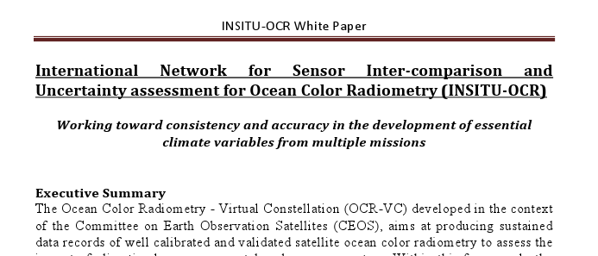
Motivation for the sensor calibration task force
Recommendation from the INSITU-OCR White Paper
INSITU-OCR = International Network for Sensor Inter-comparison and Uncertainty Assessment for Ocean Colour Radiometry
INSITU-OCR – initiative within the framework of CEOS OCR-VC
OCR-VC – aims to “provide long time series of calibrated ocean colour radiance at key wavelength bands from measurements obtained from multiple satellites. OCR-VC activities will include calibration, validation, merging of satellite and in situ data, product generation, as well as development and demonstrations of new and improved applications.”
Mission Statement
Create a framework for active and hands-on collaboration among instrument calibration and characterization experts from the Agencies engaged in the OCR-VC initiative.
The collaboration focuses on calibration needs specific to ocean-color measurements and has the objective to maximize the accuracy and temporal and spatial stability of OCR records from individual missions for the purpose of climate, research and operational applications.

Slide 3
Meetings and collaborations
Biennial IOCS meetings
Side-meetings (e.g. S3VT)
Inter-agency collaboration (e.g. visiting scientists)
IOCS-2015 calibration session
Chairs:
G. Meister (NASA) and B. Fougnie (CNES)
Fred Patt (NASA): changes of less than 1 count (on the order of 0.1% TOA radiances) caused the SeaWiFS long term trend in water leaving radiances at 555nm and were significant to be of concern to the ocean color community.
Jack Xiong (NASA): calibration efforts of the MODIS Calibration Support Team (MCST) and focus on the MODIS on the Aqua mission. MCST has started to use desert trending for those wavelengths to correct the solar diffuser trending.
Ludovic Burg (ESA/ACRI-ST): MERIS calibration improvements of the 4th reprocessing. MERIS prelaunch solar diffuser characterization did not fully explain the measurements on-orbit and an improved model will improve the accuracy.
Prakash Chaun (ISRO): status of OCM-2. Lunar calibration, vicarious calibration, Rayleigh calibration and a relative adjustment to correct for striping were used for calibration adjustments.
Seongick Cho (KIOST): status of GOCI and GOCI-II. The annual variation of the solar diffuser measurements of GOCI has been successfully modeled. GOCI-II will have an additional (pristine) solar diffuser, and lunar measurements.
Xianging He (SOA): HY1B/COCTS calibration activities. Cross-calibration to SeaWiFS is used for instrument calibration, and an approach has been developed to characterize the polarization sensitivity using on-orbit data.
Gene Eplee (NASA/SAIC) and Junqiang Sun (NOAA/GST): VIIRS calibration activities of NASA and NOAA, respectively. Both agencies adopted an approach of combining the lunar and solar diffuser measurements. NASA team developed a correction to the lunar irradiance model (ROLO) to correct for libration angle dependencies in the VIIRS lunar data.
Constant Mazeran (ESA/Solvo): challenges of the vicarious calibration for spectral matching atmospheric correction algorithms (e.g. POLYMER), the vicarious gains are not always unique.
Ewa Kwiatkowska (EUMETSAT): preparations for the OLCI (Sentinel-3) calibration. The feasibility of an on-orbit characterization of the BRDF of the solar diffuser with spacecraft yaw maneuvers is currently being evaluated.
IOCS-2015 uncertainty session
Chairs:
Part I: Kevin Turpie (UMBC), Emmanuel Boss (U. Maine)
Part II: Stéphane Maritorena (UCSB), Frédéric Melin (JRC ISPRA)
Part III: Jeremy Werdell (NASA GSFC)

Slide 4
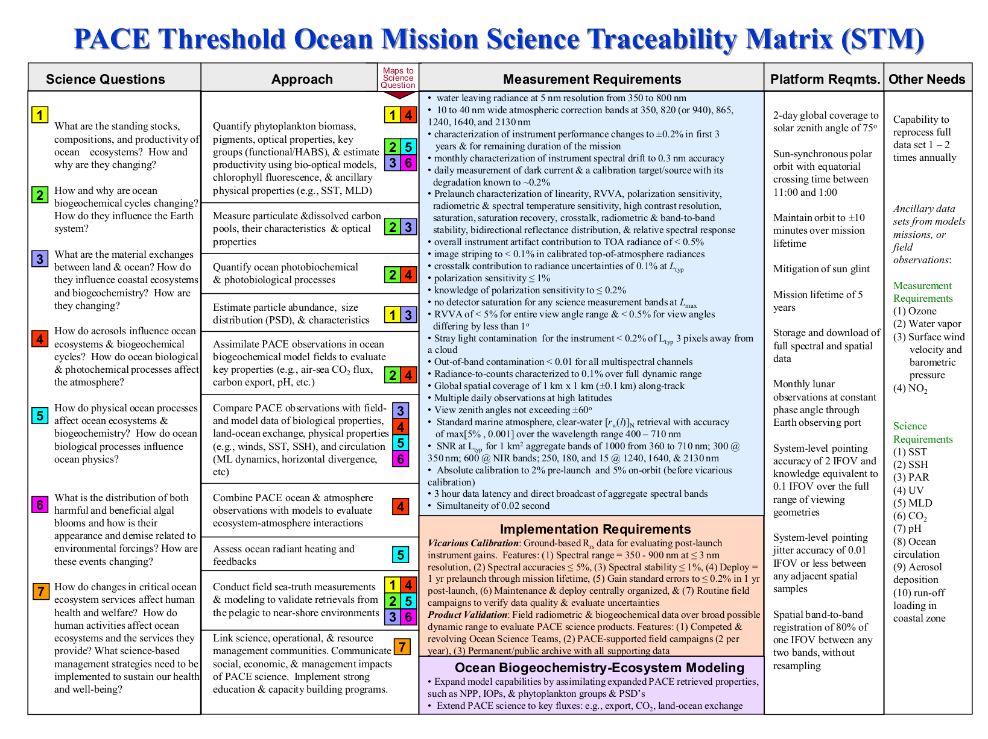
IOCCG / CEOS OCR-VC calibration task force affiliation
CEOS WGCV / IVOS argument
inappropriate to have a task group on satellite sensor calibration or comparison which is specific to an end application
calibration and validation are a generic problem (especially pre-flight and on-board calibration, both mentioned in the INSITU-OCR White Paper)
IOCCG / OCR-VC argument
ocean colour requires highly stringent uncertainties, ocean colour drives calibration requirements, design of instrumentation, and mission operations
task force works with unique issues and needs specific answers in timescales that are hard to achieve in more generic discussions
WGCV / IVOS stated “the working group should have as a minimum a close relationship with CEOS WGCV where there is significant synergy and common expertise on relevant sensor pre-flight calibration”
Task Force will remain within IOCCG / OCR-VC

Slide 5
CEOS WGCV plenary
Agreed that IOCCG has a permanent seat on the WGCV and a standing invitation to the plenaries (WGCV-40, Canberra, Australia, 14-18 March)
WGCV / IVOS will review IOCCG/OCR-VC cal/val documentation – INSITU-OCR White Paper and Report 13
WGCV / IVOS will prepare formal response to the IOCCG/OCR-VC cal/val documentation
WGCV / IVOS and IOCCG Calibration Task Force will jointly develop concrete areas of cooperation
CEOS WGCV action
WGCV39-25
Evaluation of IOCCG Requirements as basis for future collaboration/discussion IVOS IVOS-27
CEOS WGCV IVOS actions
AP .2015-5
Nigel Fox to prepare formal response to the INSITU-OCR white paper and the IOCCG Report #13
AP.2015-5A
Comments from IVOS members on proposed response to be sent to IVOS chair, March 1

Slide 6
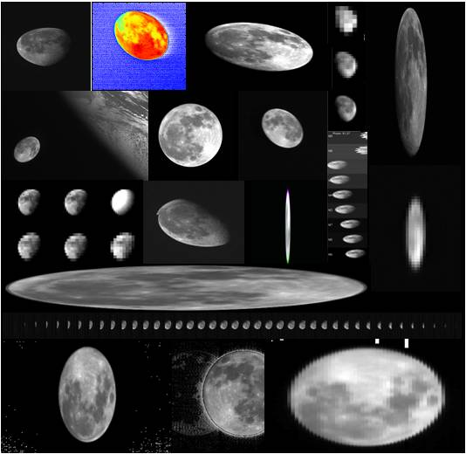
Further points of interest for calibration task force
CEOS WGCV is planning a workshop on satellite sensor calibration and characterization, pre-launch and on-orbit, with participation from industry as well as agencies and cal/val experts (CEOS CV-3 deliverable)
timing end 2016 or beginning 2017
GSICS lunar calibration implementation
development of a GSICS Implementation of the ROLO (GIRO) in collaboration with USGS and across agencies and operators
GIRO v. 1.0 made available and endorsed as a reference model under defined policy terms
long-term plans: put GIRO on an absolute scale with 1% uncertainty and SI-traceability but support from agencies still required
Extension of IOCCG Report #13

