Slide 1
EUMETSAT ocean colour services
Ewa Kwiatkowska
IOCCG-21 committee meeting, 1 – 3 March, 2016

Slide 2
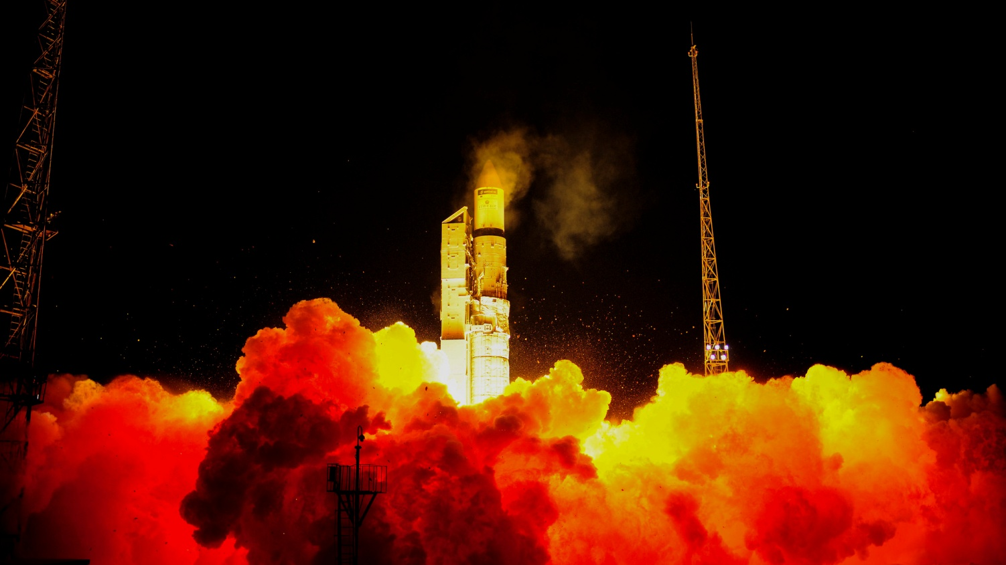
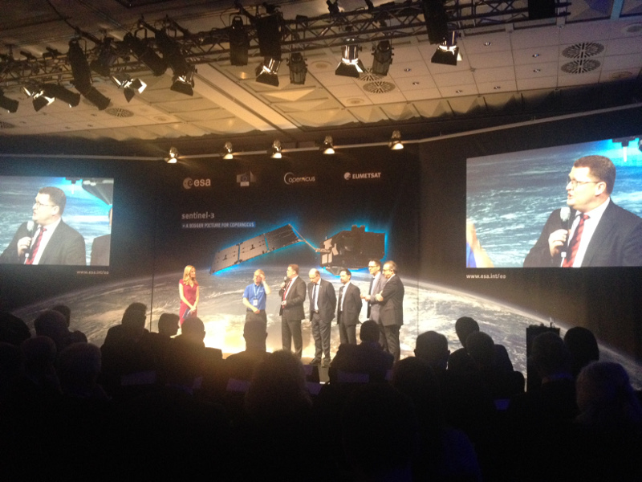
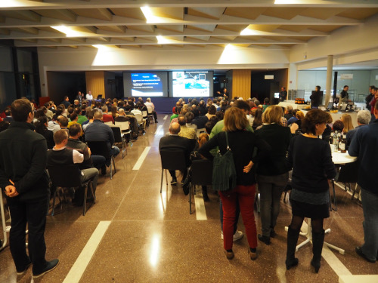


Sentinel-3A has been launched!!!
16 February 2016
17:57 GMT (18:57 CET; 20:57 local time)
Rockot launcher from Plesetsk, Russia

Slide 3

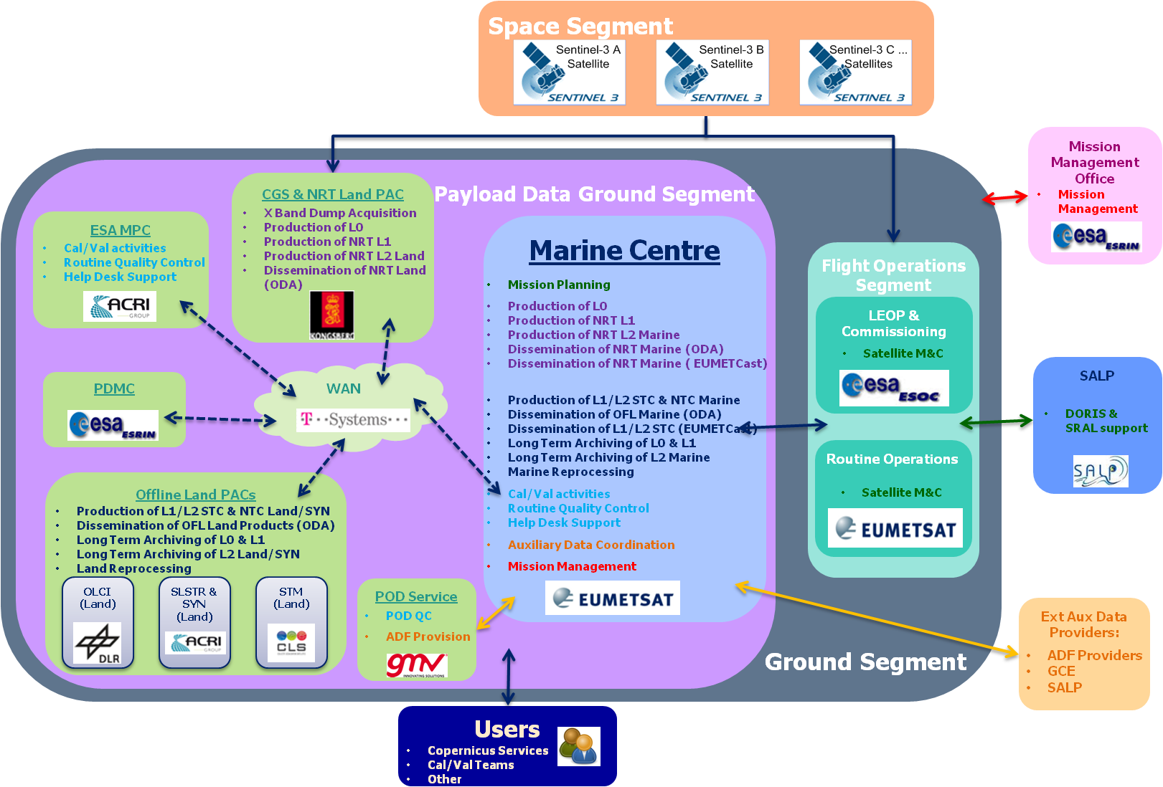


EUMETSAT Marine Centre and Flight Operations

Slide 4
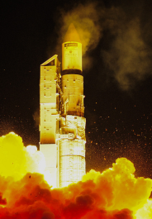







Sentinel-3A timeline
Commissioning Mid-Term Check Point:
Subsets of L0, L1, L2 to authorized users, S3VT
Gradual verification /validation of L2 data products up to official release
OLCI switch-on 29 Feb
In-Orbit Commissioning Review mid-July
Routine Operations Readiness Review
mid-April 2017
Launch 16 Feb
Commissioning (5 months)
Ramp Up (9 months)
Routine Operations
LEOP/SIOV
Satellite Monitoring /Control
ESA ESOC FOS
EUMETSAT Flight Operations Segment (FOS)
Mission Planning
Marine Centre
X Band Dump Acquisition
Core Ground Station
NRT Production
NRT Dissemination
NRT Land Processing and Archiving Centre (PAC)
Marine Centre
Auxiliary Data Coordination
Marine Centre
Goal: L1 Products Available
All Products Available
OLCI OFL Land PAC
Off-line Production
Off-line Dissemination
NRT/Off-line Long Term Archiving
SLSTR & SYN OFL Land PAC
STM OFL Land PAC
Marine Centre
Cal/Val
Routine QC
ESA Mission Performance Centre
EUMETSAT Marine Centre
Mission Management
Mission Management Office
Marine Centre Management

Slide 5
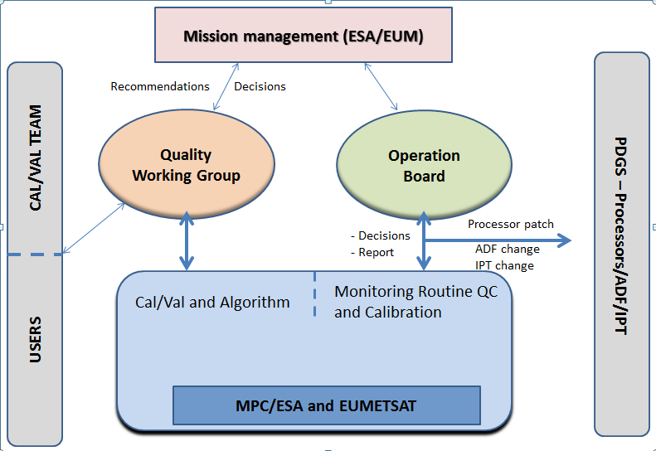
Sentinel-3 Mission Performance Framework
Sentinel-3 Validation Team: S3VT-OC videoconferences continuing
Sentinel-3 Quality Working Groups established: OLCI/SYN QWG, first meeting around IOCR
ESA Mission Performance Centre (MPC): Coordinating Centre and Expert Support Laboratory activities continue
EUMETSAT Mission Performance: in-house activities ongoing
Mission Performance Monitoring Facility (MPMF)

Slide 6
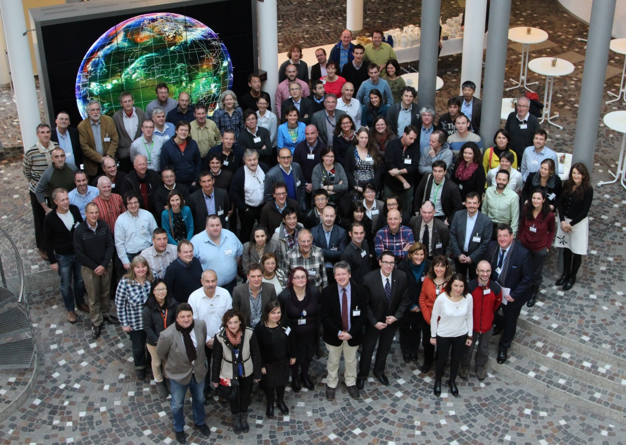
Sentinel-3 Validation Team
S3VT is based on a rolling call, call is continuously open
S3VT provides independent validation evidence for S3 cal/val
S3VT receives early access to Sentinel-3 data and some internal product
S3VT-OC next WebEx meeting 17/18 March
“to engage world-class validation expertise and activities to complement Sentinel-3 routine validation and ensure the best possible outcomes for the Sentinel-3 Mission”
for more information: ewa.kwiatkowska@eumetsat.int or marc.bouvet@esa.int
S3VT Website
http://s3vt.skytek.com/group/s3vt-oc/home
http://www.eumetsat.int/website/home/TechnicalBulletins/CopernicusUserPreparation/DAT_2437899.html

Slide 7
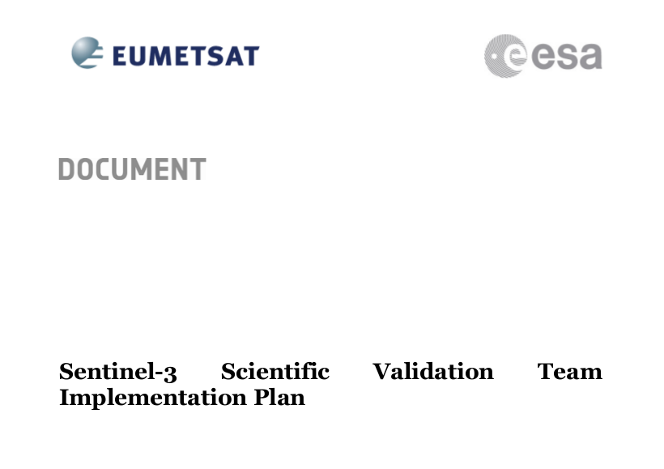
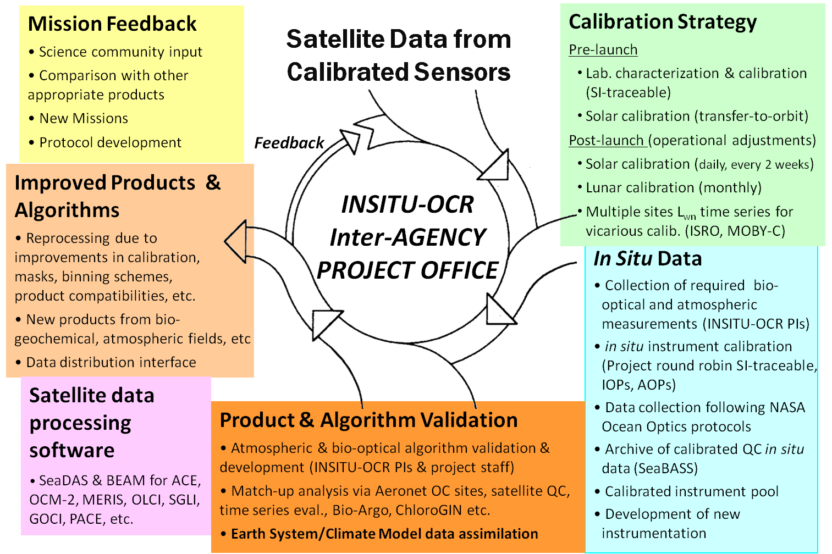
S3VT-OC Implementation Plan recommendations for in situ activities, Fiducial Reference Measurements
S3VT-OC IP in situ recommendations
SI-traceable field instrument calibration
Update of measurement protocols
Support for measurement inter-comparisons/round robins
Sharing of field data with appropriate data policy
Provision of all auxiliary information to allow reprocessings and QC
Standardization of in situ data processing and uncertainties
Input from INSITU-OCR / WG on In Situ Measurement Protocols
Data provision standards, metadata
Data provision format (inter-agency standard template)
Inter-operable databases
Data processing (community processor) calculating measurement error budget

Slide 8
EUMETSAT Sentinel-3 ocean colour evolutions
Product development currently under discussion with Copernicus Marine Environment Monitoring Service (CMEMS)
Vicarious calibration infrastructure for Copernicus: cooperation and planning with partners (ESA, CMEMS), study Step 1 issued soon
  Step 1: Scientific, Technical, Service Requirements
  Step 2: Preliminary Design, Project Plan and Costing
  Step 3: Technical Definition, Specifications, Detailed Design
  Step 4: Development, Testing and Demonstration in the Field
  Step 5: Operations
L2 algorithm improvements
Multi-water product (1 year study in the plan)
New products
EUMETSAT EUMITS - INVITATION TO TENDER SYSTEM
16212309 Copernicus Ocean Colour Vicarious Study 1st Quarter 2016
Sentinel-3 OLCI L2 operational products | Algorithms
Normalised Water Leaving Reflectances | Antoine Morel 1999
Chlorophyll Concentration in open ocean | Morel 2007 OC4ME
Chlorophyll Concentration in coastal waters | Doerffer NN
Total suspended matter concentration | Doerffer NN
Diffuse attenuation coefficient | Morel 2007
Coloured Detrital and Dissolved Material absorption | Doerffer NN
Photosynthetically active radiation | iPAR Aiken Moore 1997
Aerosol Optical Depth over water | Antoine Morel 1999
Aerosol Angstrom exponent over water | Antoine Morel 1999
Integrated Water Vapour Column | Lindstrot 2012 1-D Var
Notes:
IOPs, PFTs, carbon, fluorescence

Slide 9
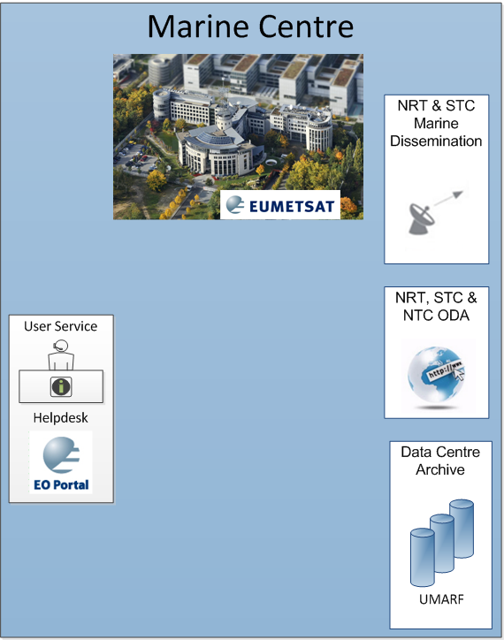
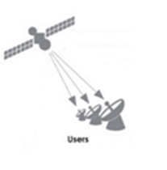

EUMETSAT Marine Centre data access
  Helpdesk: ops@eumetsat.int
EUMETCast
Main method of disseminating NRT data at EUMETSAT. It involves satellite and terrestrial methods.
User Support
User Registration and Support, Product Discovery, Helpdesk, etc
Online Data Access (ODA)
Rolling archive of 1 month of data supporting ftp/http access
EUMETSAT Data Centre
Complete historical archive of all EUMETSAT data including S-3 marine data

Slide 10
EUMETSAT Sentinel-3 user marine products
Product | EUMET Cast sat | ODA | Data Centre | Timeliness | Resolution | Size per orbit uncompressed (comp.) (GB) | Product Unit Length
SLSTR SL_L1_RBT |  | ✓ | ✓ | NRT, NTC | full | 69.5 (29.0) | Frame [3 min]
SLSTR SL_L2_WST (GHRSST L2P) | ✓ | ✓ | ✓ | NRT | full | 2.3 (0.75) | Frame [3 min]
 |  | ✓ | ✓ | NTC | full | 2.3 (0.75) | Full orbit
OLCI OL_1_EFR | ✓ | ✓ | ✓ | NRT | full | 28.6 (21.5) | Frame [3 min]
 |  | ✓ | ✓ | NTC | full | 28.6 (21.5) | Frame [3 min]
OLCI OL_1_ERR | ✓ | ✓ | ✓ | NRT | reduced | 1.9 (1.4) | Full daylight orbit [2666 sec]
 |  | ✓ | ✓ | NTC | reduced | 1.9 (1.4) | Full daylight orbit [2666 sec]
OLCI OL_2_WFR |  | ✓ | ✓ | NRT, NTC | full | 28.4 (14.2) | Frame [3 min]
OLCI OL_2_WRR | ✓ | ✓ | ✓ | NRT | reduced | 1.9 (0.95) | Full daylight orbit [2666 sec]
 |  | ✓ | ✓ | NTC | reduced | 1.9 (0.95) | Full daylight orbit [2666 sec]
SRAL SR_1_SRA | ✓ | ✓ | ✓ | NRT | full | 0.42 | Full orbit dump
 |  | ✓ | ✓ | STC, NTC | full | 0.42 | Half orbit
SRAL SR_2_WAT | ✓ | ✓ | ✓ | NRT, STC | full | 0.2 | Full orbit dump
 |  | ✓ | ✓ | NTC | full | 0.2 | Half orbit
http://www.eumetsat.int/website/home/TechnicalBulletins/CopernicusUserPreparation/DAT_2649694.html

Slide 11
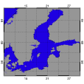
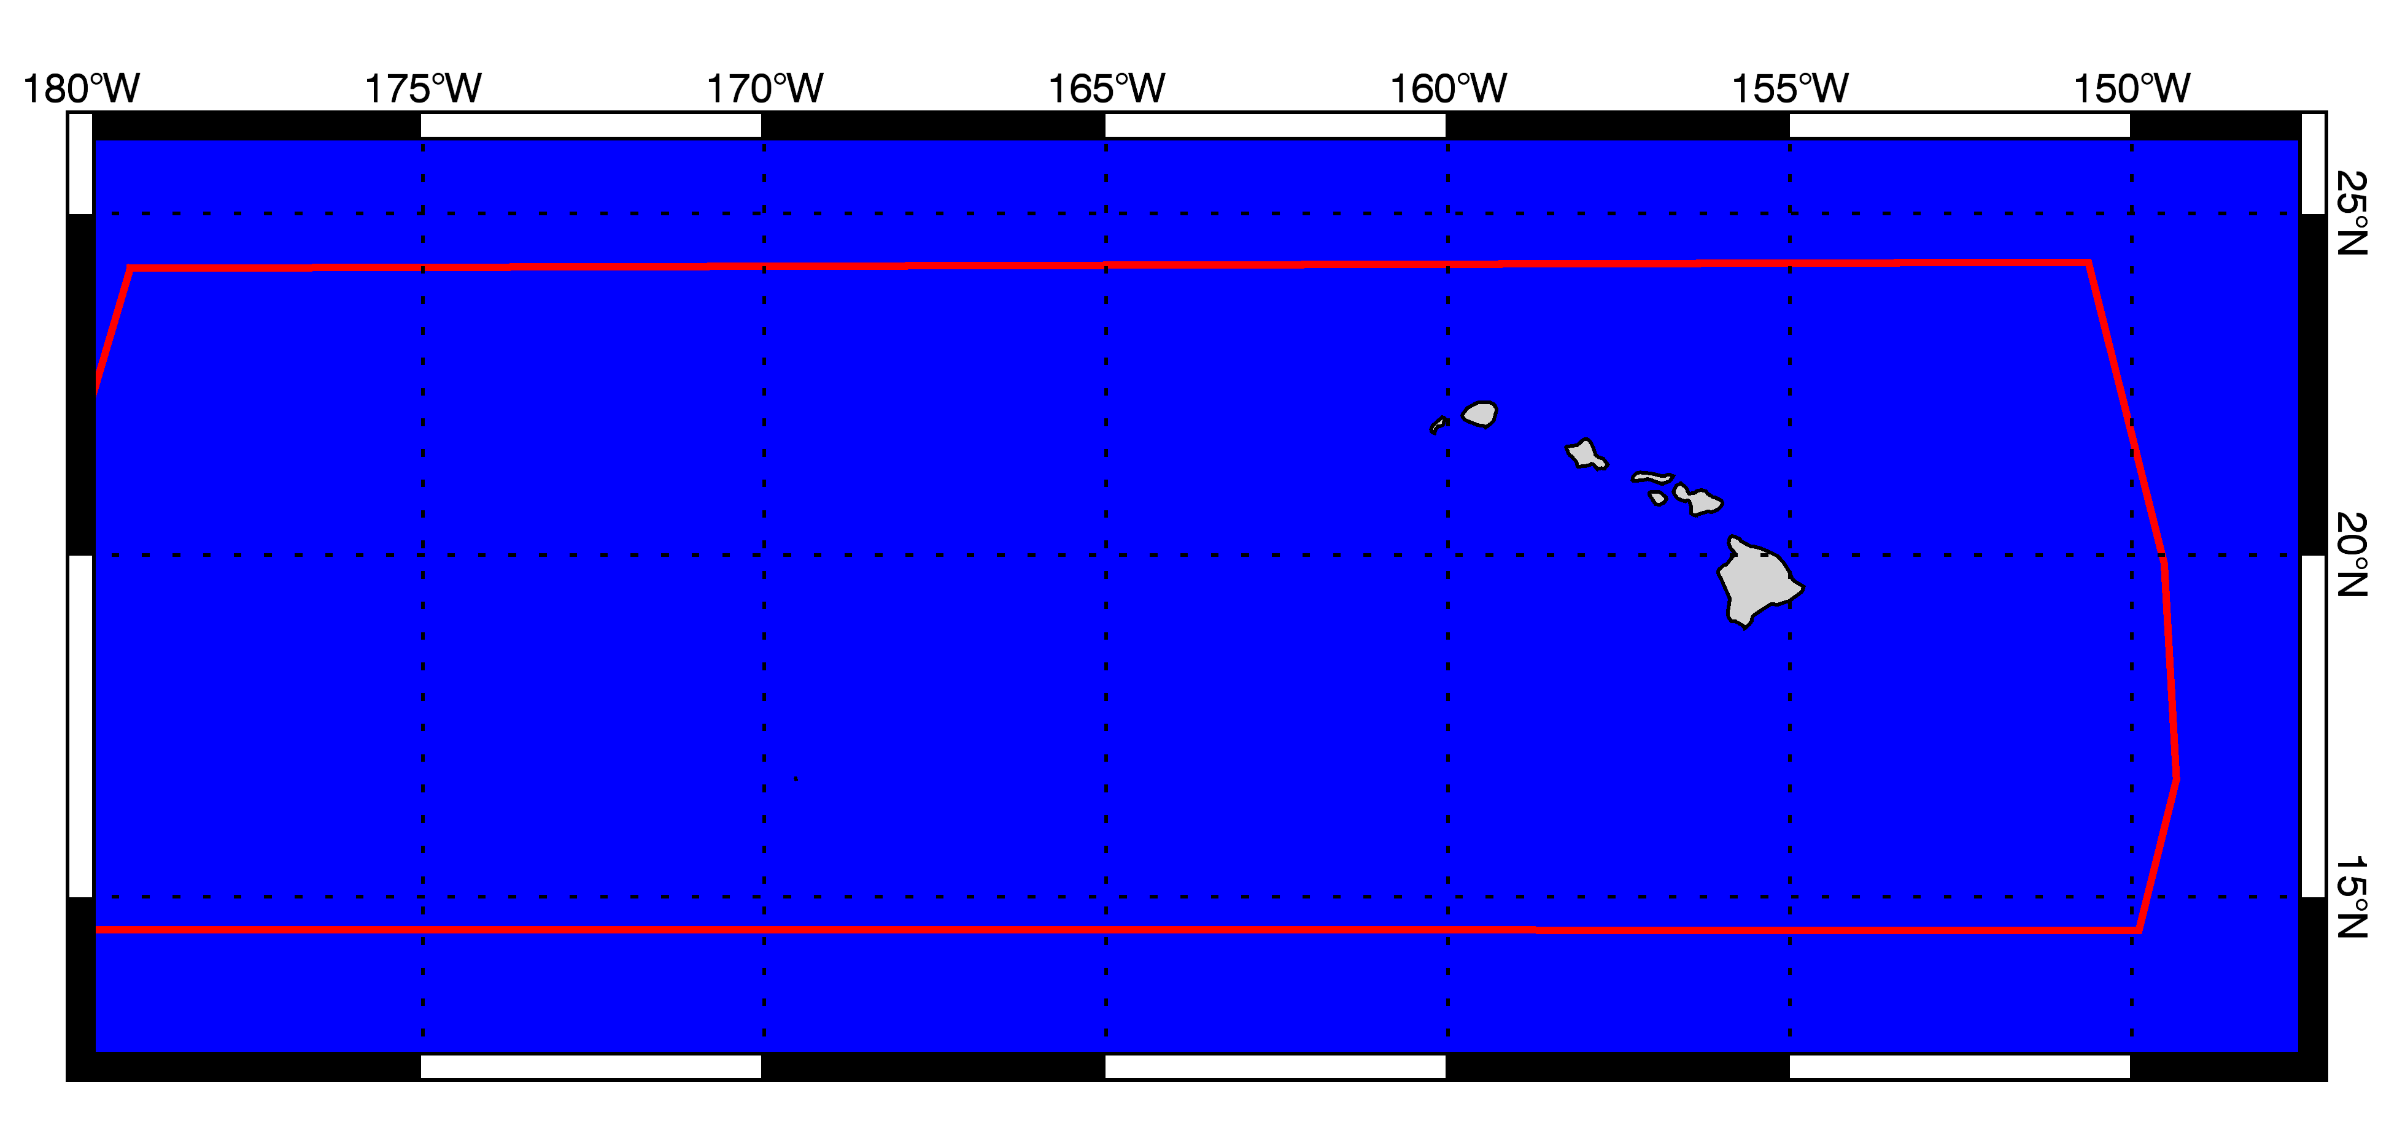

EUMETSAT Sentinel-3 data dissemination
Timeliness Categories | EUMETCast satellite | ODA | Data Centre
Near Real Time (NRT) – 3h | √ | √ | √
Short Time Critical (STC) – 48h | √ | √ | √
Non Time Critical (NTC) – 30d |  | √ | √
Reprocessed – ad hoc |  |  | √
Product Types | EUMETCast | ODA | Data Centre
User Products (operations: all users, commissioning: S3VT) | √ (selected products) | √ | √
Internal Products (authorised users, S3VT) |  | √ | √
Datasets (all users) |  | √ | √
Extracts (S3VT) | special ftp access

Slide 12
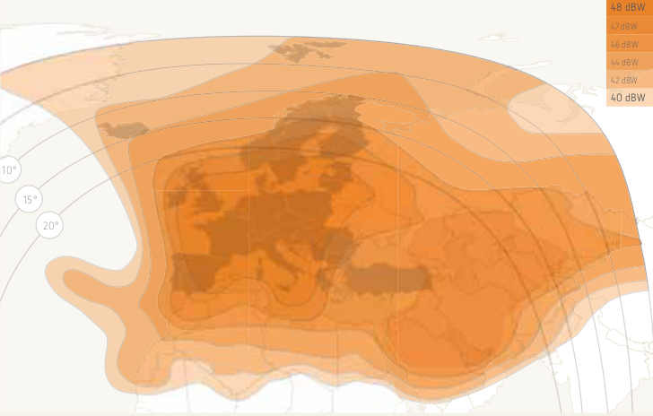
EUMETCast satellite and terrestrial
Currently distributing S3 dummy files (also distributed test data)
EUMETCast satellite over all Europe
Request to the EC to disseminate S3 L2 marine data to Africa via EUMETCast satellite
Set up of EUMETCast terrestrial at NOAA STAR
Set up of EUMETCast terrestrial at National Computational Infrastructure, Canberra, Australia
Definition of EUMETCast terrestrial data requirements

Slide 13
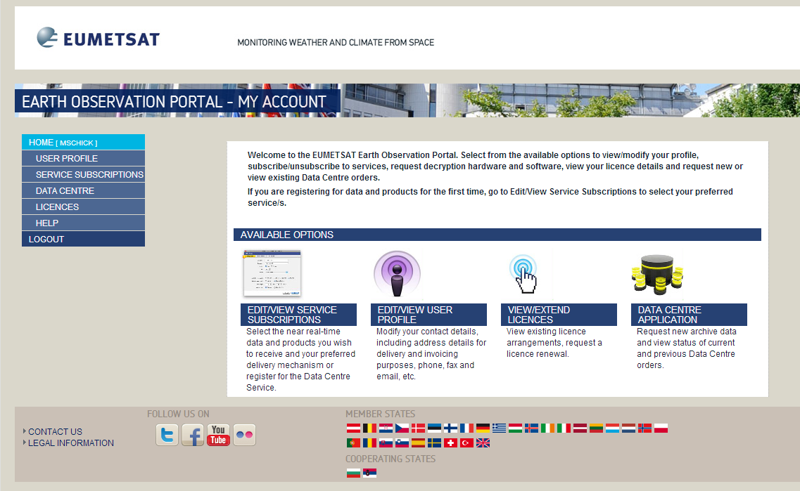
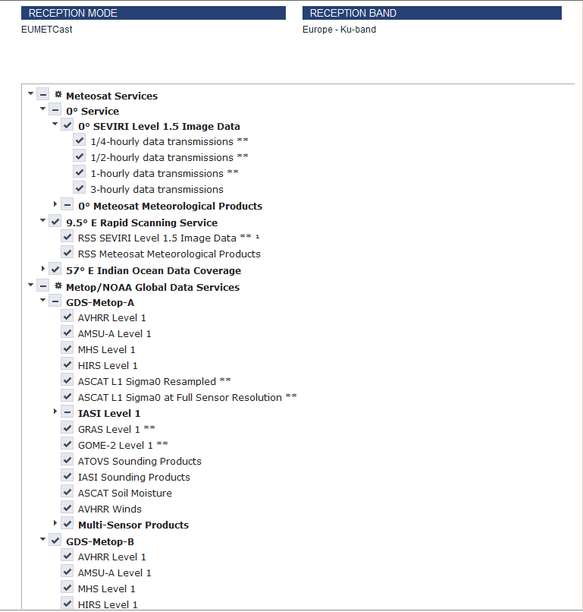
EUMETSAT EO Portal: subscription service open soon
Subscription to data services
  EUMETCast
  Online Data Access
  EUMETSAT Data Centre (Long Term Archive)
EO Portal
  eoportal.eumetsat.int
Product Navigator
  navigator.eumetsat.int
User Notification emails
Helpdesk
  Email: ops@eumetsat.int
http://eoportal.eumetsat.int

Slide 14
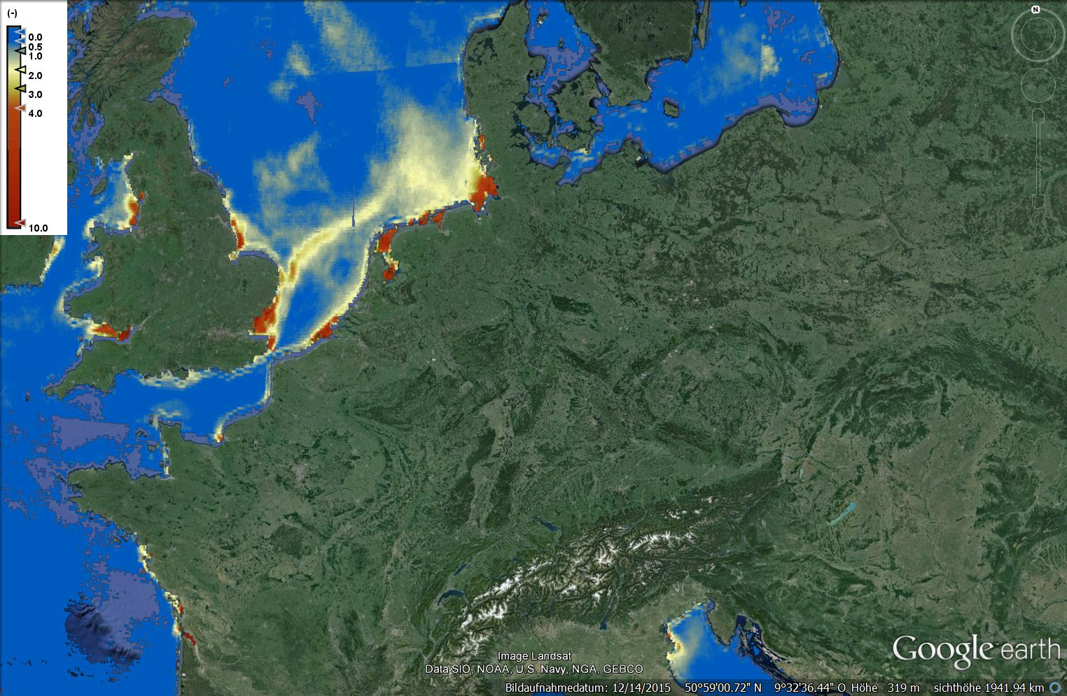
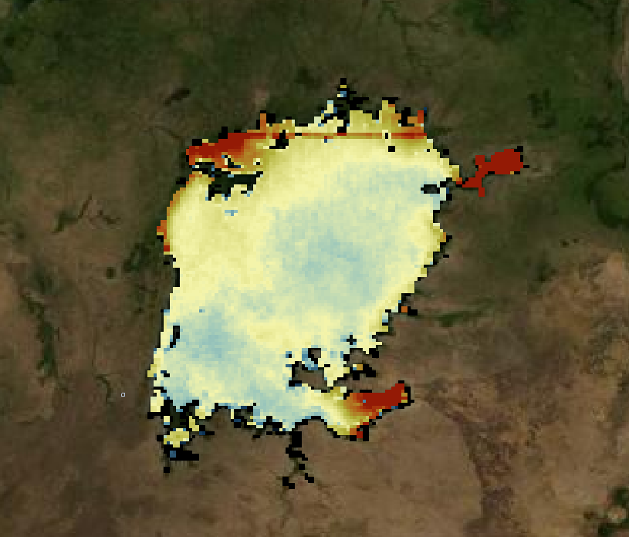

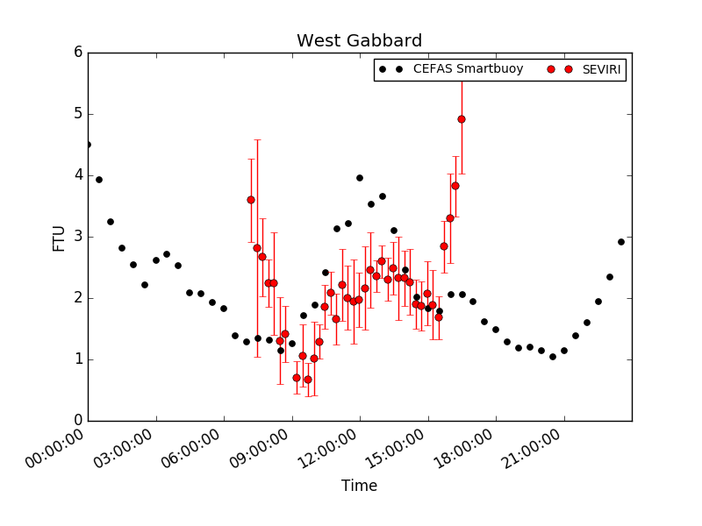
MSG SEVIRI geostationary water turbidity products
Application | Parameter | Spatial Resolution | Temporal | Accuracy requirement
Coastal Water Quality (MSFD) | TUR, SPM, SD | 300m-1km | 1h – 10y+ | threshold
Water quality of European lakes (WFD) | TUR, SD, XCYA | 300m-1km | 1h – 10y+ | threshold
Coastal Water Quality - Africa | TUR, SD, XHAB | ~1km | 1h – 10y+, NRT | scientifically sound
Water quality of African lakes | TUR, SD, XCYA | 300m-1km | 1h – 10y+ | scientifically sound
Sediment Transport | TUR, SPM | 10m-1km | 1h – 10y+ | absolute
Ecosystem modelling (eutrophication) | KdPAR/ZE, SPM | 1-10km | 1h – 10y+, some NRT | uncertainty per pixel
Offshore diving operations | TUR (… HVIS) | 1-100m? | 10m – 6h, NRT | scientifically sound
Carbon burial by coccolithophores | COCCO | ~10km? | 1h – 10y+ | unknown
Support for ocean colour validation | Rrs | 300m-1km | 5m – 10y+ | absolute
User requirements
Scientific development
Prototype processor
TUR (NTU)
Lake Victoria, Africa
Planning
Time series reprocessing
MTG feasibility

Slide 15

IOCS-2017
IOCCG, the EC, EUMETSAT and ESA co-convening IOCS-2017

