Slide 1
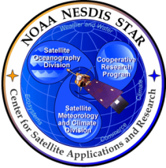


NOAA Ocean Colour Activities: Data, Products and Applications
Paul M. DiGiacomo
NOAA-NESDIS Center for Satellite Applications & Research (STAR)
On behalf of the NOAA Ocean Color Coordinating Group (NOCCG)
IOCCG-21 Committee Meeting
Santa Monica, CA, USA
2 March 2016
IOCCG-21; 1-3 March 2016; Santa Monica, USA 1 of 22

Slide 2
Outline
Mapping NOAA Contributions to IOCCG
INSITU-OCR
NOAA “End-to-End” Ocean Colour
Plans for utilizing data from upcoming
international missions
Ocean color data utilization and end-user
engagement
Conclusions/Summary/Future Directions
IOCCG-21; 1-3 March 2016; Santa Monica, USA 2 of 22

Slide 3
NOAA Contributions to IOCCG INSITU-OCR
Space Sensor Radiometric Calibration, Characterization and Temporal Stability | NOAA
R1.1: Comprehensive pre-launch instrument calibration and characterization | Yes, VIIRS JPSS-1 and JPSS-2
R1.2: Open access to calibration and characterization data
R1.3: Permanent working group on satellite sensor calibration | Yes, NOAA participates
R1.4: Vicarious calibration | Yes, MOBY
R1.5: Support for calibration teams | Yes, VIIRS cal/val teams
R1.6: Assess and correct for instrument degradation | Yes, OC-improved SDRs!
IOCCG-21; 1-3 March 2016; Santa Monica, USA 3 of 22

Slide 4
NOAA Contributions to IOCCG INSITU-OCR
Development and Assessment of Satellite Products | NOAA
R2.1: Distribution of calibrated and uncalibrated data | Yes
R2.2: Permanent working groups on algorithm topics | Yes
R2.3: Product uncertainties | Yes
R2.4: Regional bio-optical algorithms | Working/ Collaborations
R2.5: Open access to source codes for processing algorithms | Yes
R2.6: Long-term field measurement programs | Yes
R2.7: Validation protocols | Yes
R2.8: Level-3 data products generation | Yes
R2.9: Ancillary data | Yes, available
IOCCG-21; 1-3 March 2016; Santa Monica, USA 4 of 22

Slide 5
NOAA Contributions to IOCCG INSITU-OCR
In situ Data Generation and Handling | NOAA
R3.1: Improving traceability of in situ measurements | Yes, in progress
R3.2: Continuous consolidation and update of measurement protocols | Yes, participation with community for best practices
R3.3: Uncertainty budgets | Yes, in progress
R3.4: Quality Assurance of in situ data | Yes, in progress
R3.5: Archival of in situ data | Yes, in progress
R3.6: Community processor for in situ data | Yes, in progress
R3.7: Priority for variables to be collected | Yes, participation with community for best practices
R3.8: General coordination of field campaigns | Yes, with multiple partners
IOCCG-21; 1-3 March 2016; Santa Monica, USA 5 of 22

Slide 6
NOAA Contributions to IOCCG INSITU-OCR
Information Management and Support | NOAA
R4.1: Accessibility and distribution of large volumes of data | Yes, in progress through CoastWatch/OceanWatch, OSPO and NCEI
R4.2: Processing capabilities for calibration and validation activities | Yes
R4.3: Accessibility to documentation | Yes, recently revised OC and NOAA/STAR and JPSS website links
R4.4: Data formats | CF compliant NetCDF
R4.5: Support for open source data processing and visualization | Yes, in progress through CoastWatch/OceanWatch
IOCCG-21; 1-3 March 2016; Santa Monica, USA 6 of 22

Slide 7
NOAA End-to-End Ocean Colour
  NOAA’s End-to-End Ocean Colour:
  Multi-Sensor Level-1 to Level-2 (MSL12) - Measurement-based, mission
  agnostic ocean color data processing system.
  Level-0 (or Raw Data Records (RDR)) to Level-1B (or Sensor Data Records (SDR)).
  Level-1B (SDR) to ocean color Level-2 (Environmental Data Records (EDR).
  Level-2 (EDR) to global Level-3 (e.g., routine daily, 8-day, monthly, and climatology data/images).
On-orbit instrument calibration (solar/lunar) for OCR data processing.
Validation and Quality Monitoring
In situ data collections for Cal/Val activities, e.g., MOBY, AERONET-OC sites,
NOAA dedicated VIIRS validation cruises, etc.
Data distribution - through NOAA CoastWatch/OceanWatch; OSPO; NCEI
Data archiving – NCEI (NOAA Centers for Environmental Information)
IOCCG-21; 1-3 March 2016; Santa Monica, USA 7 of 22

Slide 8
NOAA VIIRS ocean color products
MSL12 (Multi-Sensor Level-1 to Level-2 (MSL12)
- The official VIIRS ocean color data processing system.
Routine ocean color data processing since VIIRS launch.
- Two data streams (NRT and Science Quality)
MSL12 Inputs:
    VIIRS: Visible M1-M7; SWIR M8, M10, and M11 bands; Operational SDR
    Terrain-corrected geo-location file
    Ancillary meteorology and ozone data
Eight “standard” products:
    nLw’s at 5 bands (410, 443, 486, 551, 671 nm)
    chlorophyll;
    Kd(490); Kd(PAR)
    Level-2 quality flags
Experimental Products (examples):
    Inherent Optical Properties (IOP-a, IOP-a_{ph}, IOP-a_{dg}, IOP-b_{b}, IOP-b_{bp}) at VIIRS M2 and others (QAA, Lee)
    Photosynthetically Available Radiation (PAR) (Frouin)
    Chlorophyll-a from ocean color index (OCI) method (Hu et al., 2012)
    Others from users requests
IOCCG-21; 1-3 March 2016; Santa Monica, USA 8 of 22

Slide 9
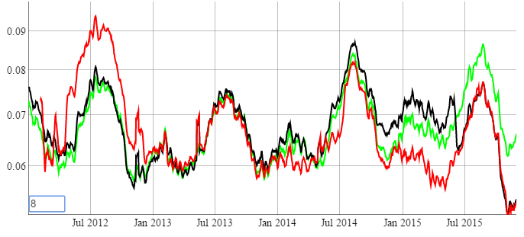
VIIRS Ocean Color SDR
Global Oligotrophic Waters
VIIRS Chl-a
Red: VIIRS IDPS-SDR
Near-real-time data
Black: VIIRS previous OC-SDR (Apr)
Science quality data
Green: VIIRS latest OC-SDR (Dec)
Science quality data
IOCCG-21; 1-3 March 2016; Santa Monica, USA 9 of 22

Slide 10
NOAA VIIRS ocean color products
Two data streams: NRT and Science Quality
Attribute | Near-Real Time | Science Quality Delayed Mode
Latency: | Best effort, as soon as possible (~12-24h) | Best effort, ~1-2 week delay
SDR: | IDPS Operational SDR | OC-improved IDPS SDR
Ancillary Data: | Global Forecast System (GFS) Model | Science quality (assimilated; GDAS) from NCEP
Spatial Coverage: | May be gaps due to various issues | Complete global coverage
Processed by: | MSL12 by CoastWatch now, transferring to OSPO | MSL12 by NOAA/STAR
Distributed by: | CoastWatch, OSPO | CoastWatch, NCEI
Archive Plans: | Yes, NCEI by OSPO | Yes, NCEI by CoastWatch
Reprocessing: | No | Yes, ~2-3 years or as needed
IOCCG-21; 1-3 March 2016; Santa Monica, USA 10 of 22

Slide 11
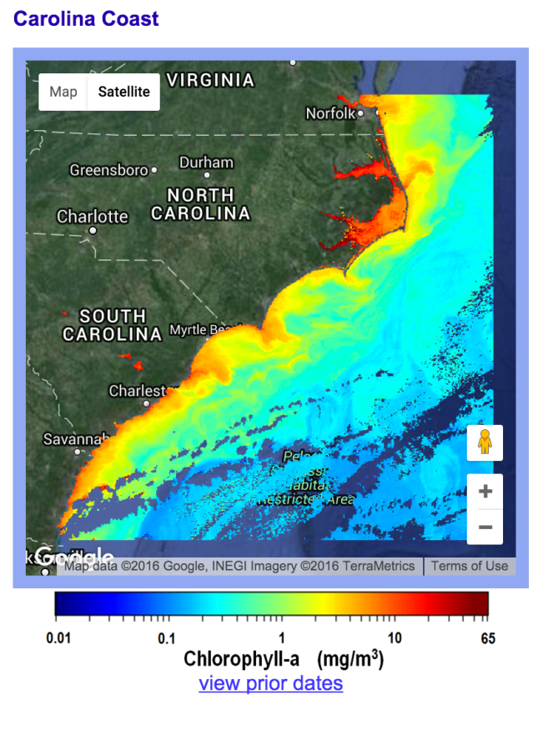
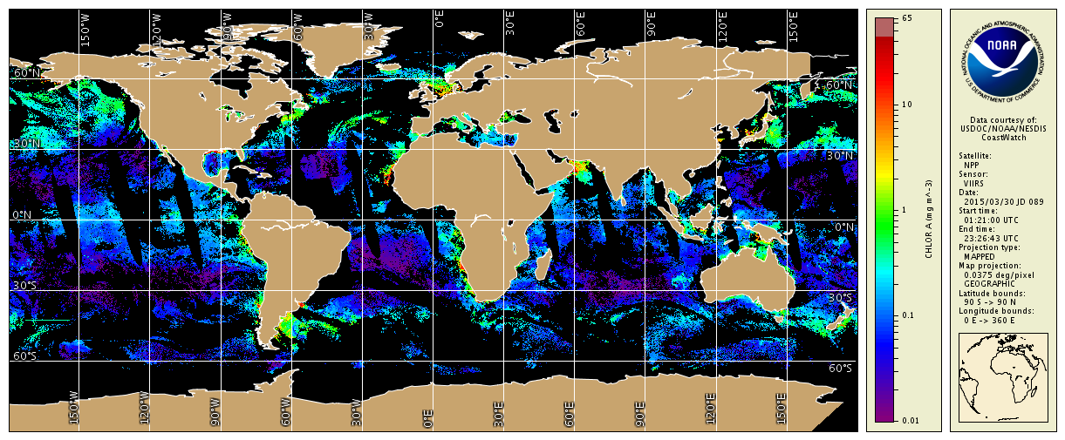
NOAA VIIRS ocean color products
Distribution of NRT and Science Quality Delayed Mode; Reduced (4 km) and Full-Res (750 m) global/regional data, e.g., L2 and L3
IOCCG-21; 1-3 March 2016; Santa Monica, USA 11 of 22

Slide 12
NOAA VIIRS ocean color products
Distribution of NRT and Science Quality Delayed Mode; Reduced (4 km) and Full-Res (750 m) global/regional data, e.g., L2 and L3
Full Mission VIIRS Science Quality (reprocessed) global dataset will be available in mid-2016;
Ongoing future reprocessing as appropriate (~2-3 years)
Data access through NOAA CoastWatch/OceanWatch
Formal archiving through NOAA/NESDIS/NCEI
IOCCG-21; 1-3 March 2016; Santa Monica, USA 12 of 22

Slide 13
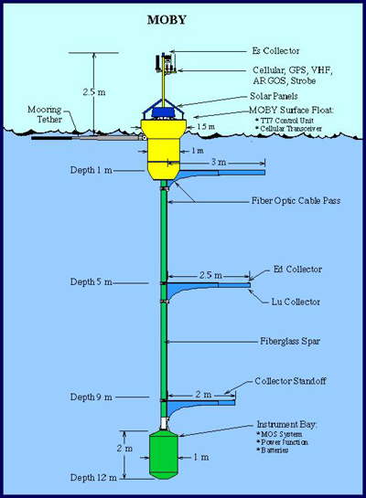
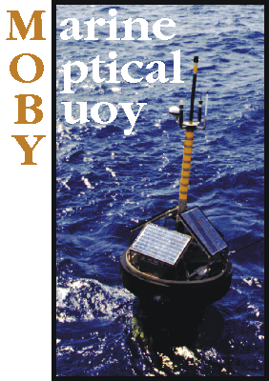
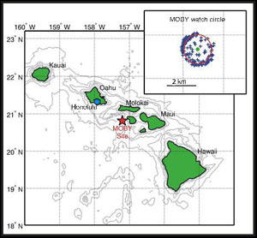

MOBY
NOAA Support of MOBY and MOBY Refresh
MOBY data are freely available from:
http://www.star.nesdis.noaa.gov/sod/moby/
IOCCG-21; 1-3 March 2016; Santa Monica, USA 13 of 22

Slide 14
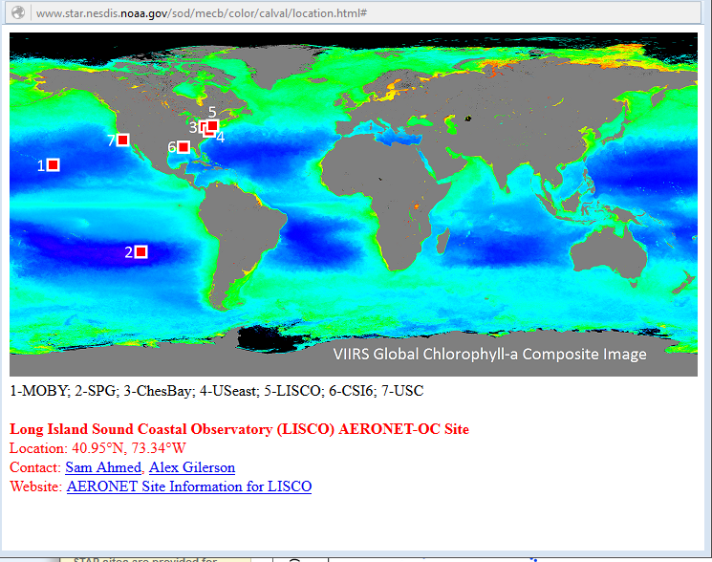
AERONET-OC
NOAA Support of 3 AERONET-OC
Site | Full Name | Location
CSI | WaveCIS_CSI¹ | Gulf of Mexico
LISCO | Long Island Sound Coastal Observatory | 2 miles off shore on Western Long Island Sound
USC | Univ. Southern California SEAPRISM² | 18 km off the coast of Newport Beach, CA
NOAA is currently working to establish an AERONET-OC Lake Site at Lake Erie (with NOAA/GLERL and Univ. of NH).
AERONET-OC data obtained from: http://aeronet.gsfc.nasa.gov/new_web/ocean_color.html
We thank AERONET-OC PIs and the NASA AERONET program
IOCCG-21; 1-3 March 2016; Santa Monica, USA 14 of 22

Slide 15
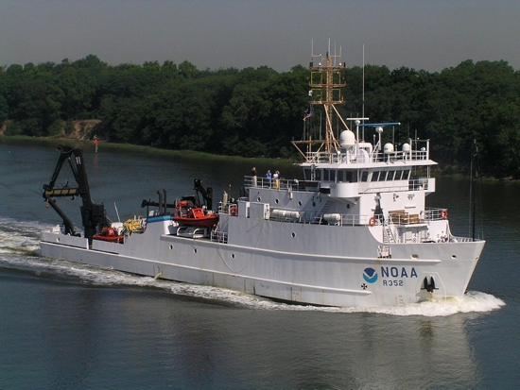
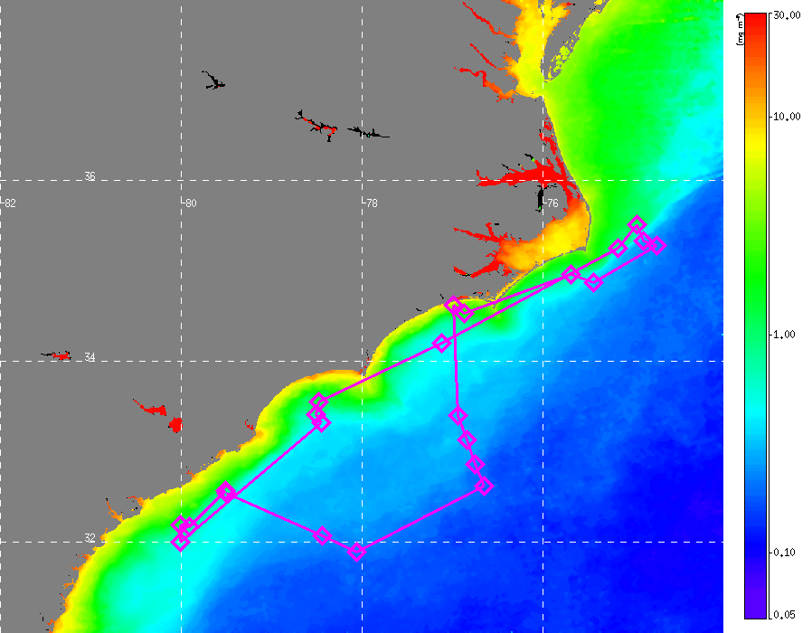
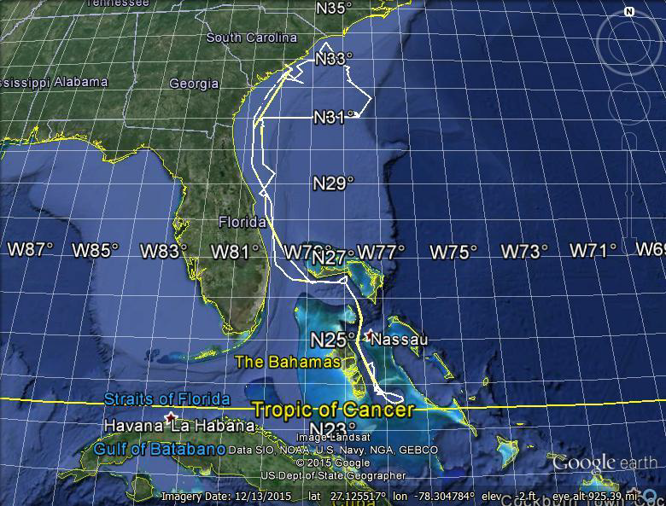
Dedicated (Annual) VIIRS Cal/Val Cruises
NOAA Ship Nancy Foster
Instrument Calibrations at NOAA
with NIST
Nov. 2014 Cruise Track
VIIRS Chlorophyll-a
Oct.-Dec. 2014
Measurements
Water-leaving radiances (hyper- and multi-spectral);
Chlorophyll-a and other pigments;
Absorption and backscattering coefficients;
Bi-directional radiance distribution; Phytoplankton physiology;
Carbon (POC, DOC)
CDOM
Total suspended matter;
Aerosol optical depth;
etc.
International, Interagency, and
Academic Collaborations:
4 US Agencies, EU-JRC, 6 Universities
Dec. 2015 Cruise Track
Also Underway
Flowthrough
http://dx.doi.org/10.7289/V52B8W0Z
IOCCG-21; 1-3 March 2016; Santa Monica, USA 15 of 22
Notes:
Recent and planned collaborations
VIIRS Cal/Val team member observations and collaborations (Hawaii, Puerto Rico, West Fla., Gulf of Mexico, California Coast, etc.)
NOAA Ocean Acidification Program
East Coast (ECOA Jun-Jul 2015)
West Coast (WCOA May-Jun 2016
Collaboration with NASA/GSFC and Korean Institute of Ocean Science and Technology (KIOST) on KORUS-OC field campaign (May-Jun 2016)
Planned Collaboration with Australia
AIMS
CSIRO

Slide 16
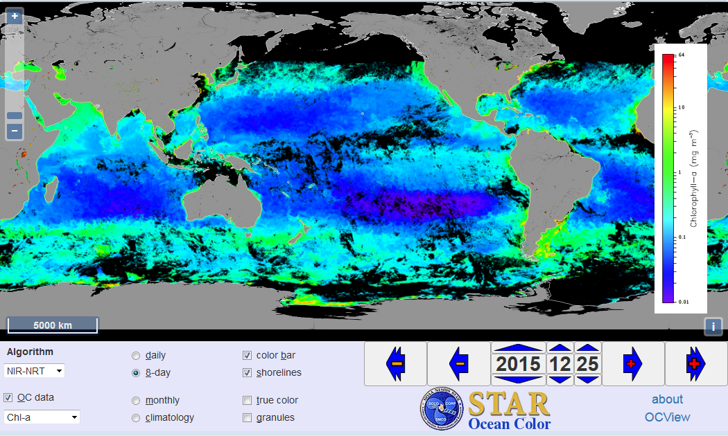
VIIRS Ocean Color Image from interactive
“OCView”
17-25 December 2015
Chlorophyll-a
http://www.star.nesdis.noaa.gov/sod/mecb/color/
IOCCG-21; 1-3 March 2016; Santa Monica, USA 16 of 22

Slide 17
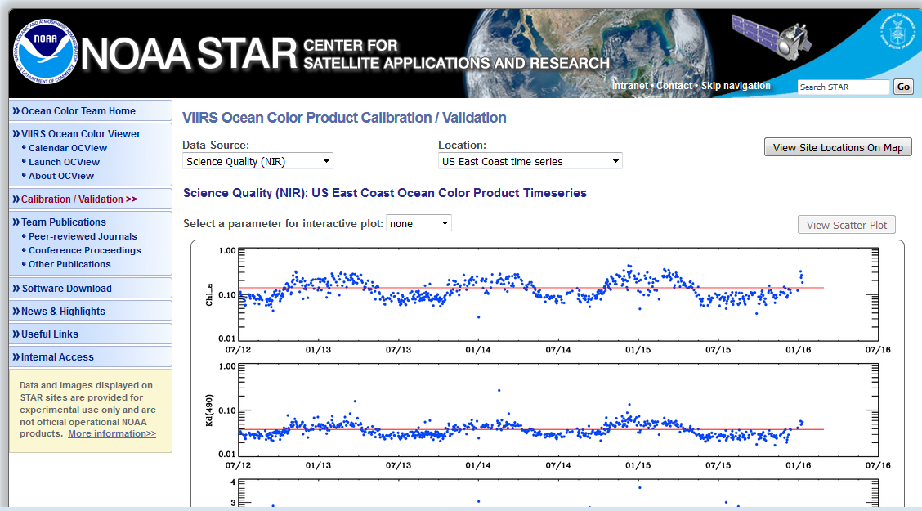
Ocean Color Quality Monitoring
http://www.star.nesdis.noaa.gov/sod/mecb/color/
IOCCG-21; 1-3 March 2016; Santa Monica, USA 17 of 22

Slide 18
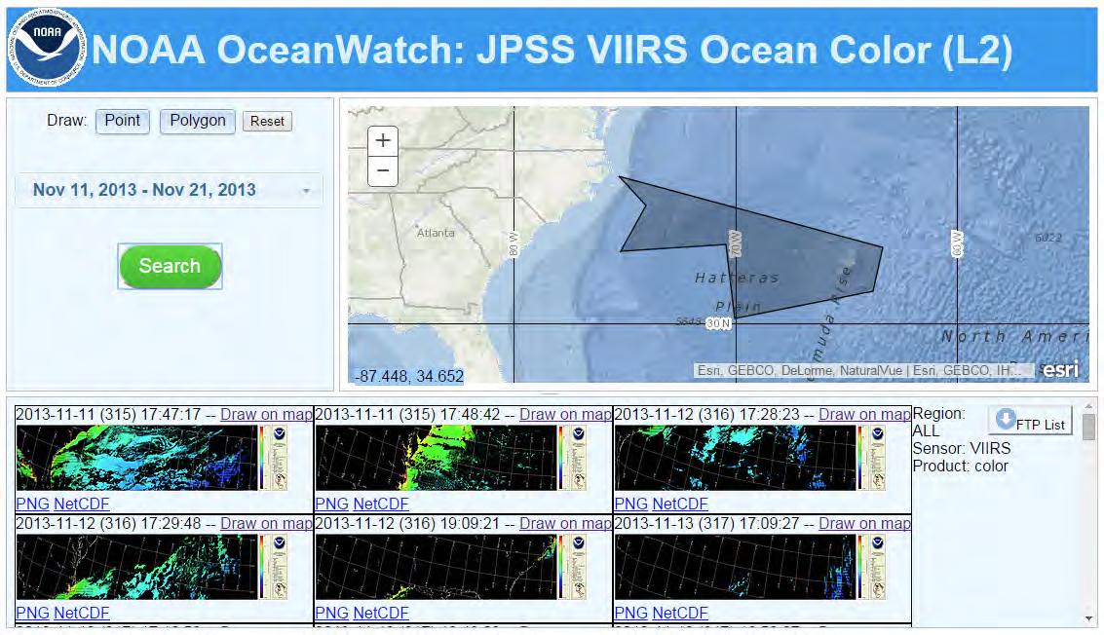
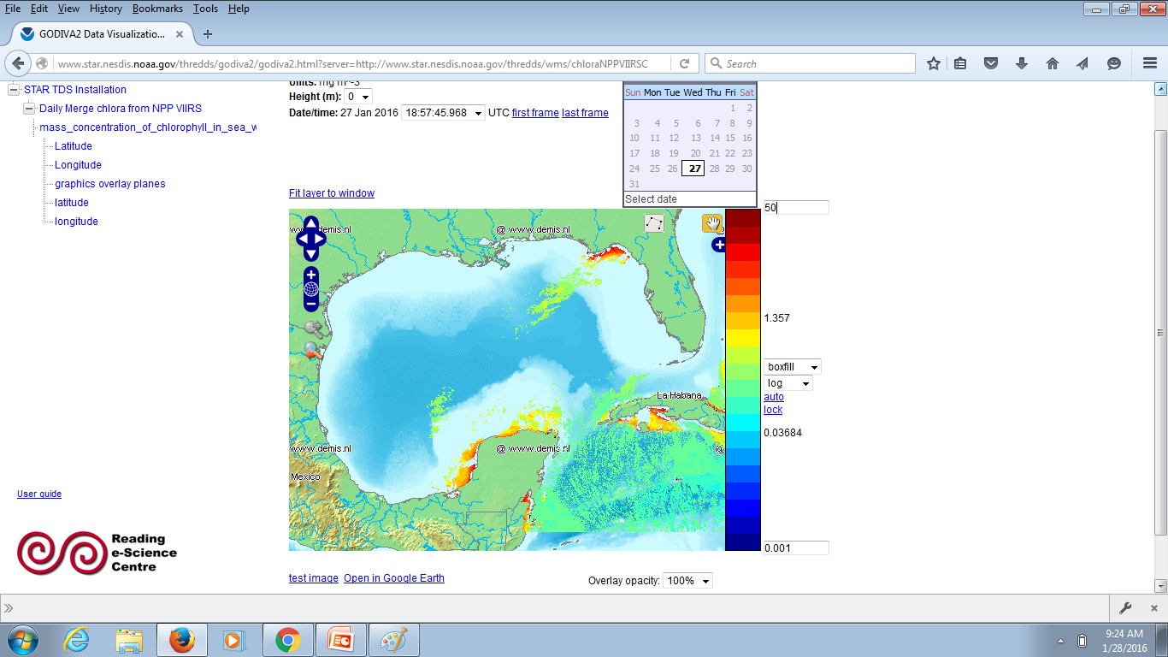
CoastWatch/OceanWatch
Data Distribution
Examples of polygon L2 granule selector tool
←
And
L3 visualization tool
↓
IOCCG-21; 1-3 March 2016; Santa Monica, USA 18 of 22

Slide 19
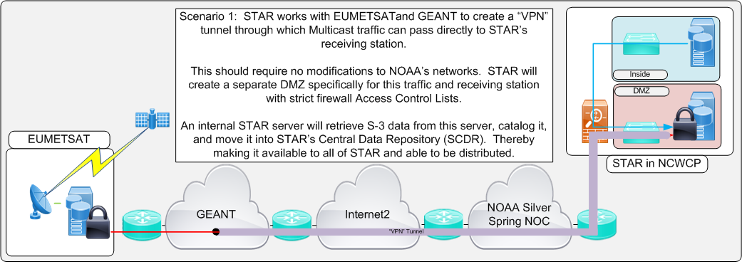
Non-NOAA (Ocean Colour) Satellite Data at NOAA
United States and European Union Sign Cooperation Arrangement on Copernicus Earth Observation Data (Oct. 2015)
NOAA and EUMETSAT are working on sub-level technical arrangements
NOAA will be primary distributor of Sentinel-3 OLCI ocean colour data from EUMETSAT to US users
With the cooperation of EUMETSAT, NOAA has established a multi-cast link, has accessed test data through this channel and is now ready to receive Sentinel-3 data.
IOCCG-21; 1-3 March 2016; Santa Monica, USA 19 of 22

Slide 20
NOAA Ocean Color Users/Apps (VIIRS et al.)
Examples within NOAA:
Fisheries (NMFS) – “Integrated Ecosystem Assessment” stock management;
Operational ocean physical and biogeochemical modelling (NWS)- toward operational ocean modeling (phys/BGC)/Bio, data assimilation & forecasting
HAB forecasting; NOAA Sanctuaries (research and management) (NOS)
Isoprene emissions; Ocean Acidification Program (OAR)
Ecosystem Forecasting (NESDIS): - support of infrastructure to use satellite data
CoastWatch/OceanWatch: Central – Tailoring VIIRS ocean color products for
downstream users; Distribution portal for users; Nodes - NOAA Chesapeake
Bay Office (Chesapeake “Atlantis” modelling)
Coral Reef Watch: Puerto Rico project – Light and temperature stress
product (based on K_{d}(490); also, suspended sediment load product
And others
IOCCG-21; 1-3 March 2016; Santa Monica, USA 20 of 22

Slide 21
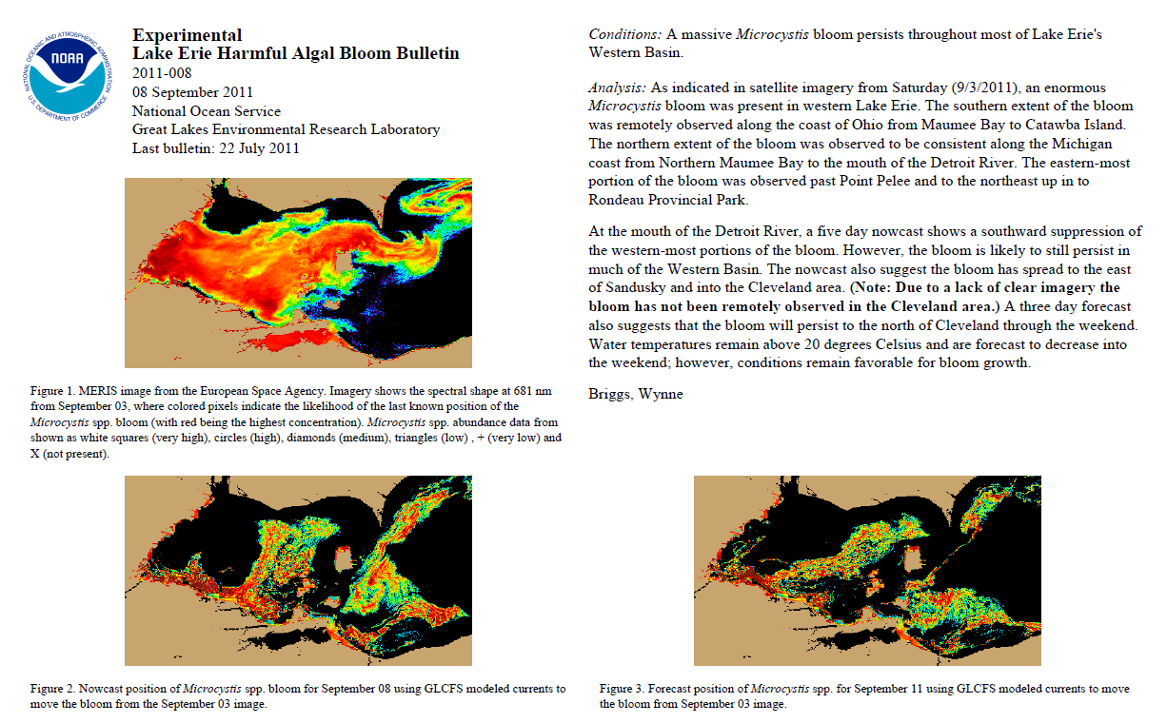

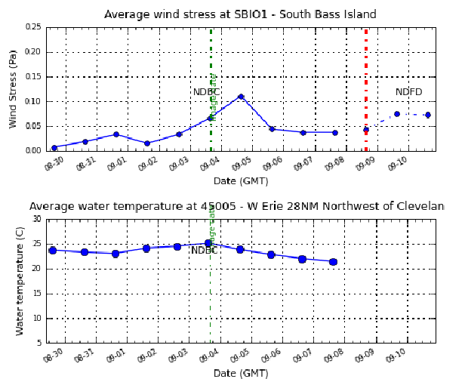
NOAA Lake Erie HAB Bulletin
(MERIS 2009-2011, now MODIS, soon Sentinel-3/OLCI!)
Bloom from MERIS
Forecast (with Great Lakes CFS)

Slide 22
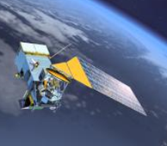
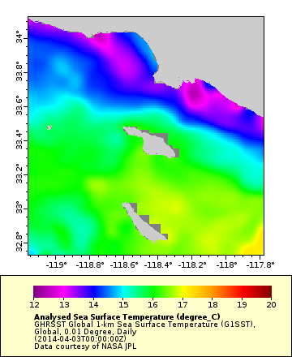
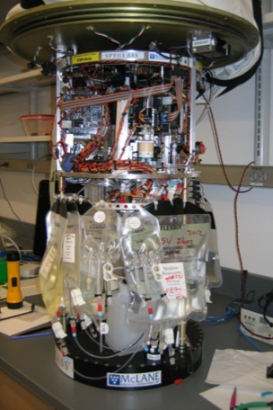
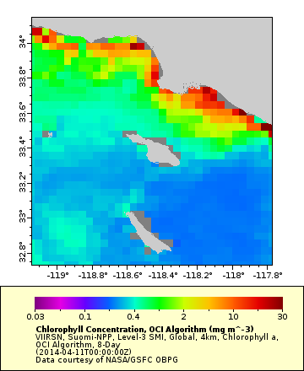
Satellite & Subsurface Remote Sensing: potential influence
of an upwelling event on HAB dynamics in San Pedro Bay, CA
Gregory J. Doucette, National Ocean Service
1
2
Purple line (1): peak of upwelling event revealed by GHRSST data, corresponding to the appearance of cells in HAB genus, Pseudo-nitzschia (PN), at ESPmack mooring
ESPmack
GHRSST: San Pedro Bay, CA; 1-day composite (2014-04-03)
Environmental Sample Processor (ESPmack): subsurface HAB & toxin detection at mooring ( )
Observations
GHRSST data revealed strong upwelling event at ESP mooring preceding toxic HAB
VIIRS chlorophyll data consistent with PN HAB associated with upwelling event
HAB DA toxicity peaked during upwelling relaxation period
Blue line (2): peak of domoic acid (DA) concentration following upwelling relaxation & corresponding to high VIIRS chl signature & continued presence of Pseudo-nitzschia cells at ESPmack mooring
ESPmack
VIIRS Chl: San Pedro Bay, CA; 8-day composite (2014-04-11)
August 2015
Notes:
Greg’s travel was paid for by the JPSS VSP. This slide produced during the 3-day NOAA Satellite Course in 2015. Greg didn’t think he should come to the course because he wasn’t sure how he would use satellite data, he just wanted to learn more about the data streams. This is one of the best slides we’ve ever received, and it was made entirely during the course, showing easy it is for participants to discover, access and start using data.

Slide 23
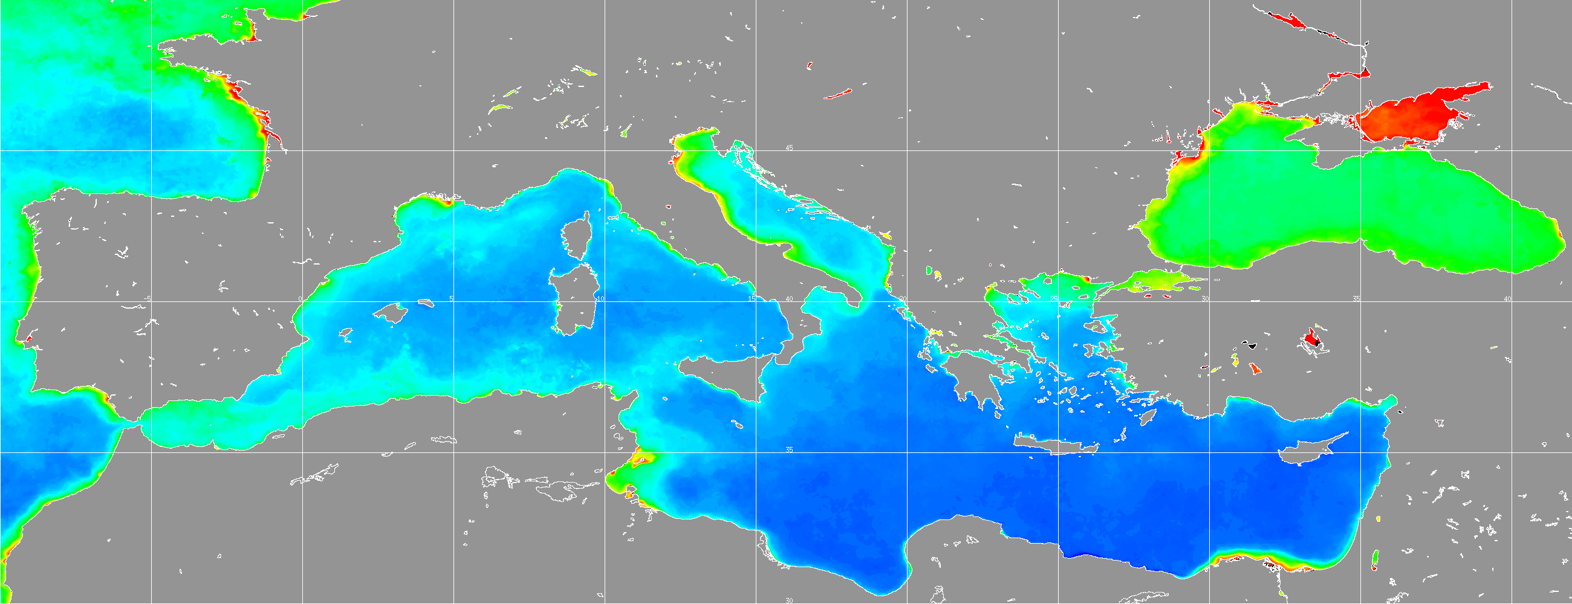
NOAA/VIIRS Ocean Color Users
Examples outside NOAA:
EUMETSAT: Mediterranean Region; Copernicus Program
CSIRO: New partnerships, developing new uses
Resource managers
University researchers: (e.g., many at Ocean Sciences)
And others
IOCCG-21; 1-3 March 2016; Santa Monica, USA 23 of 22

Slide 24
Conclusions/Summary/Future Directions
With improved SDR (calibration) and EDR (data processing algorithms), VIIRS ocean color
products are now comparable to or better than those from MODIS-Aqua. VIIRS-SNPP is
capable of providing high-quality global ocean color products in support of science
research and operational applications.
Initial VIIRS mission-long science quality ocean color data reprocessing (including SDR and
EDR), will finish in mid-2016.
Two data streams will be produced: near-real-time and delayed-mode science quality
ocean color data products.
Calibration from both solar and lunar is necessary; significant efforts underway.
More in situ data are needed for validation and improvement of VIIRS ocean color products
(VIIRS dedicated cruises, collaborations, etc.). Also emerging efforts - PFTs et al.
Actively working with other current and future ocean color sensors, e.g., MODIS-Aqua,
EUMETSAT for Sentinel-3, Korean GOCI, JAXA GCOM-C (launch early 2017), and VIIRS on J1
(launch 2017).
IOCCG-21; 1-3 March 2016; Santa Monica, USA 24 of 22

Slide 25
GEO Blue Planet Initiative
NOAA is co-hosting the GEO Blue Planet Secretariat in partnership with CSIRO, with NOAA having employed a dedicated Scientific Coordinator and CSIRO
supporting a dedicated
Technical Manager. This
is viewed as a significant
contribution by CEOS to the Blue Planet Initiative.
IOCCG-21; 1-3 March 2016; Santa Monica, USA 25 of 22

Slide 26
END
Thank you
IOCCG-21; 1-3 March 2016; Santa Monica, USA 26 of 22

Slide 27
Additional/Backup Slides
Additional/Backup Slides
IOCCG-21; 1-3 March 2016; Santa Monica, USA 27 of 22

Slide 28
VIIRS
VIIRS Ocean Color Team
NOAA VIIRS EDR ocean color products
  MSL12
  VIIRS EDR Products
  Cal/Val (e.g. VIIRS OC-SDR; MOBY; AERONET-OC; dedicated In situ program and other collaborations and observations of opportunity)
  Reprocessing
OC Web site and Monitoring
Distribution and Archiving
IOCCG-21; 1-3 March 2016; Santa Monica, USA 28 of 22

Slide 29
VIIRS Ocean Color Team
Name | Organization | Task
Menghua Wang (OC EDR & Cal/Val Lead), L. Jiang, X. Liu, W. Shi, S. Son, L. Tan, X. Wang, J. Sun, K. Mikelsons, V. Lance, M. Ondrusek, E. Stengel | NOAA/NESDIS/ STAR | Leads – Ocean Color EDR Team & Cal/Val Team OC products, algorithms, SDR, EDR, Cal/Val, vicarious cal., refinements, data processing, algorithm improvements, software updates, data validations and analyses
Robert Arnone Sherwin Ladner, Ryan Vandermeulen Adam Lawson, Paul Martinolich, Jen Bowers | U. Southern MS NRL QinetiQ Corp. SDSU | Coordination Look Up Tables – SDR-EDR impacts, vicarious calibration Satellite matchup tool (SAVANT) – Golden Regions cruise participation WAVE_CIS (AERONET site)
Carol Johnson | NIST | Traceability, AERONET Uncertainty
Curt Davis, Nicholas Tufillaro | OSU | Ocean color validation, Cruise data matchup West Coast
Burt Jones, Matthew Ragan | USC | Eureka (AERONET Site)
Sam Ahmed, Alex Gilerson | CCNY | LISCO (AERONET site) Cruise data and matchup
Chuanmin Hu | USF | NOAA data continuity
Ken Voss & MOBY team | RSMAS –Miami | Marine Optical Buoy (MOBY)
Zhongping Lee, Jianwei Wei | UMB | Ocean color IOP data validation and evaluation Ocean color optics matchup
Working with: NOAA CoastWatch, VIIRS SDR team (C. Cao, F. DeLuccia, X. Xiong), DPA/DPE (R. Williamson, Neal Baker), Raytheon, NOAA OC Working Group, NOAA various line-office reps, NASA OBPG (K. Turpie, et al.), NOAA OCPOP, etc.
Collaborators: D. Antoine (BOUSSOLE), B. Holben (NASA-GSFC), G. Zibordi (JRC-Italy), R. Frouin (for PAR), and many others.
IOCCG-21; 1-3 March 2016; Santa Monica, USA 29 of 22

Slide 30
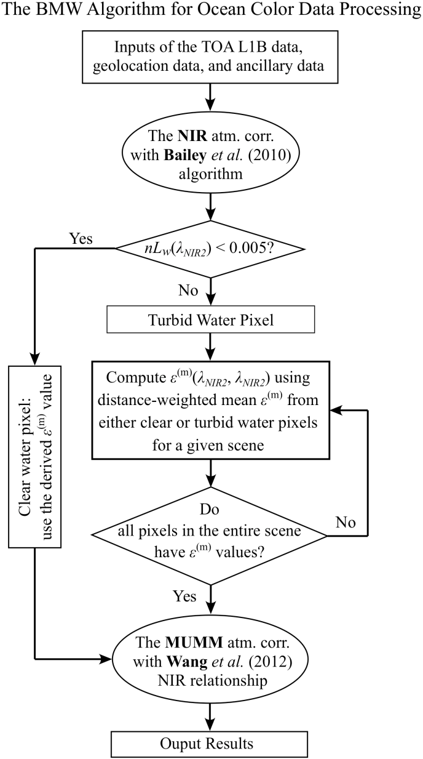
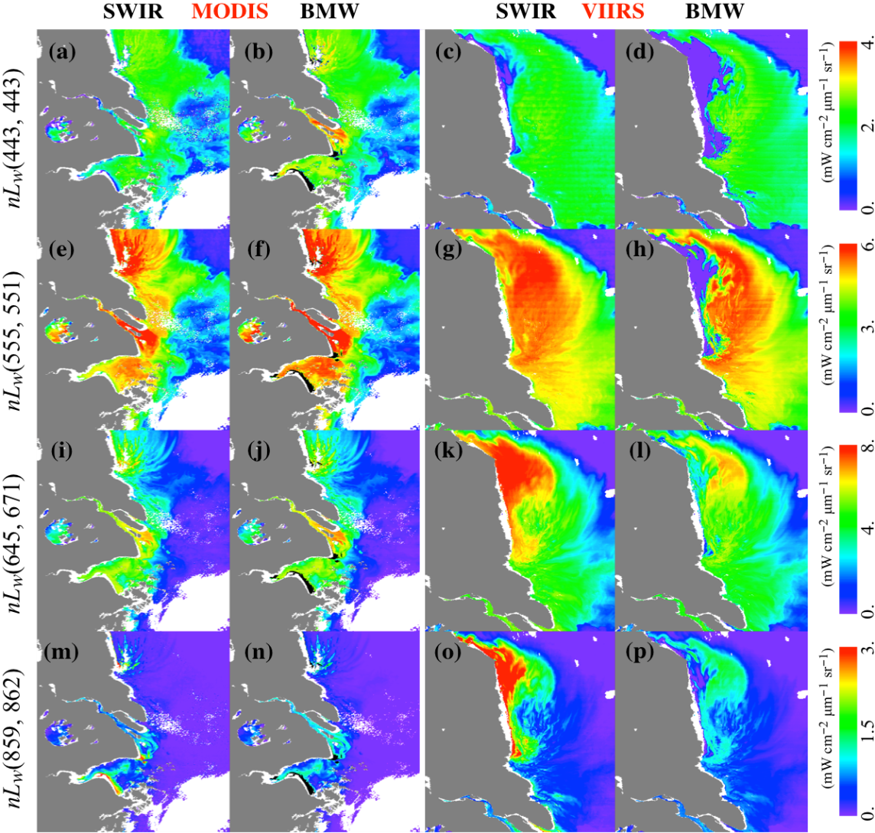
BMW (Bailey (2010), MUMM (2000), and Wang (2012)):
A new NIR ocean reflectance correction algorithm
Comparisons of MODIS and VIIRS-derived nL_{w}(λ) images at four selected bands.
Jiang, L. and M. Wang, “Improved near-infrared ocean reflectance correction algorithm for satellite ocean color data processing,” Opt. Express, 22, 21,657–21,678, 2014. http://dx.doi.org/10.1364/OE.22.021657
IOCCG-21; 1-3 March 2016; Santa Monica, USA 30 of 22

Slide 31
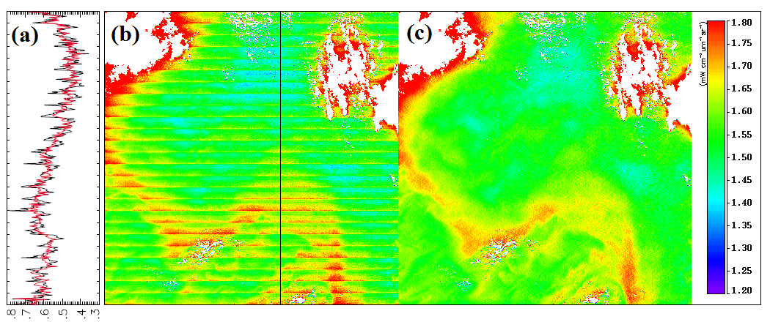
Destriping of VIIRS Ocean Color Products
nL_{w}(412)
Mikelsons, K., M. Wang, L. Jiang, and M. Bouali, “Destriping algorithm for improved satellite-derived ocean color product imagery,” Opt. Express, 22, 28058-28070, 2014. http://dx.doi.org/10.1364/OE.22.028058
IOCCG-21; 1-3 March 2016; Santa Monica, USA 31 of 22

Slide 32
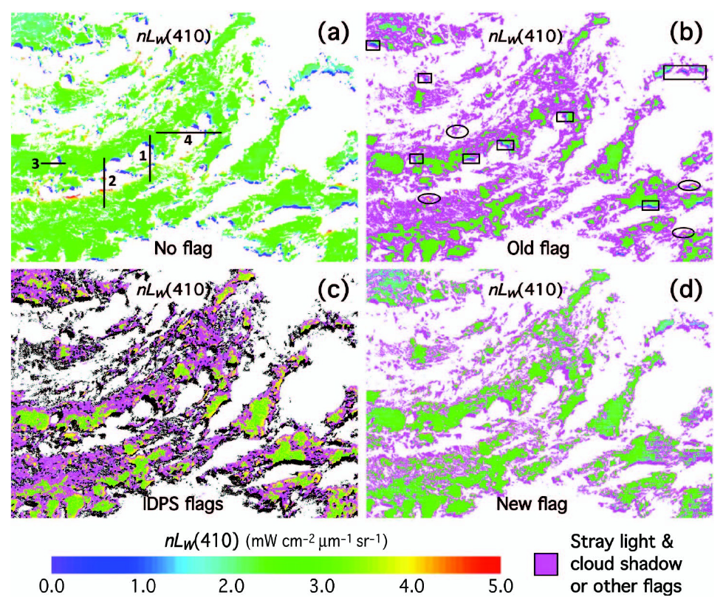
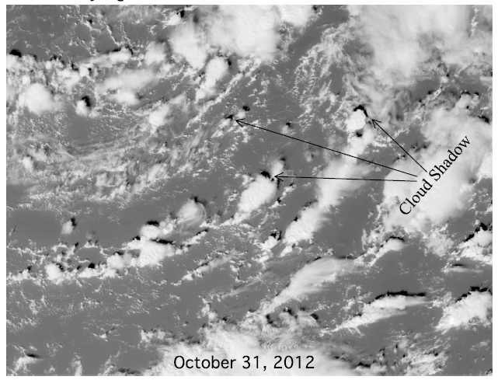
Stray Light & Cloud Shadow Effects
Jiang, L. and M. Wang, “Identification of pixels with stray light and cloud shadow contaminations in the satellite ocean color data processing,” Appl. Opt., 52, 6757–6770, 2013. http://dx.doi.org/10.1364/AO.52.006757
IOCCG-21; 1-3 March 2016; Santa Monica, USA 32 of 22

Slide 33
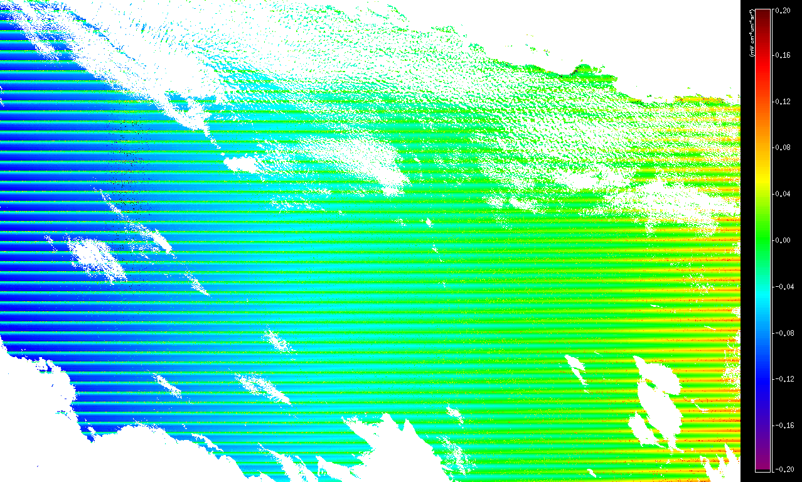
Polarization Correction
Difference = nL_{w}(412, polcor) – nL_{w}(412, nopolcor)
nL_{w}(412, polcor) increased in the right side, make it more uniform
IOCCG-21; 1-3 March 2016; Santa Monica, USA 33 of 22

Slide 34
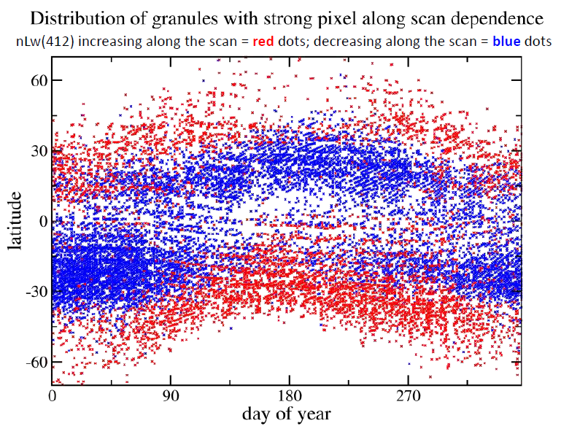
VIIRS MSL12 Ocean Color Statistical Evaluation
Dependence on pixel along the scan correlated with deviation in dependence on solar zenith angle (for low values of this angle)
Granules with strongest pixel along the scan dependence have distinct seasonal / latitude dependence
IOCCG-21; 1-3 March 2016; Santa Monica, USA 34 of 22

Slide 35
VIIRS OC-SDR
SD/SDSM and Lunar Calibrations
Hybrid and SD Calibration Coefficients
SDSM Calibration
  SDSM is a ratio radiometer
  Accurate SD screen VFs and SD BRFs
  Careful sweet spots selection
SD Calibration
  SD has a near Lambertian property
  Accurate SD screen VF and SD BRFs
  Improved H-factors
  Careful sweet spot selection
Lunar Calibration
  Moon is very stable in its reflectance
  View geometric effect correction
Symbols: Hybrid
Lines: SD
Green: VIIRS IDPS; Blue: MOBY in Situ
Red: VIIRS Hybrid (NOAA Ocean Color Team)
Normalized Water -leaving Radiance
nL_{w}(551), M4
Developed Hybrid Approach
  SD calibration has long-term bias due to SD degradation non-uniformity and others
  Lunar calibration provides long-term baseline
  SD calibration provides smoothness and frequency
Hawaii
    J. Sun and M. Wang (2014, 2015a, 2015b, 2015c)
IOCCG-21; 1-3 March 2016; Santa Monica, USA 35 of 22
Notes:
SDSM – solar diffuser stability monitor
VF – vignette function
BRF – Bidirectional reflectance function
J. Sun and M. Wang, “On-orbit characterization of the VIIRS solar diffuser and solar diffuser screen," Appl. Opt., 54, 236 -252(2015).
J. Sun and M. Wang, “Visible infrared image radiometer suite solar diffuser calibration and its challenges using solar diffuser stability monitor,” Appl. Opt., 53, 8571-8584 (2014).
J. Sun and M. Wang, “On-orbit calibration of Visible Infrared Imaging Radiometer Suite reflective solar bands and its challenges using a solar,” Appl. Opt., 54, 7210-7223 (2015).
J. Sun and M. Wang, ““Radiometric Calibration of the VIIRS Reflective Solar Bands with Robust Characterizations and Hybrid Calibration Coefficients,” Appl. Opt.,54, 9331-9342 (2015).
M. Wang, et al, “Evaluation of VIIRS ocean color products,” Proc. SPIE 9261, 92610E (2014).

Slide 36
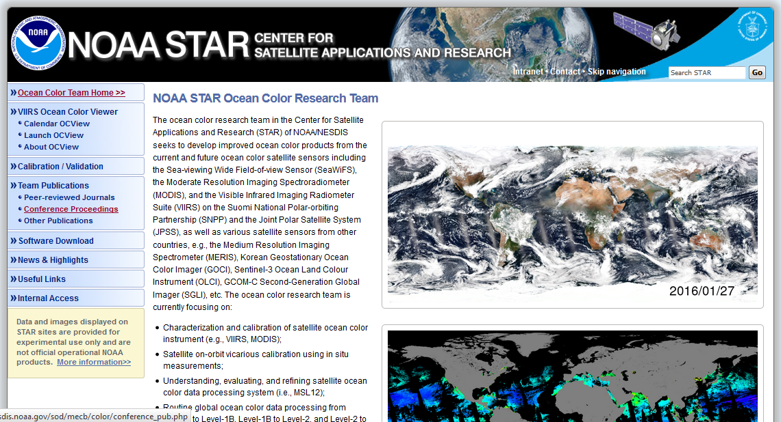
NOAA STAR Ocean Color Website and Monitoring
http://www.star.nesdis.noaa.gov/sod/mecb/color/
IOCCG-21; 1-3 March 2016; Santa Monica, USA 36 of 22

Slide 37
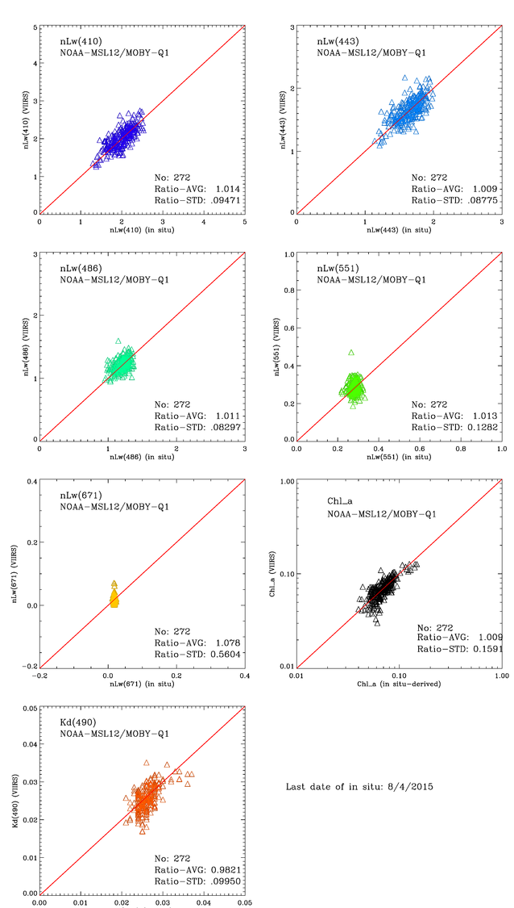
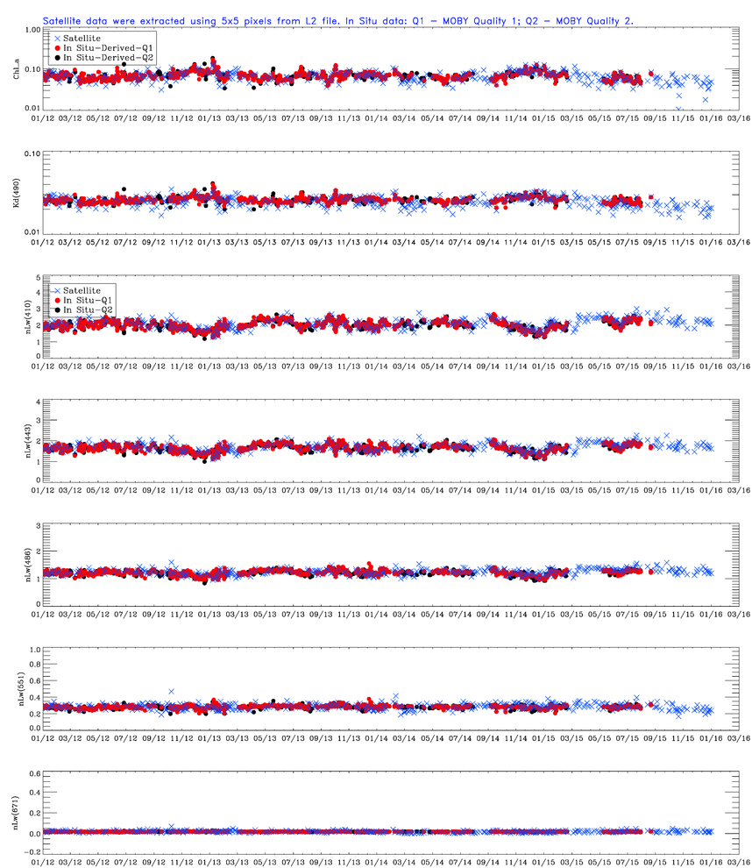
Ocean Color Quality Monitoring
Science quality MOBY match ups
IOCCG-21; 1-3 March 2016; Santa Monica, USA 37 of 22
Notes:
MOBY
AERONET-OC
NOAA VIIRS Cal/Val Team dataset
NASA SeaBASS dataset
Compared with MODIS-Aqua at Hawaii and SPG
VIIRS global images compared with those from MODIS-Aqua

Slide 38
Other collaborations and observations of opportunity
Recent and planned collaborations
VIIRS Cal/Val team member observations and collaborations (Hawaii, Puerto Rico, West Fla., Gulf of Mexico, California Coast, etc.)
NOAA Ocean Acidification Program
  East Coast (ECOA Jun-Jul 2015)
  West Coast (WCOA May-Jun 2016
Collaboration with NASA/GSFC and Korean Institute of Ocean Science and Technology (KIOST) on KORUS-OC field campaign (May-Jun 2016)
Planned Collaboration with Australia
  AIMS
  CSIRO
Oct.-Dec. 2014
IOCCG-21; 1-3 March 2016; Santa Monica, USA 38 of 22

Slide 39
Other collaborations and observations of opportunity
CoastWatch/OceanWatch Ocean Color Products
VIIRS
A)
8 Products: Chlorophyll, Kd(490), Kd(PAR) nLw’s at 5 bands (nominal 412, 445, 555, 672, 865)
Global, full resolution, Daily granules (L2)
Global 750m, mapped (L3) Daily, by sector (x24 sectors)
Global, 4km, mapped (L3) Daily, Rolling 7-day, Calendar Month
B)
Chlorophyll, Kd(490), Kd(PAR)
Regional (CONUS and International Partners) 750m daily mapped (L3)
C)
Special products for NOAA and Partner Users (i.e. HAB anomalies for CONUS regions, Rrs-672, 61 day baselines, etc.)
MODIS Aqua
Chlorophyll
Regional (GL, GoM, WC) 1km swath (L2)
Regional (Ches, Lake Er, PR) 250m swath (L2)
MODIS Terra
Chlorophyll
Regional (GL, GoM) 1km swath (L2)
Regional (Ches, Lake Er, PR) 250m swath (L2)
Oct.-Dec. 2014
IOCCG-21; 1-3 March 2016; Santa Monica, USA 39 of 22

