Slide 1
Sensible Earth Network: Enhancing Access to Earth Observations for Societal Benefit
Clarissa Anderson, UC Santa Cruz
CJ Reynolds, Univ. of South Florida
Frank Muller-Karger, Univ. of South Florida

Slide 2
RATIONALE
Major obstacles hindering adequate exchange of NASA Earth Observation (EO) products for societal use are:
EO data awareness
access/flow of EO data
lack of remote sensing/technical expertise among social scientists

Slide 3
GOALS
Create a sophisticated networking database to facilitate information and data exchange between Earth science experts and non-academic/non-governmental entities in support of critical conservation or socioeconomic issues
Improve connections between scientists, practitioners, and end users

Slide 4
KEY PARTNERS & ADVISORS
Future Earth – Coasts (formerly LOICZ)
International Association of Impact Assessment (IAIA)
Fondation pour la Protection de la Biodiversité Marine (FoProBim)
Center for Biological Diversity
World Resources Institute
Google Earth Engine
Notes:
Emphasis on international organizations

Slide 5
FUTURE PARTNERS?
ESA
CEOS
UN Convention on Biological Diversity
Intergovernmental-Science Policy Platform on Biodiversity and Ecosystem Services (IPBES)
Notes:
Emphasis on international organizations

Slide 6
DATABASE ARCHITECTURE
Self-populating database of remote sensing experts and social scientists
Sorted by topics
natural resource use
habitat type
target organism
geographical region
type of EO data product

Slide 7
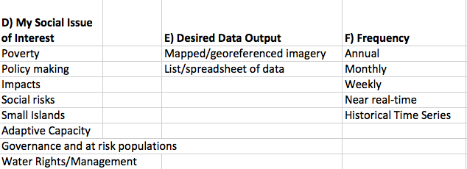
Search Fields – criteria served as drop-downs; determined by the end-users & experts

Slide 8
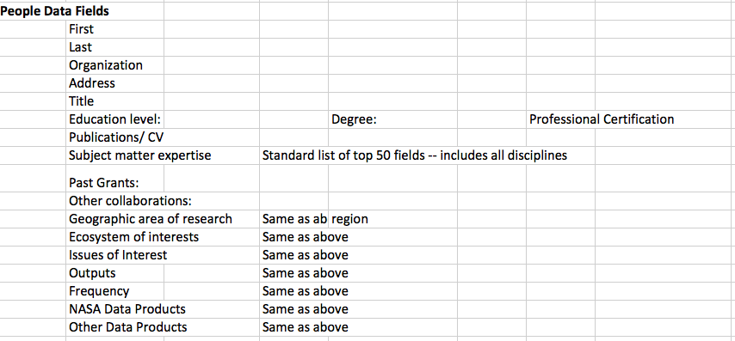
Populating the Expert List

Slide 9
CASE STUDY
We will focus on key issues facing coastal communities in Small Island Developing States to conduct assessments and implement workshops
Haitian NGO/MPA (FoProBim) – working with director Jean Weiner to establish needs & communication for mangrove conservation
Connection to social scientists to help define needs for combatting pressures from deforestation and climate change
EO needs: Landsat8 derived time series of canopy cover, diversity; coral reef imagery?
Any available airborne imagery?

Slide 10
CHALLENGES & RISKS
Garnering expert interest
Proposed workshops at scientific meetings (e.g. IOCS) to engage experts and invite social scientists
Long-term sustainability of the database
Possible Hosts:
NASA
IOCCG
Future Earth
Broad reach to user groups
Partnering with large networks such as IAIA
Quality control of expert list

Slide 11
POSSIBLE IOCCG ROLE
Database host during development phase when focus is on coastal systems
Assistance with engaging remote sensing scientists in the ocean color field, i.e. workshops or break-out groups at IOCS meetings

