Slide 1
Earth Observations in Support of Global
Water Quality Monitoring
Steven Greb
Senior Scientist, Fisheries and Aquatic Sciences Research, Wisconsin Department of Natural Resources; Steven.Greb@wisconsin.gov
Arnold Dekker
Director, Earth Observation & Informatics Transformational Capability Platform, CSIRO Land & Water
Paul DiGiacomo
Chief, Satellite Oceanography and Climatology Division (SOCD), NOAA/NESDIS Center for Satellite Applications and Research
21st IOCCG Meeting
Santa Monica, CA
March 2016

Slide 2
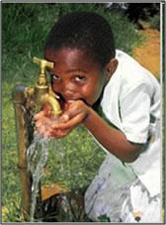
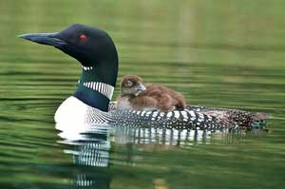
Earth Observations in Support of Global Water Quality Monitoring
Rationale
  Declining water quality has become a global issue
  Nutrient over enrichment of freshwater and coastal ecosystems
  Water-borne diseases
  Lack of systematic water quality monitoring programs.
WDNR photo
EPA photo

Slide 3
Earth Observations in Support of Global Water Quality Monitoring
Overarching Objectives:
  Assess current knowledge regarding coastal and inland water quality and associated use of remote sensing data
  Assess existing and identify new space-based and in situ observing capabilities
  Identify supporting research and development activities
  Identify best practices and new & improved data streams and products
  User engagement and outreach

Slide 4
Water Quality Monitoring Report
Timeline
Draft proposal completed Jan 2014
19th IOCCG Meeting
First Organizational
Meeting
Meetings
Milestones
Timeline
Activities
World Lakes Conference
Working Group Accepted
Structure Approved
Chapter Outlines
Approved
2014
Jan
Feb
Mar
Apr
May
Jun
Jul
Aug
Sep
Oct
Dec
Nov
Report Structure
Chapter Outlines
Nov 7
Report Writing
Dec 20
5 days
Today
16 days
24 days
17 days
25 days

Slide 5
Water Quality Monitoring Report
Timeline
Draft proposal completed Jan 2014
19th IOCCG
Meeting
First Organizational
Meeting
World Lakes Conference
Meetings
Milestones
Timeline
Activities
Working Group Accepted
Structure Approved
Chapter Outlines
Approved
2014
Jan
Feb
Mar
Apr
May
Jun
Jul
Aug
Sep
Oct
Dec
Nov
Report Structure
Chapter Outlines
Nov 7
Report Writing
Dec 20
5 days
Today
20th IOCCG
GEO Water Quality
Summit
IOCS
Meetings
Milestones
Timeline
Activities
16 days
Telecon
Telecon
24 days
17 days
2015
Jan
Feb
Mar
Apr
May
Jun
Jul
Aug
Sep
Oct
Dec
25 days
Nov
Report Writing

Slide 6
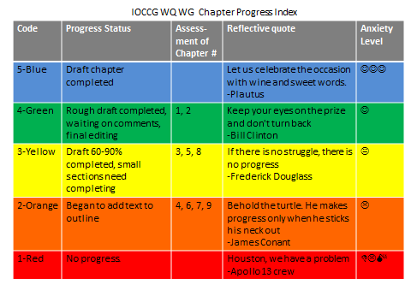
Water Quality Monitoring Report Timeline
Future Plans
GloboLakes
Meeting
21th IOCCG Meeting
Meetings
Milestones
Timeline
Activities
IOCCG mid-term
Exec. Comm./OO
Nov 7
Chapters Completed
Submission of final draft report to IOCCG
Dec 20
2016
Jan
Feb
Mar
Apr
May
Jun
Jul
Aug
Sep
Oct
Dec
Nov
5 days
Today
Report Writing
16 days
24 days
Report Compiled and Edited
Report compiling, review, feedback to authors, additional revisions
17 days
Copy and technical review
25 days

Slide 7
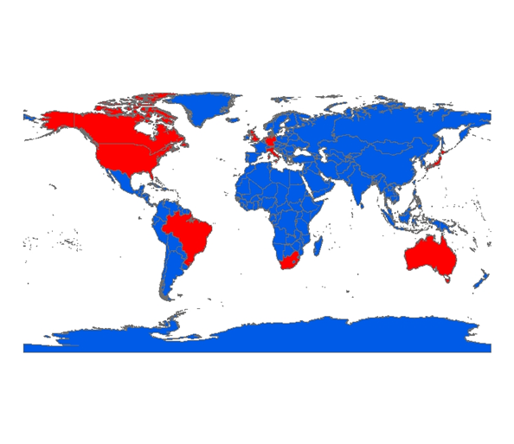
Earth Observations in Support of Global Water Quality Monitoring
Working Group Membership
 | First name | Last name | Affiliation | Country
1 | Stewart | Bernard | CSIR | South Africa
2 | Caren | Binding | Environment Canada | Canada
3 | Carsten | Brockman | CB Assoc. | Germany
4 | Arnold | Dekker | CSIRO | Australia
5 | Paul | DiGiacomo | NOAA | USA
6 | Mark | Dowell | JRC | Italy
7 | Steven | Greb | WDNR | USA
8 | Steve | Groom | PML | UK
9 | Milton | Kampel | INPE | Brazil
10 | Chris | Mannaerts | ITC | Netherlands
11 | Yuji | Sakuno | Hiroshima Univ. | Japan
12 | Blake | Schaeffer | USEPA | USA
13 | Richard | Stumpf | NOAA | USA
14 | Andrew | Tyler | Univ. Stirling | UK
15 | Menghua | Wang | NOAA | USA

Slide 8
Earth Observations in Support of Global Water Quality Monitoring
Working Group Membership Additions
 | First name | Last name | Affiliation | Country
1 | Stewart | Bernard | CSIR | South Africa
2 | Caren | Binding | Environment Canada | Canada
3 | Carsten | Brockman | CB Assoc. | Germany
4 | Arnold | Dekker | CSIRO | Australia
5 | Paul | DiGiacomo | NOAA | USA
6 | Mark | Dowell | JRC | Italy
7 | Steven | Greb | WDNR | USA
8 | Steve | Groom | PML | UK
9 | Milton | Kampel | INPE | Brazil
10 | Chris | Mannaerts | ITC | Netherlands
11 | Yuji | Sakuno | Hiroshima Univ. | Japan
12 | Blake | Schaeffer | USEPA | USA
13 | Richard | Stumpf | NOAA | USA
14 | Andrew | Tyler | Univ. Stirling | UK
15 | Menghua | Wang | NOAA | USA
16 | Daniel | Odermatt | Brockmann Assoc. | CH
17 | Erin | Hestir | NC State | USA
18 | Evangelos | Spyrakos | Univ. Stirling | UK
19 | Mark | Matthews | Cyanolakes | South Africa
20 | Veronica | Lance | NOAA | USA
21 | Emily | Smail | NOAA/GEO | USA
22 | Tiit | Kutser | U. Estonia | Estonia

Slide 9
Earth Observations in Support of Global Water Quality Monitoring
Report framework centered on three audiences with three differing time scales

Slide 10
Earth Observations in Support of Global Water Quality Monitoring
Report framework centered on three audiences with three differing time scales
Report
Partition
Time
horizon
Audience
Short time frame
0-1 yr
Societal Infrastructure
Mid range
1-5 yr
Science Infrastructure
Research Community
Long range
Technical Infrastructure
Space Agencies
End Users
Section A
Section B
Section C

Slide 11
Earth Observations in Support of Global Water Quality Monitoring
Section A: User/manager – short time frame,
Societal Infrastructure
  Chapter 1: Stakeholder frameworks, needs, and requirements
  Co-leads: Blake*, Steve Greb, Caren
  Chapter 2: Introduction to deriving water quality measures from satellites
  Co-lead: Caren*, Rick, Blake , Andrew
  Chapter 3: Complementarity of in-situ and satellite measurements
  Co-leads: Steve Greb*, Blake, Paul, Menghua, Evangelos, Mark, Daniel
  Chapter 4: Linkages between data providers and end users
  Co-lead: Rick*, Carsten, Paul, Rick, Blake, Arnold

Slide 12
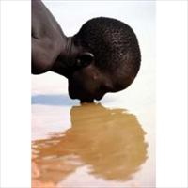
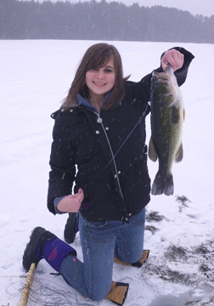
Chapter 1
Water Quality Monitoring and Assessment:
Needs, Benefits and Frameworks
The need for protecting water’s designated uses
Benefits of maintaining water designated uses
  Environmental Stewardship
  Human Health
  Economy
Frameworks for monitoring and protecting designated uses
  Global and regional challenges
How satellite remote sensing can contribute
Gambia News Community
Wisconsin DNR photo

Slide 13
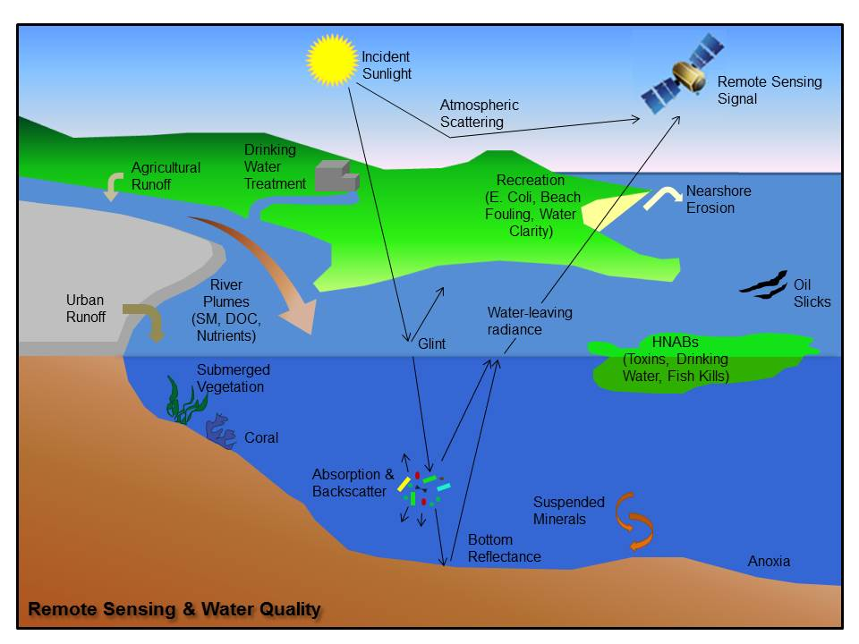
Chapter 2
Introduction to Deriving Water Quality Measures from Satellites
Theoretical Basis of Water Quality Remote Sensing
What Can be Measured Using Remote Sensing?
Water Quality Retrieval Algorithms
Platform, Resolution, and Data Processing Considerations
Advantages and Limitations of Remote Sensing for Water Quality Monitoring

Slide 14
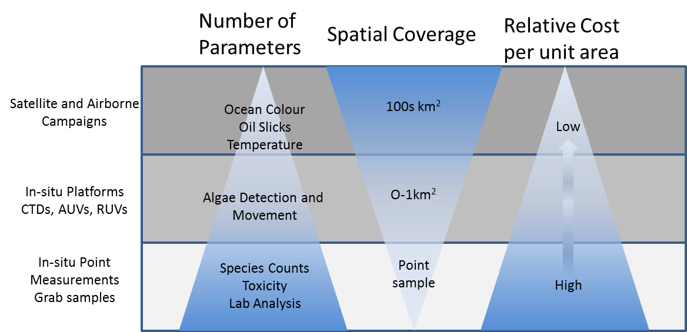
Chapter 3
Complementarity of In-situ and Satellite Measurements
Water quality monitoring approaches
Discussion of measurement statistics and related attributes for all three approaches
  Accuracy
  Representativeness considerations
  Complementary role of remote sensing with in situ measurements
  Complementary role of remote sensing with modelling
Costs
Resources

Slide 15
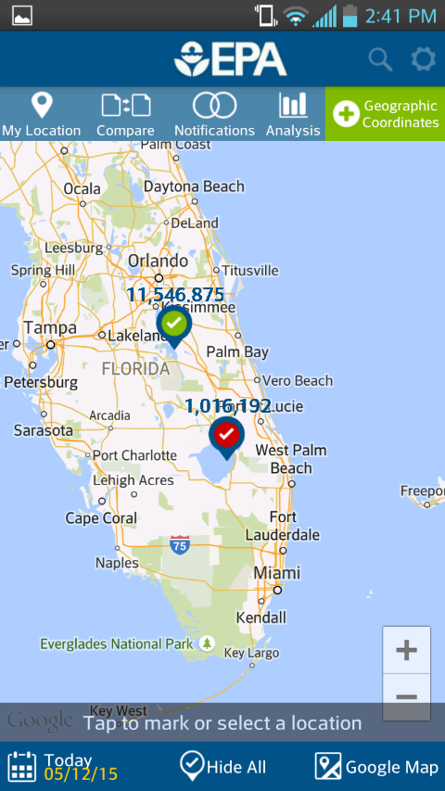
Chapter 4
Linkages Between Data Providers and End Users
Data delivery
  Data formats
  Data extraction and analysis tools
  Training
  Quality Control
  Validation
Timeliness
  Real-time Monitoring and Response
  Current Assessment
  Retrospective Assessment
Future Collaborative Efforts

Slide 16
Earth Observations in Support of Global Water Quality Monitoring
Section B: Remote Sensing Science – 1-5 yr. time frame, Science Infrastructure
  Chapter 5: Measures from satellites
  Co-leads: Stewart*, Mark, Menghua, Carsten, Andrew, Yuji, Tiit
  Chapter 6: Sensors
  Co-leads: Arnold*, Erin, Milton, Menghua, Stewart

Slide 17
Chapter 5
Measures from Satellites
Understanding the satellite signal measured from inland and coastal waters
  The water-leaving signal
  The atmospheric signal
Deriving water quality products from satellite: algorithms and issues
  Algorithm types
Outlook
Credit: Lisl Robertson Lain

Slide 18
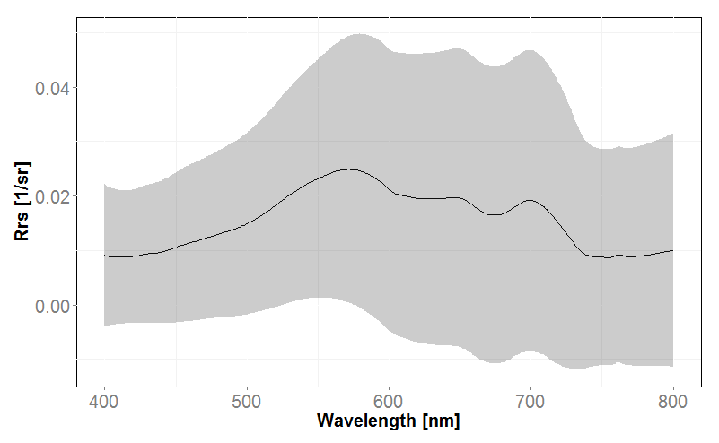
Chapter 6
Sensors
The directly measurable variables of interest
Spectral band requirements
Spatial, radiometric, and temporal resolution requirements
Trade-offs and solutions between spectral, spatial, radiometric and temporal requirements
The application potential of relevant existing and planned space-borne sensors
Credit: Spyrakos

Slide 19
Earth Observations in Support of Global Water Quality Monitoring
Section C: Agencies – long time frame
Technical infrastructure
  Chapter 7 Space Segment & CalVal Support Infrastructure
  Co-Leads: Milton, Paul*, Menghua, Mark, Chris, Arnold
  Chapter 8 Ground Segment
  Co-Leads: Arnold, Steve Groom*, Chris, Carsten
  Chapter 9 New Concepts (Virtual Laboratory)
  Co-Leads: Carsten*, Steve Groom, Paul
  Chapter 10 Data Exploitation, Programmes and User Support
  Co-Leads: Carsten*, Paul, Rick, Blake
  Chapter 11: Recommendations and outlook
  Co-leads Steve Greb, Paul, Arnold

Slide 20
Chapter 7
Coastal and Inland Water Quality Observing System Assets and Supporting Infrastructure
  Observing System Assets: Current Status and Future Directions
  Satellite Assets
  In situ Assets
Supporting observing system infrastructure
  Calibration and Validation
Recommendations to agencies and programs

Slide 21
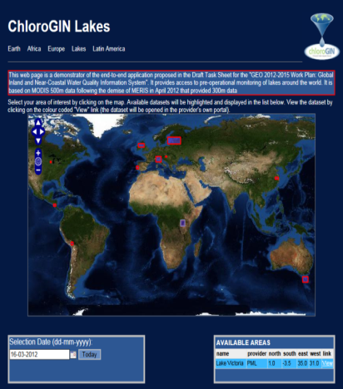
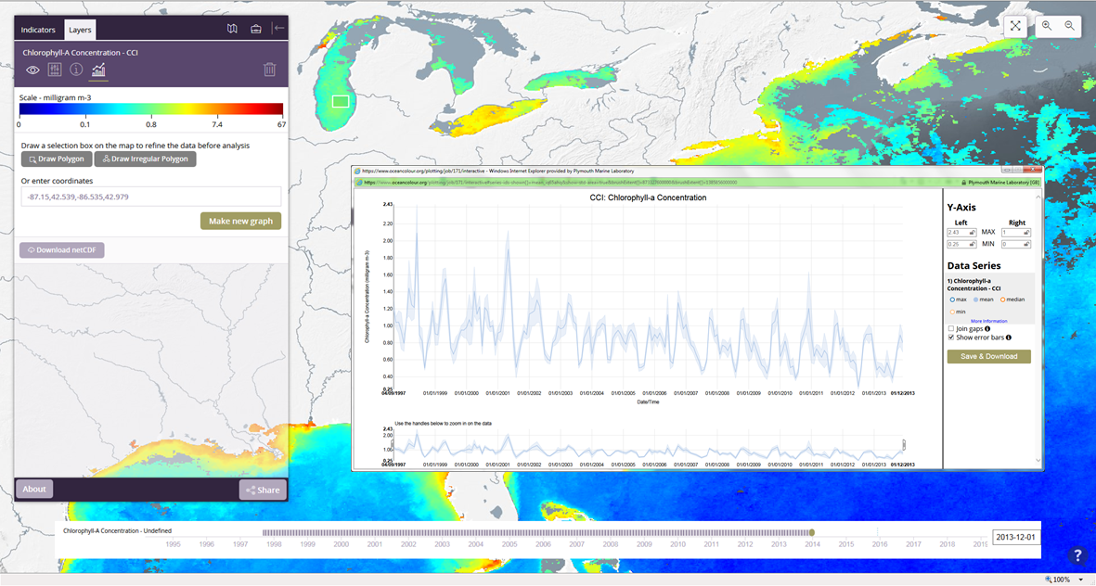
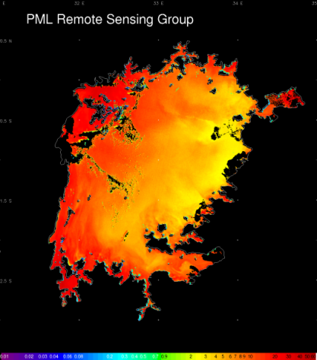
Chapter 8
Ground and User Segment
Mission or satellite ground segment
  Data distribution mechanisms
  Web-based analysis systems
User Ground Segments
  ChloroGIN-Lakes: an end-to-end demonstrator

Slide 22
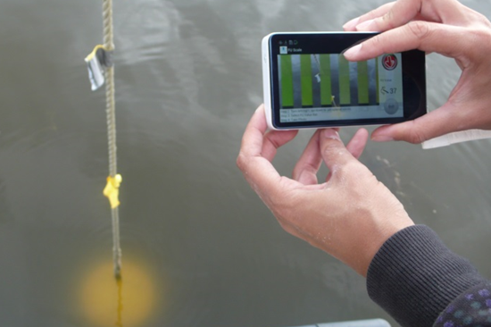
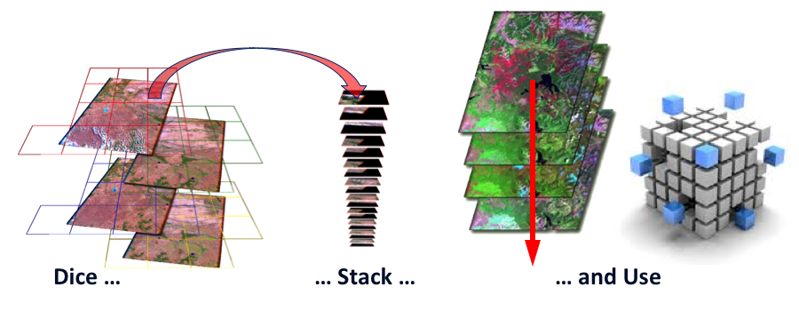
Chapter 9
New Concepts (Virtual Laboratory)
    “Big data” from Space
  Historic archives and future data volumes
  Challenges for data access and data processing
Moving software to the data
  Data harmonization (“Data Cube”)
  Exploratory tools (e.g. Product Feature Extraction)
  Community tools and Mobile Technology
Citclops EC-FP7 Programme
Australian Geoscience Data Cube

Slide 23
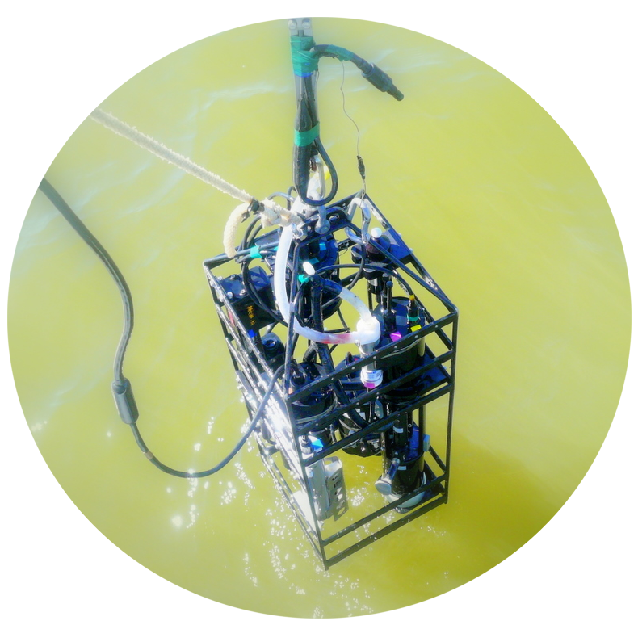
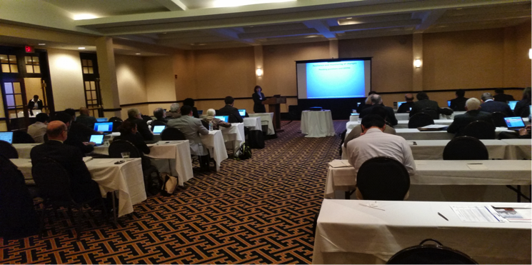
Chapter 10
Data Exploitation Programs and User Support
User support programs
Thematic workshops
Dedicated R&D studies
Validation
GEOSS in the Americas
UFI Photo

Slide 24

Questions?
Huffington Post

Slide 25
GEO Water Quality Community of Practice

